Slide 1

Social Media Strategy Masterclass

Slide 2
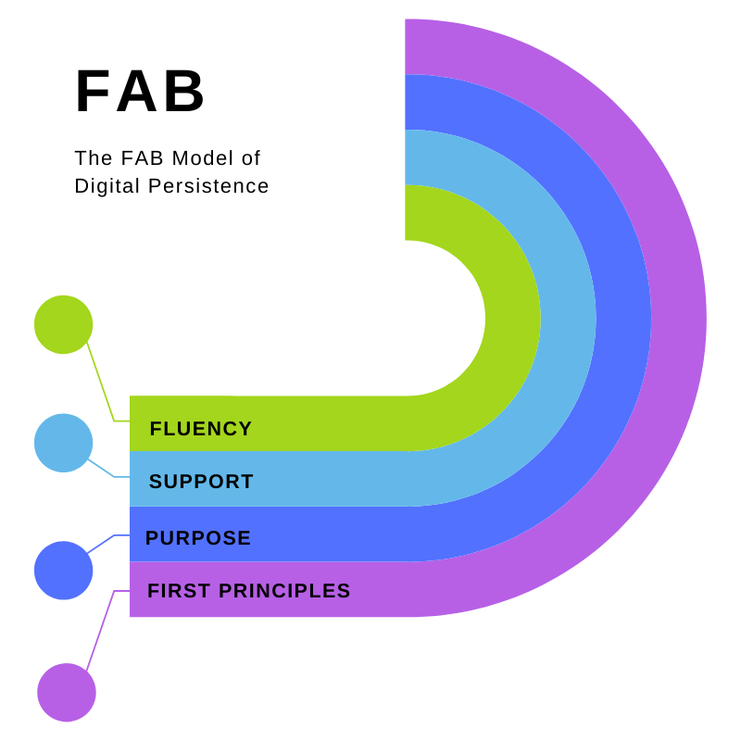
FAB (folded arms brigade)

Slide 3

Weaving Social Fabric (80:20)
“Transformative relationships in our personal and professional lives cultivate deeper human connection through vulnerability, empathy and listening.”
Shawn A Ginwright
The Four Pivots

Slide 4
#Hashtags
Hashtags are how you reach out beyond your echo chamber
Learn how to shape, share and use them
Don’t overuse (5-7 is fine)
They are great for jumping onto current events, celebration and community days #WorldAIDSDay2024

Slide 5

Emojis
Beautifully expressive
Perfect for building relationships
Beware passive aggression!

Slide 6





The Big Four Three Platforms
Gamechanger

Slide 7


Sharing Content

Slide 8



Creating Content
BEWARE
FREEMIUM

Slide 9

What about AI?
Helps generate content
Makes searches more responsive
No substitute for the human touch
Has bias built in
More change to come…
Photo by Steve Johnson on Unsplash

Slide 10
Trends in Social Media 2024
AI is here to stay and makes content creation easier but you can tell.
Be selective about platforms.
User generated content (UGC) and influencer marketing are having more impact than emails* and even search engines.
Video content is on the rise.
Employee advocacy – brand ambassadors to do the work.
Not everyone has or needs a website but feed back to it if you do (and it’s in good order). Consider Linktree.
Customer care in social media is a must. Too much self-promotion is a turn-off.
*Why are you still using emails?

Slide 11
Lessons Learned
Be community first. 80% connect, 20% (max) sell.
Customer service is everything. Reply promptly.
It’s easy to get overwhelmed. Get organised and don’t overthink.
Archive channels you’re not using.
Have a dedicated email address for all social media.
Keep your avatars/images/names consistent across channels.
Make sure passwords are shared. Use a collective password saver.
Don’t outsource your message (to AI or anyone else).
Work in shared documents as a default. It’s a game changer.
Curate collectively - this may need a culture change.
Don’t go down rabbit holes with analytics – you need less than you think.
Consistency is key. Little and often.

Slide 12

Agenda
Scheduling social media posts to work smart and ensure consistency of communication.
(Beware Freemium)
Hootsuite
Twittimer
Later

Slide 13
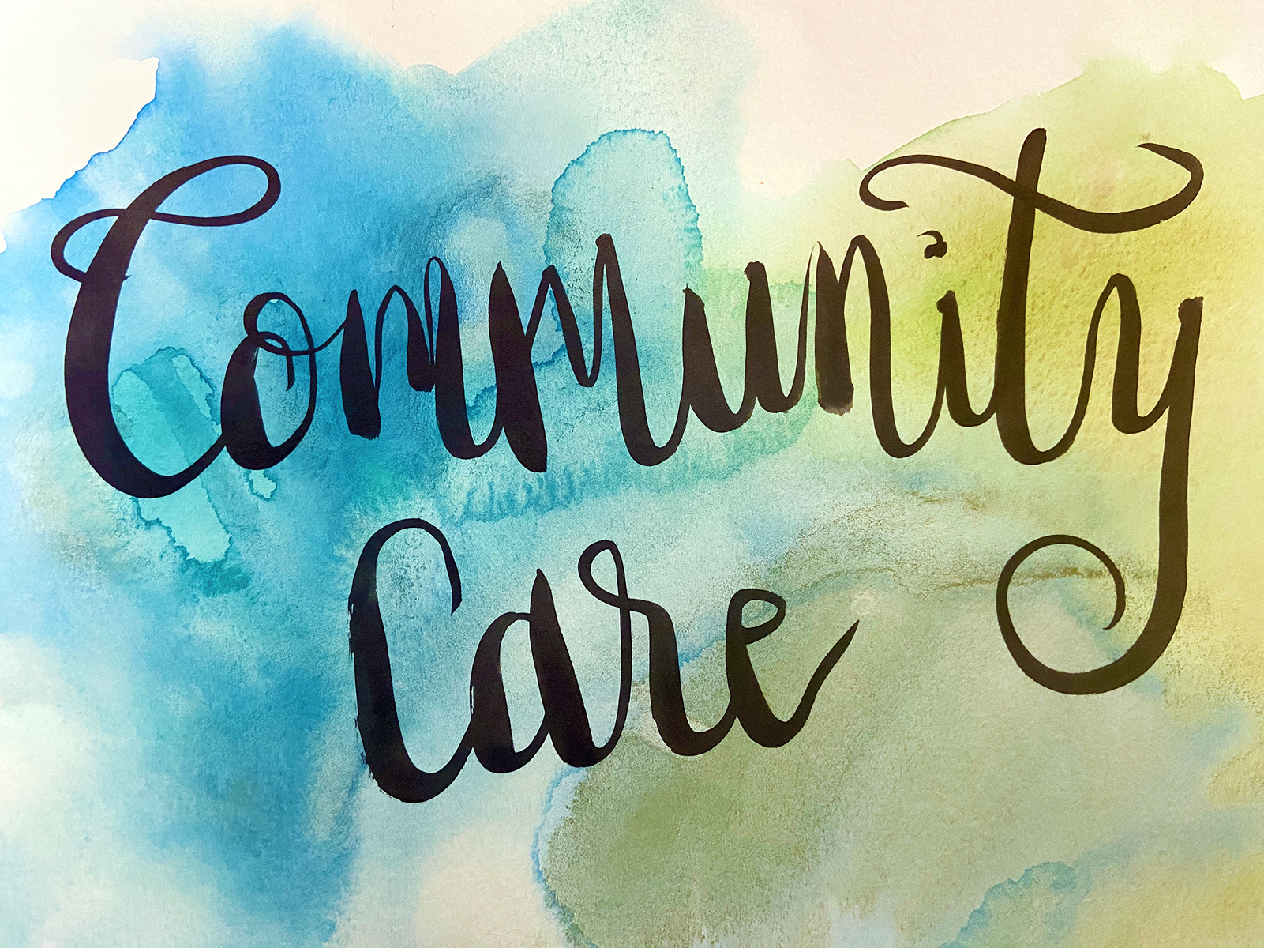
Keeping Yourself Safe
Social Media is a practice of care – for everyone.
Set boundaries.
Don’t engage with haters.
Block and report.
“A boundary is a place where I can care for me and also care for you.” Prentiss Hemphill
This Photo by Unknown Author is licensed under CC BY

Slide 14

(Intersectional) Accessibility
Are you reaching out to everyone, or just to ‘people like you’?
How do you welcome people across dimensions of difference?
As an absolute minimum:
Plain English
ALT-text
Respectful language

Slide 15
Principles
Think about what you want to use social media for, the relationships you want to build, and why
Work smartly, collectively and strategically
Review often - together
Have a consistent social media presence
Think FAB

