Slide 1
Kelly Broadbent
North Yorkshire Regional Manager

Slide 2
St Giles Trust - A national charity with a local heart
St Giles Trust are a national charity with a turnover of over £18m
North Yorkshire challenges:
Central fundraising team applications
Misconceptions around North Yorkshire
Local knowledge/hidden harms/needs = find solutions
Local funding opportunities often aimed at small charities
Time taken for applications/reporting
Suggestions:
Consider local funding applications for larger charities based on local needs and budget limitations
Repeat funding
Relationships - funders to be invited to ‘the table’ to contribute to decision making, learn about local intelligence for transparency and confidence building
Visit the provisions being funded to witness the service and impact
Voice of the client in applications

Slide 3
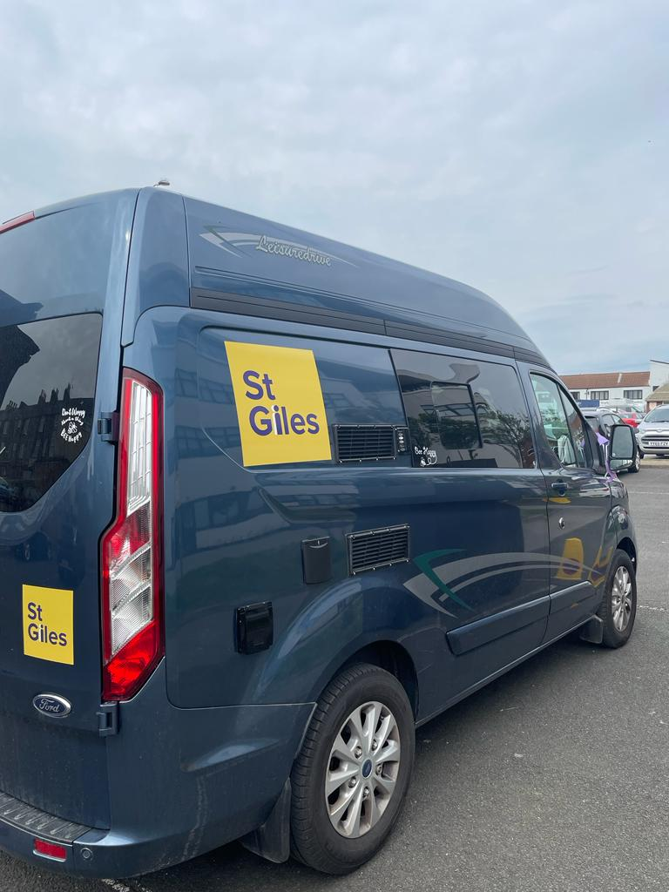
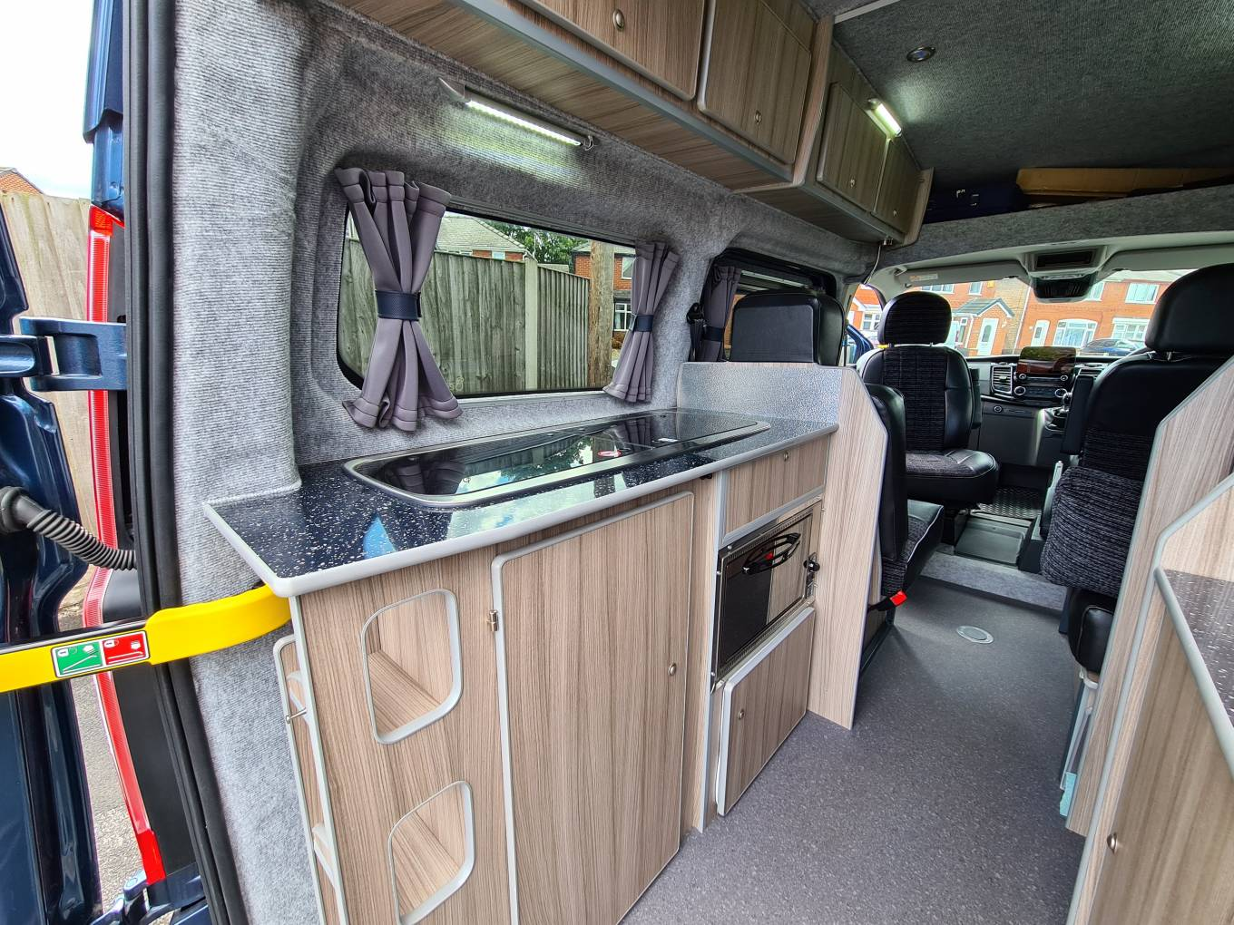
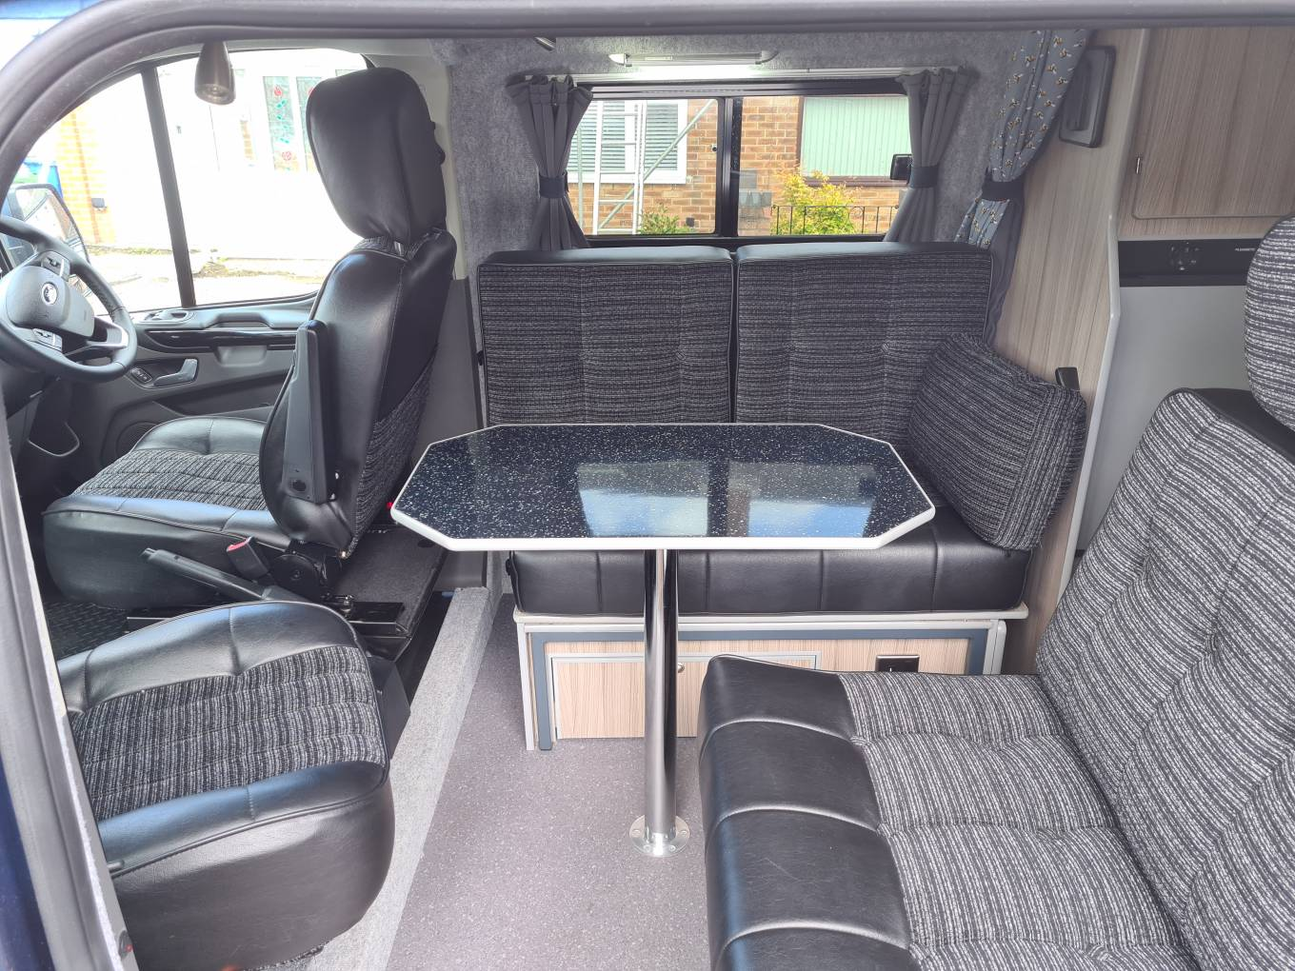
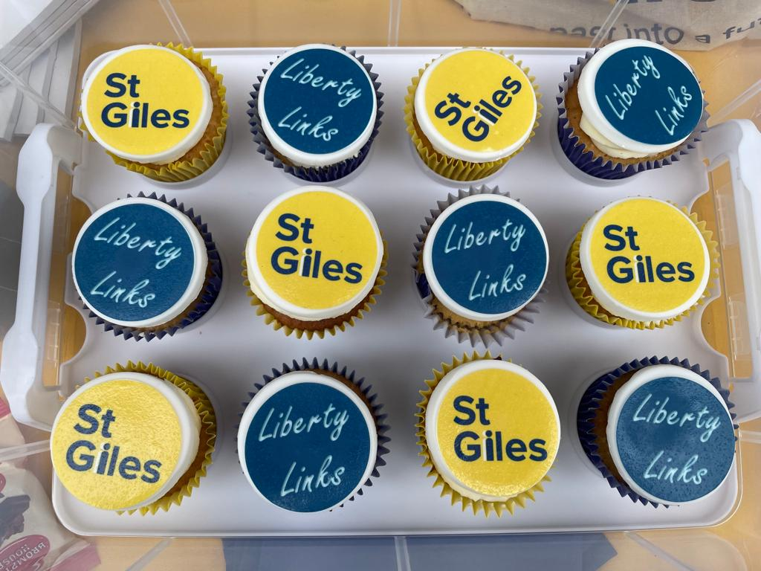
Liberty Links has Launched

