Slide 1


Jo-Anne Bell
East Riding of Yorkshire Council
FlexiGrant®

Slide 2
What drove the need to update the grants management system – was there a specific pain point that led to the change?
Previous grant management system - Idox product BidTrack/FundTrack
No longer supporting developments of system
Due to be switched off 31st March 2018
BidTrack/FundTrack was difficult to use and hard to encourage staff to use it
Required a lot of information to be input but could only get minimum information back out
Notes:
Found out in March 2017 that it would be turned off on 31st March 2018. A year seems like a long time to procure a new system however those with local authority knowledge will know how long these things can take and at this stage we didn’t know other systems were available.

Slide 3
What criteria we had for system preferences?
Specification with 130 essential criteria and 20 desirable criteria
These included;
  - the need for a 'real-time' dashboard
  - the ability to create bespoke application forms
  - the requirement for applications to be scored online
  - reports to be easily generated

Slide 4
How we went about getting to the chosen grants management system?
Initial desk top research
Invited five organisations to demo their systems and scored them against our specification
Narrowed it down to two – FlexiGrant® and SalesForce
Visited organisations face to face to view their set up
Did we have to make any compromises
Initial costs of FlexiGrant® were higher but SalesForce would charge per application that needed building / amending so in the long run it would have been more expensive.
Currently 107 programmes on FlexiGrant®.
The system doesn’t have a separate BidTrack element to allow us to track bids to external funders that the council makes.

Slide 5
Which system we procured?
Selected Fluent’s FlexiGrant® system after visiting an organisation in London to see the system live
No tweaks required for our specific needs
Offered data migration as part of implementation
Procured the system using the Government's G-Cloud framework

Slide 6
What difference has it made?
Easier for applicants to access all their forms
Online scoring for review panel has reduced need for face to face panel meetings saving time
For programme managers, all information is in one place, offer letters can be generated, monitoring reports sent out via the system
Powerful reporting mechanism
Flexibility to create bespoke programmes

Slide 7
Knowing what we know now, what would we do differently if we had to do it again?
Procure a new system sooner
Worked hard to rebuild trust with applicants and programme managers
Future hopes for the system
Currently working with Fluent on a project change request process

Slide 8
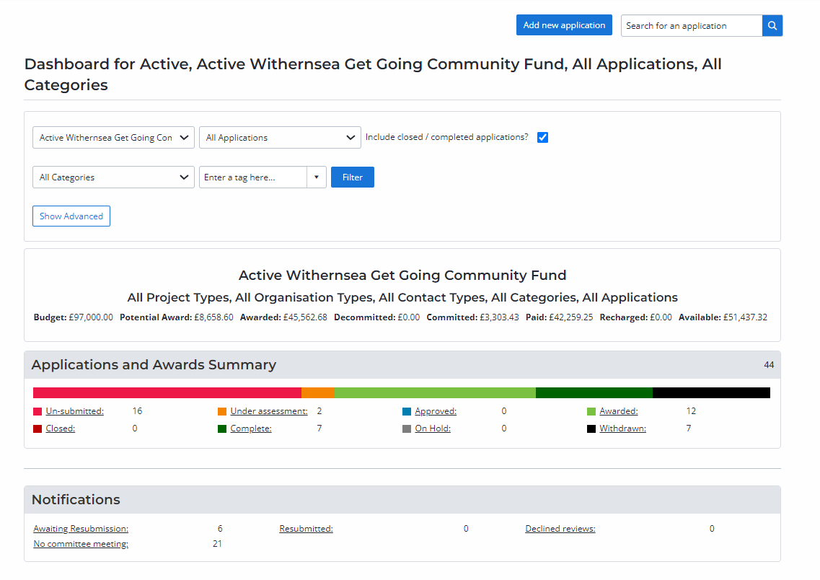
FlexiGrant® – Manage Grants Real Time Dashboard

Slide 9
Any questions?

