Slide 1
Voluntary sector trends Sarah Vibert CEO
Notes:
Problem
Inconsistent terminology when categorising our work:
is confusing
makes it hard to cross promote and link content, products and services
What we did
Cross-team group (M&M and D&C)
Wanted to be user focused
Did some user testing and looked at analytics
Developed a list of category/tag names that we think will make sense to our users.

Slide 2
3 roles of charities: - campaigning / raising voice - service delivery - community building

Slide 3
3 parts: - Financial climate and shape of the sector - Views of charities – government and the public - How we operate

Slide 4
Financial climate and shape of the sector

Slide 5
Financial climate and shape of the sector
Costs are rising
energy
property
staff
Income is falling
donations
government
The shape of the sector is changing

Slide 6
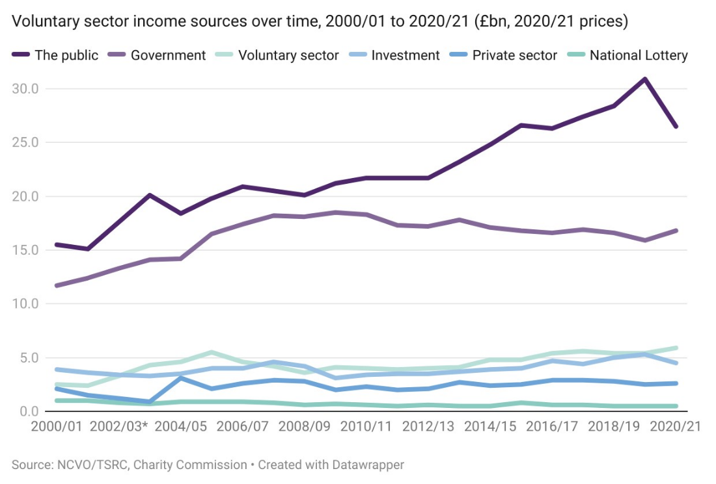
Income from the public and investment have fallen, while income from the government has risen.
Notes:
Despite an increase in government income in 20/21, overall income of the sector declined by 3%, down from £58.7 billion in 19/20 to £56.9bn in 2020/21. The public remains the biggest income source (46% or £26.4bn) for the sector in 20/21, although due to the increase in government income as a result of pandemic funding for charities, it no longer made up more than half of the sector’s income (51% in 19/20).
Income from the public and investment have fallen in 2020/21, reversing the previous pattern of increase, while income from the government has risen.
Almost half of voluntary sector income is from the public (the largest source) followed by close to a third from the government. Reversing the pattern of increase seen in the past few years, income from the public decreased by 14% to £26.5bn, while
investment income decreased by 15% to £4.5bn from 2019/20. Most other sources of income increased, most notably government income (up 6% to £5.9bn).
Smaller organisations receive a larger share of income from the public than larger ones. Environmental and parent teacher organisations in particular depend on the public for more than two thirds of their income. Just under half of all voluntary organisations rely on the public for the majority of their income
The number of major charities – those with an income between £10m and £100m – decreased by 5% from 782 in 2019/20 to 743 in 2020/21. Similarly, the pandemic also shrank the number of super-major charities – those with an income upwards of £100m, by almost 5%.
Of the larger charities, the income of super-major charities saw the greatest level of decrease of 11% from £14,220m in 2019/20 to £12,671.7 in 2020/21.

Slide 7
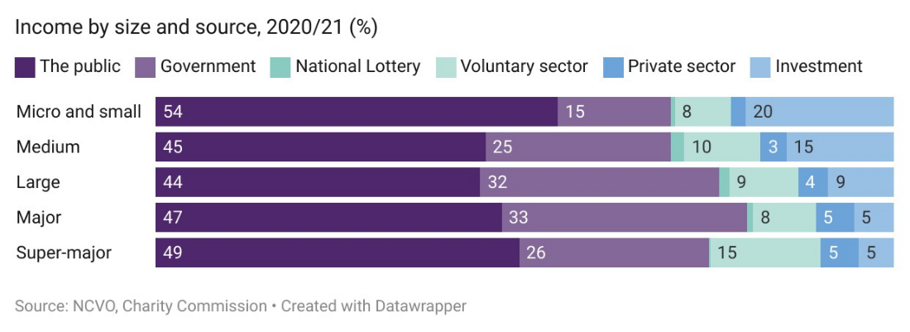
Smaller organisations get a greater share of their income from the public
Notes:
This is the second year in a row that public is the highest source of voluntary and charity sector income in the UK, and we found that smaller charities are dependent on the public for their income. They are also recipients of greater income proportion from the public than charities of larger size
Micro and small organisations (those with less than £100,000 income) receive a higher income share (54%) from the public than other sized charities.
Micro and small organisations also received the largest share of income from investment (20%) — four times the proportion for major and super-major (5%) and more than double that of large (9%).

Slide 8
Financial climate and shape of the sector
Costs are rising
energy
property
staff
Income is falling
donations
government
The shape of the sector is changing

Slide 9
View of charities – government and the public

Slide 10
Views of charities: Government
The long road to the election
The dual role of charities – campaigning and service delivery
Conservative views of charities
The Charity Commission view of campaiging
Labour views of charities
A compact for the 2020s?

Slide 11
views of charities: The public
Trust is rising
A country not as divided as culture wars would suggest
View on respective responsibilities of government and charities

Slide 12
How we operate

Slide 13
People, workforce and volunteers
A more hybrid workforce
Motivations of staff are changing
Low pay is a persistent challenge
Formal volunteering numbers are falling
Expectations of volunteers are changing
The need to upskill – digital, AI, net zero
Towards a more diverse and inclusive sector

Slide 14
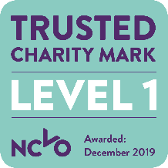
We’re the membership community for charities, voluntary organisations and community groups in England. Together we champion voluntary action.
We’ve been here for over 100 years. We have over 17,000 members, made up of all causes, shapes and sizes. From big charities to local sports clubs.
Our members are at the heart of everything we do. We exist to make your life easier – so you can focus on changing people’s lives and making our communities stronger and more resilient.
Search for NCVO membership
Visit www.ncvo.org.uk/join
Email membership@ncvo.org.uk

