Slide 1
The charity sector in Yorkshire and the Humber and the Autumn Statement Jack Larkham
January 2024

Slide 2
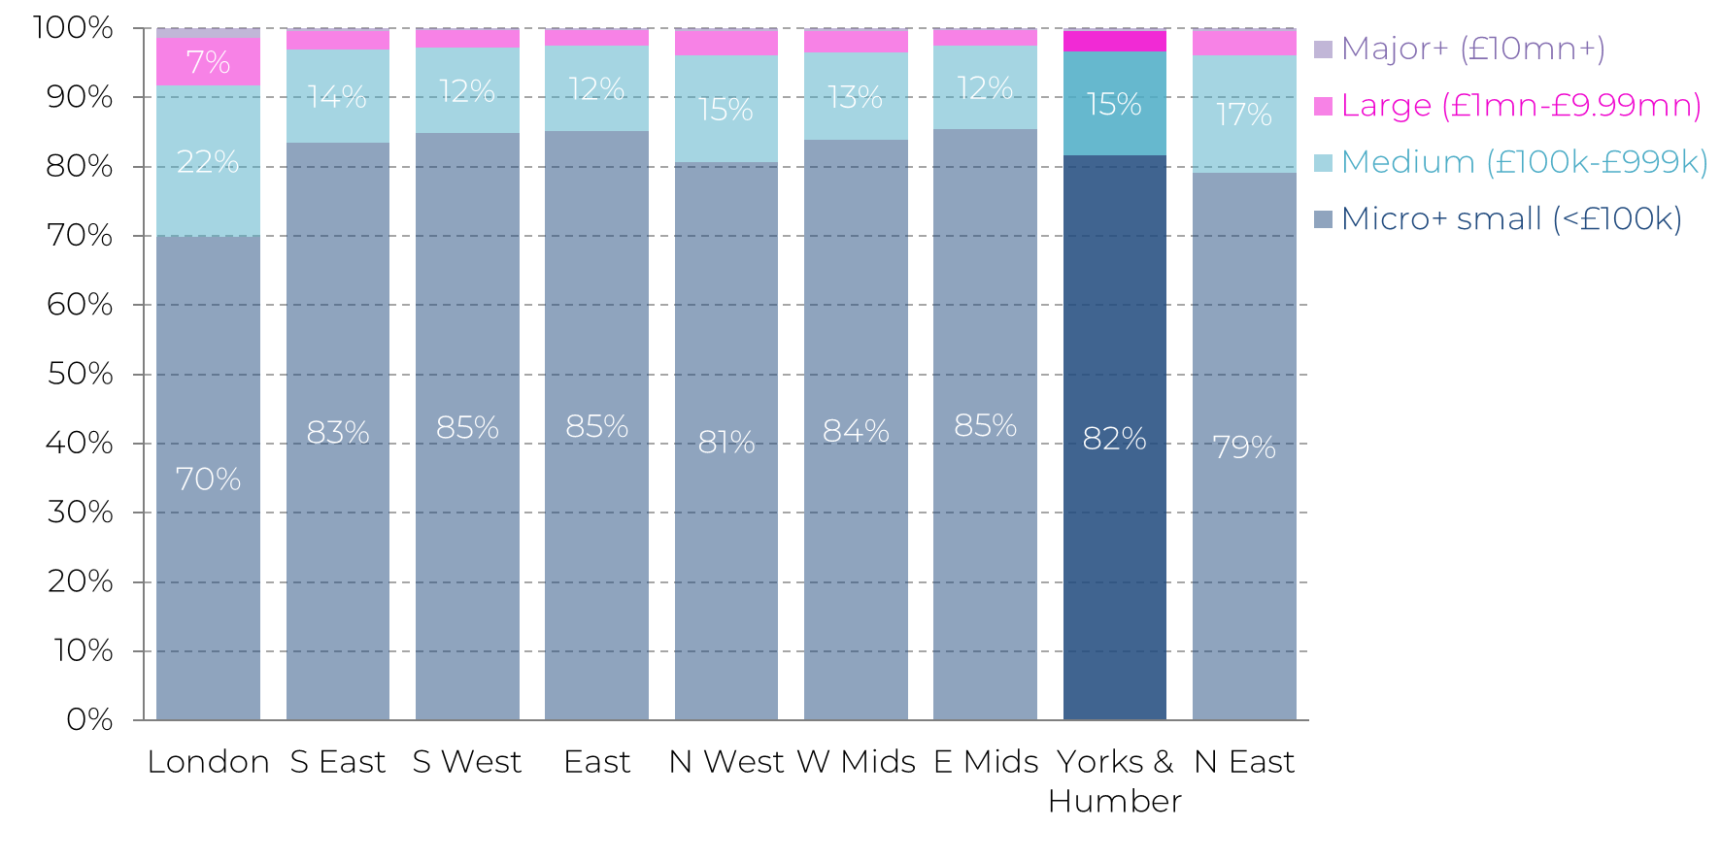
In terms of the shape of the sector, Yorkshire and the Humber is fairly typical - around 8 in 10 charities have an annual income of <£100k
Proportion of charities by size, by region
Notes:
The shape of the charity sector in Yorkshire and the Humber looks much like many of the other regions of England
Just over 8 in 10 charities have an income of less than £100,000 – with medium sized charities making up the majority of the remaining 20% of organisations – with very few organisations in that £1mn+ category
London is the clear outlier here - which generally gets put down to the ‘headquarters effect’ – i.e. that London tends to be the place where many of the largest charities are based – in fact 40% of charities with an income of £1millon + - the large, major and super major charities in England are based in London

Slide 3
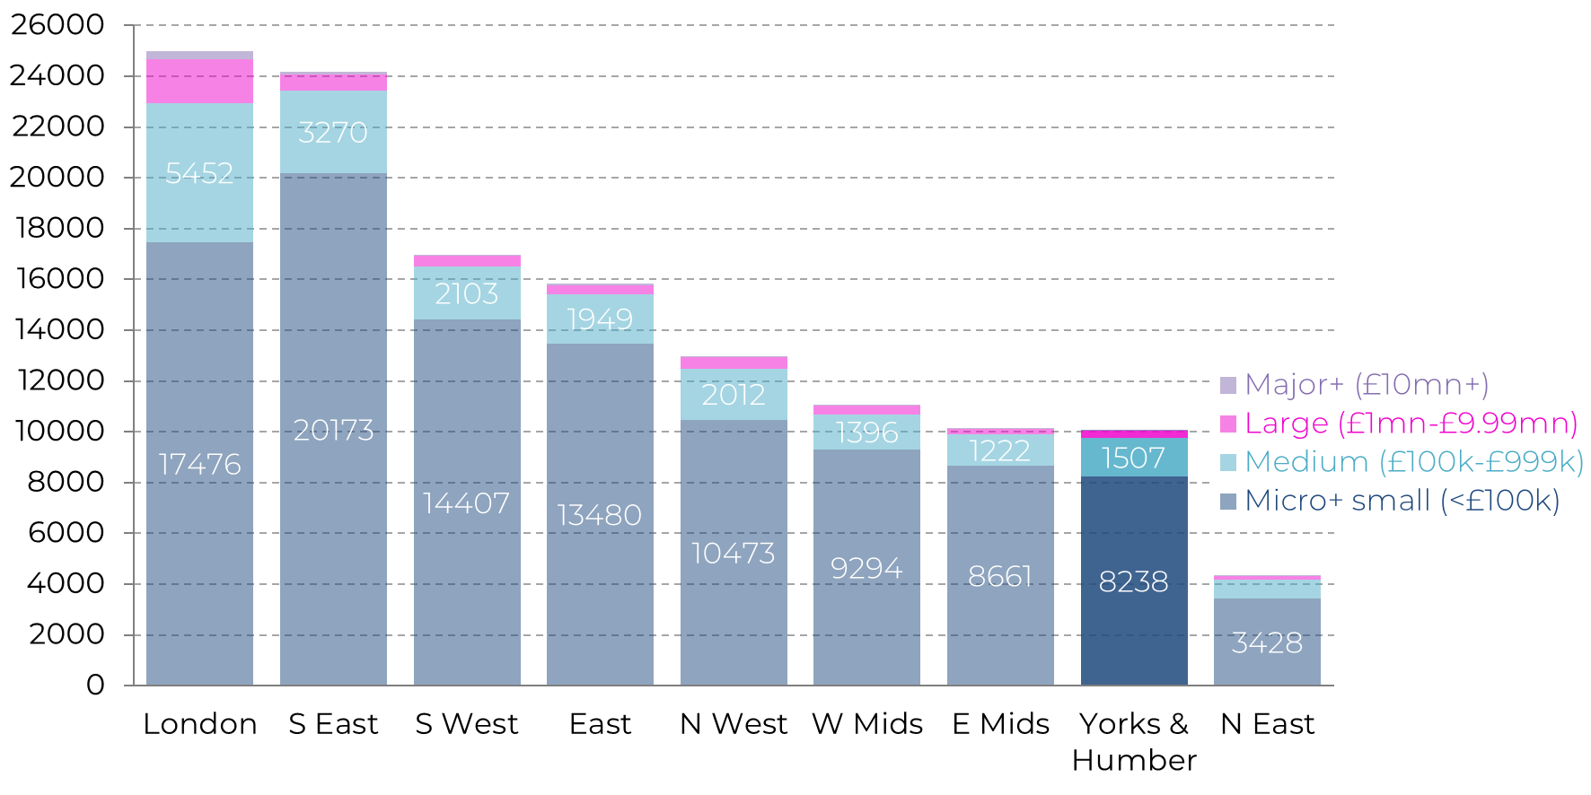
However, in terms of the number of charities, the sector in Yorkshire and the Humber is smaller than in most regions of England
Number of charities, by region and charity size
Notes:
This slide gives us a breakdown of the total number of charities in each region of England – as you can see Yorkshire and the Humber is one of the smallest in terms of the number of charities – around 10,000, of which just over 8000 are classified as micro or small, with 1500 medium charities, 300 large and 37 major charities
Size-wise then, this puts it on a similar level to the East Midlands – with only the North East having fewer charities

Slide 4
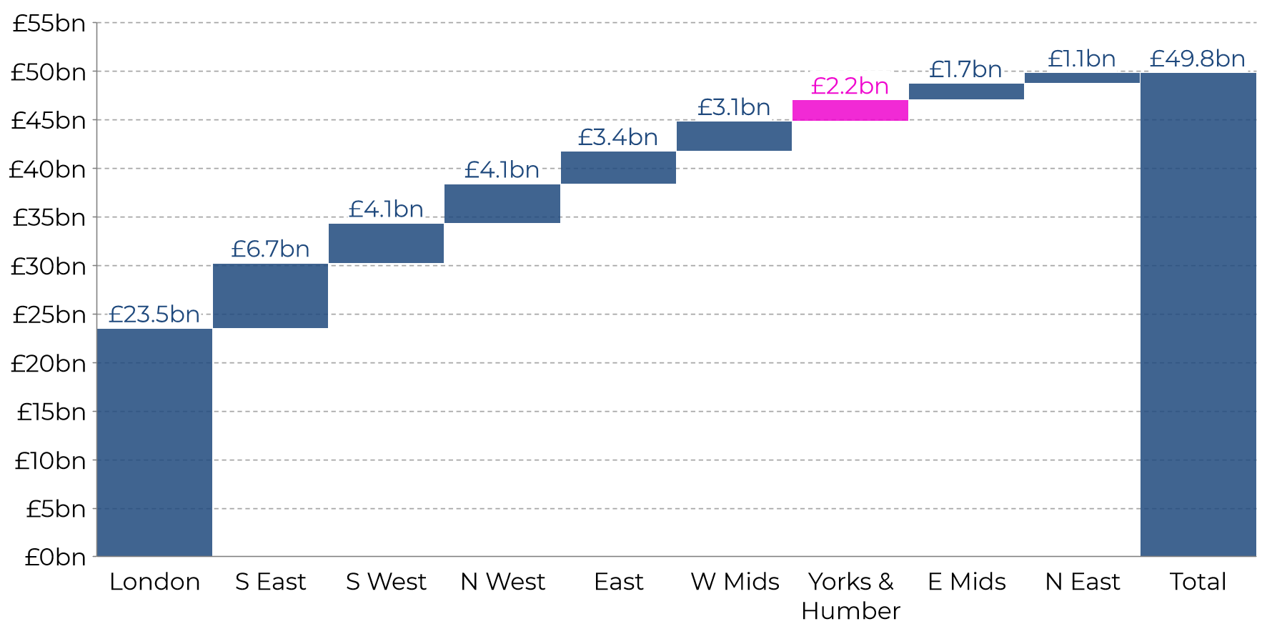
Unsurprisingly, the region is also one of the smallest in terms of total income
Total charity income, by region
Notes:
Just to give another perspective – this time thinking about size in terms of income rather than the number of organisations, we can see that while the region moves above the East Midlands in the league table, it is still one of the smallest in England
As can be seen in the chart, charities in Yorkshire and the Humber have a combined income of £2.2bn – this equates to just over 4% of total charity income in England
And you can see the London HQ effect here, skewing the distribution of income, almost half of charity income going to charities based in London
Interestingly the three most north-easternly regions – Yorkshire and the Humber, East Midlands and the North East sitting at the bottom of the income table

Slide 5
In terms of income per head, the region is below average
Charity income per capita in Yorkshire and the Humber, total and by income source
Notes:
Digging a little into the sector’s income in the region highlights even further the extent to which it struggles in relation to the rest of the country. And to provide perhaps a slightly more accurate picture I’ve done the analysis on a per capita basis so as to take into account population size.
This chart shows various sources of charity income per head of population in Yorkshire and the Humber and compares that to the average in England – however because of the fact that London is such an outlier I’ve excluded it from the calculation.
So starting with the column on left – the dark blue outline shows the charity income per head in England – excluding London is £525. The light blue column inside shows the figure for Yorkshire and the Humber as you can see it is considerably lower – just shy of £400
And this pattern repeats across the various sources of income – most noticeably income from the public – we can see in that middle and right hand columns - income from government per head and income from the private sector per head - the region is much closer to the norm

Slide 6
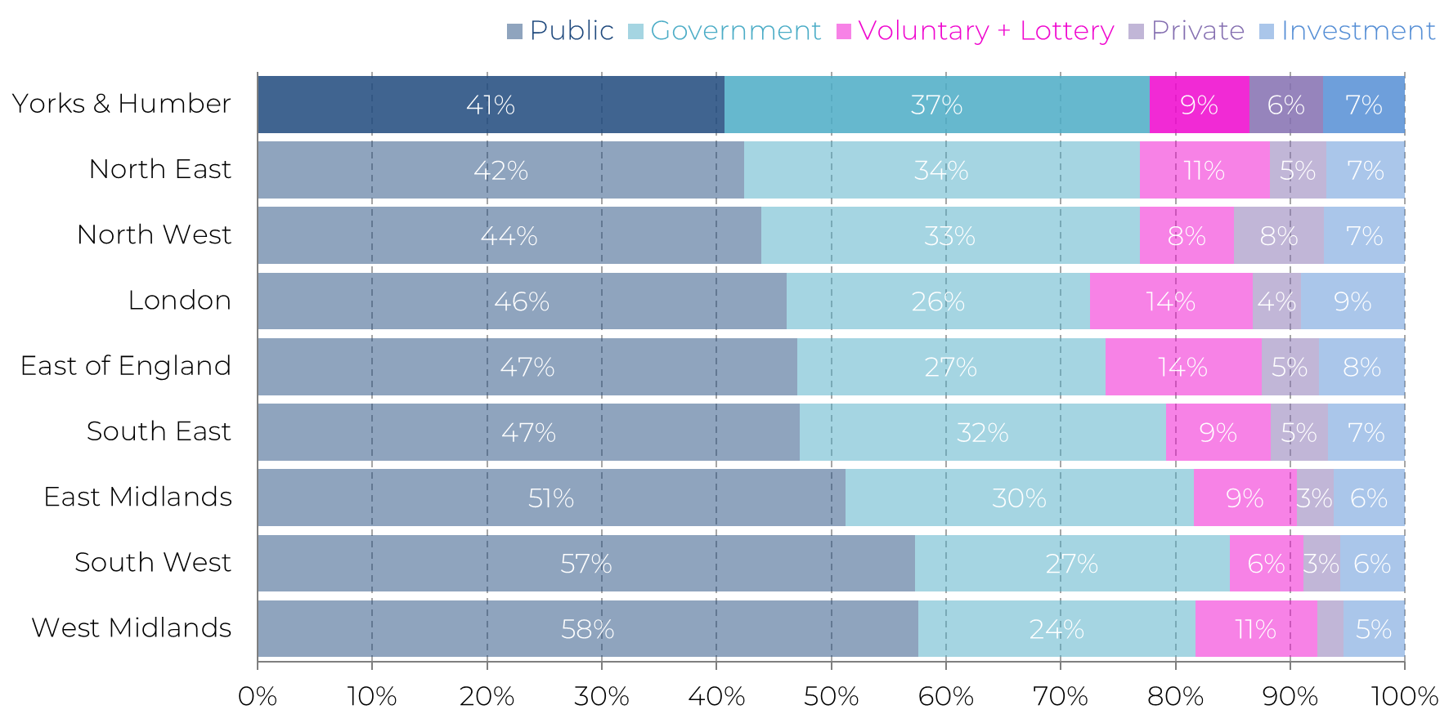
The charity sector in Yorkshire and the Humber is more reliant on income from the government, which offsets a lower proportion of income from the public
Proportion of total charity income by source, by region
Notes:
And this is reflected when we look at how different sources of income contribute to total income across each of the regions – as you can see Yorkshire and the Humber is at once both fairly typical and a bit of an outlier.
Its typical in the fact that income from the public and income from the government combined make up around 80% of income – which is pretty similar to the general picture.
But it is a bit of an outlier in the split between public and government income – with income from the public accounting for 41% of total income – the smallest across all regions of England – and income from government accounting for 37% of income – the largest across the regions – and meaning that the sector in Yorkshire and the Humber is more reliant on government income than in any other region

Slide 7
Cost of living crisis will ease, but inflation staying higher for longer means interest rates likely to slow economic growth and push up unemployment
Consumer price index, quarterly annual rate, outturn and OBR forecasts, Q1 2009 to Q1 2028
Notes:
Turning now to the macro economic picture – the first place I’d like to start is with the cost of living crisis – which I think is best demonstrated by looking at the rate of inflation.
So, the cost of living crisis, has had a significant impact on many parts of the charity sector – what we’ve seen through many of the Barometer surveys we’ve done over the past year or so and what many others are reporting has been the with the triple threat of rising demand, rising costs and falling real terms incomes.
Its pretty well established that we are over the worst of the inflation crisis. As you can see inflation has fallen throughout 2023, although it has fallen less quickly than the OBR forecast in March 2023. The forecasts released after the Autumn Statement (the dotted pink line) now show that it is expected to return to the Bank of England’s 2% target in 2025, a year later than was expected in March.
Higher-than-expected inflation has meant that interest rates have been higher than expected, and will remain that way for longer than was hoped. And because interest rates increase mortgage and other borrowing costs they act as a drag on economic activity - meaning that expectations for GDP growth next year have been revised down while forecasts for the rate of unemployment have gone up, with that higher rate expected to last for longer.
The impact of this on charities is complex – unemployed people are four times more likely to use foodbanks so we might see increased demand there – but with wage growth starting to outstrip inflation we might see an easing of ‘in work poverty’ – higher interest rates are good for charity reserves, and for households with lots of savings – but bad for people in debt or those who rely on credit to make ends meet – all of which will impact fundraising

Slide 8
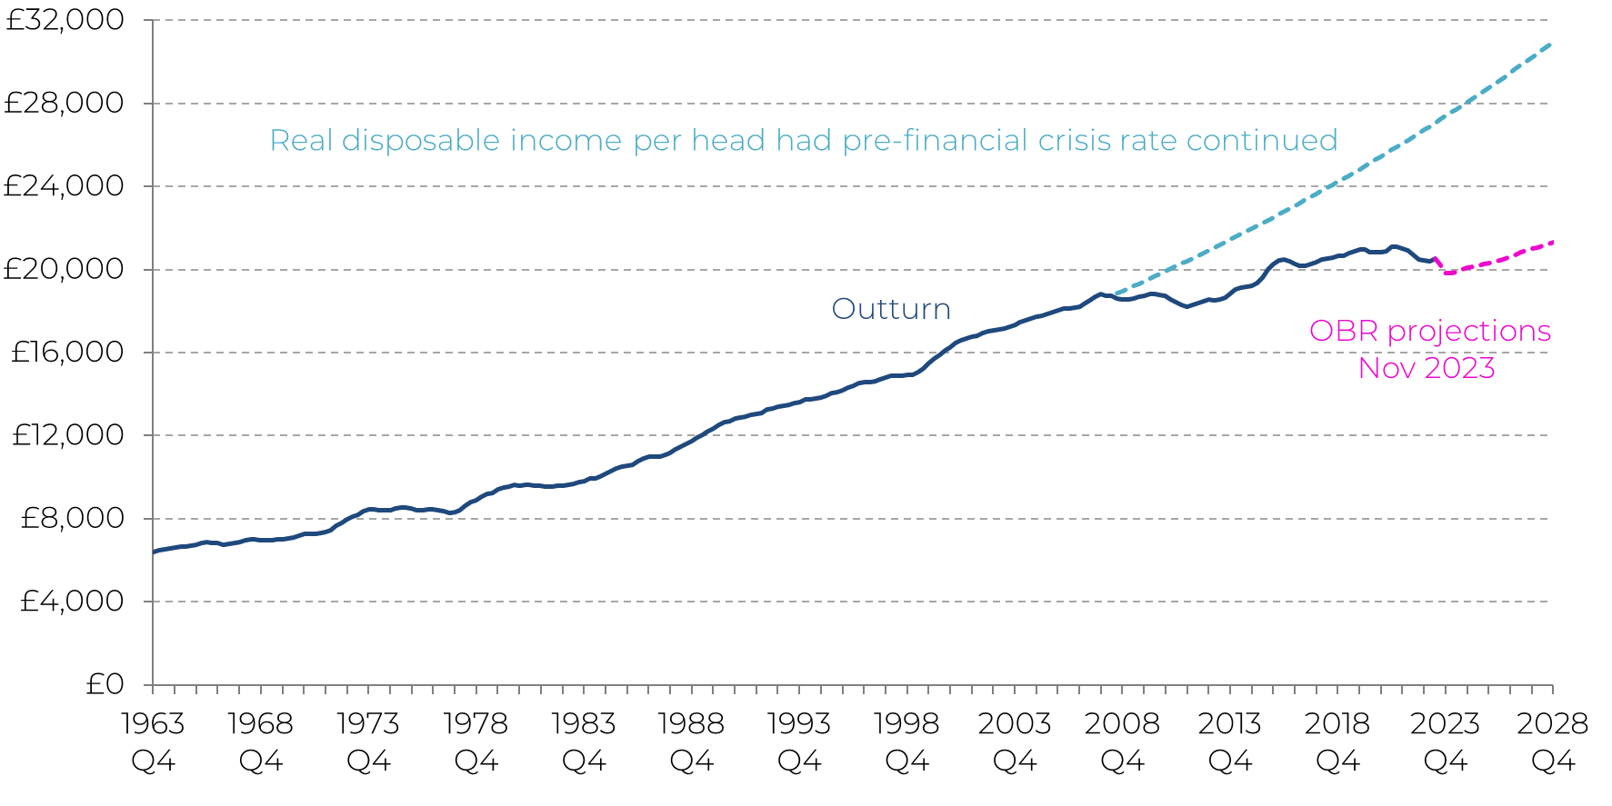
In the medium-term continued stagnation means that disposable incomes won't recover to their previous peak until the middle of 2028
Real terms disposable income per head: outturn, projection and OBR forecasts, Q4 1963 to Q4 2028, 2023 prices
Notes:
On the question of fundraising in particular I think its important to explore what the forecasts say about disposable incomes because this has a big impact on people’s ability to give to charity – and the key message here is that the long period of stagnation in disposable incomes look set to continue.
When I talk about a long period of stagnation, I’m referring to the period since the 2008 financial crisis in which improvements in GDP, productivity and living standards slowed considerably. And you can see that in this chart –the dotted blue line demonstrates what would’ve happened to disposable incomes if living standards had continued to improve at their historic, pre financial crisis rate, while the solid dark blue line shows that actual change and the dotted pink line shows the projections released in November
As you can see disposable incomes are projected to fall this year, concluding what the OBR describes as “the largest reduction in real living standards since ONS records began” and with the election due this year many are predicting that this parliament will be the first in history in which disposable incomes will be lower at the end than they were at the start
There is then likely to be a slow recovery, with incomes not reaching pre-pandemic levels until 2027-28.

Slide 9
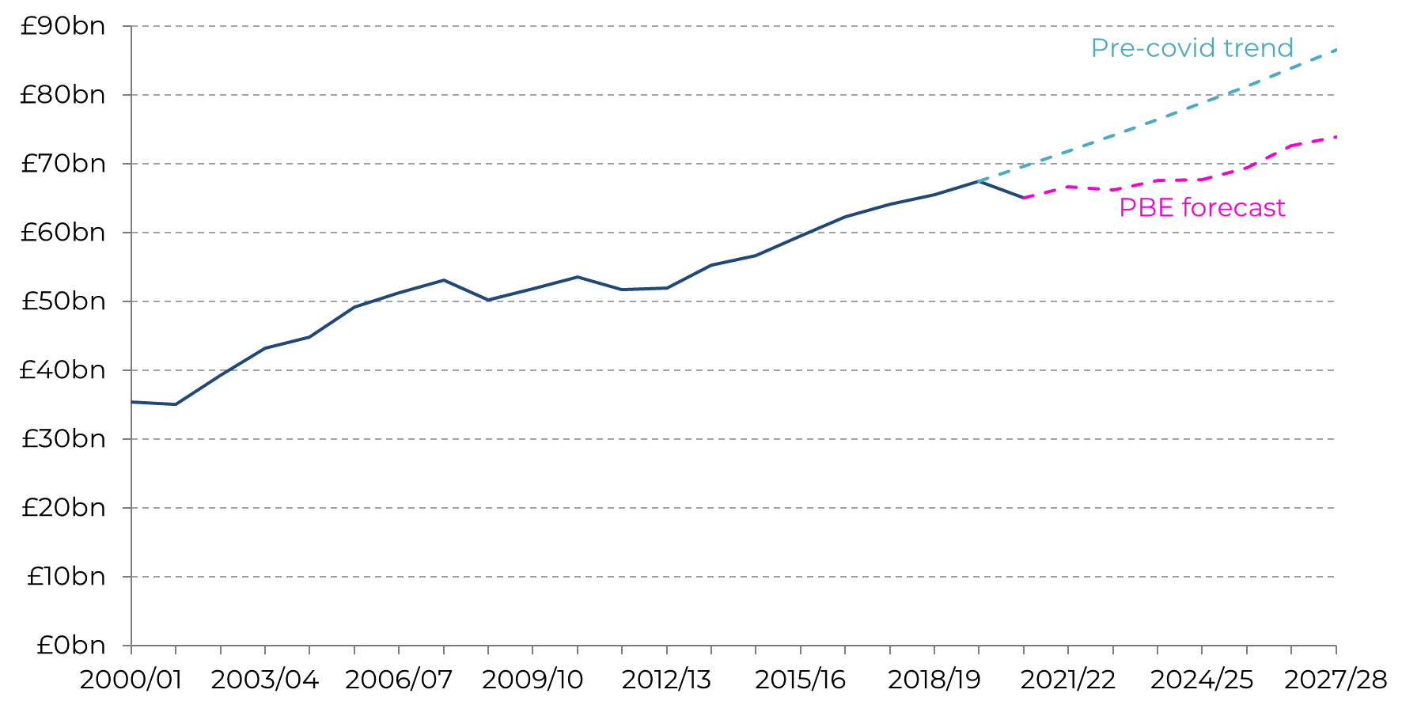
Sector income is likely to return to growth, but slowly. We think that by 2027/28, sector income will be £12bn below the pre-covid trend
Charity income: outturn, projection and pre-covid trend, 2000/01 to 2027/28, 2022/23 prices
Notes:
And much of that plays out in our forecast for charity sector income.
We estimate that charity sector income was around £66.3bn last year – a recovery from the big drop seen during the pandemic. However, the slow recovery in the economy projected by the OBR suggests that income growth for charities is likely to be sluggish in the near term.
If the historical relationship between charity income and key economic data continues into the future then the latest OBR projections suggest that sector incomes are likely to rise to between £67bn and £68bn by 2024/25. This is an annual growth rate of around 1% per year, compared to an average growth rate of around 3% per year over the 10 years prior to the pandemic. The modelling then implies that income growth will pick up speed a little in 2026/27, but by the end of the forecast period sector income will be about £12 billion lower than it would have been had that pre-pandemic trend continued
Description of approach: We use historic data to establish the strength of the relationship between different sources of charity income and key economic drivers. We then combine these relationships with the projections for the UK economy from the OBR Economic and Fiscal Outlook to project charity income forwards. While we use data on historic income from NCVO’s Almanac, they differ due to adjustments for inflation

Slide 10
Some relief for those on the lowest incomes, but many people out of work due to long-term conditions or disability look set to be worse off
Benefit uprating
Local Housing Allowance
Work Capability Assessments
In line with September inflation figure of 6.7%
Housing benefit relinked to the price of rents
Reclassification of ~340k people’s needs as ‘less severe’
Expected to result in 10k more in employment
Loss of income of £390 a month
Match the 30th percentile in the local area
Plans to refreeze from 2025-26
From April 2024
Notes:
Moving on from the macro economic picture to look at the policy and spending decisions the Chancellor took at the Autumn Statement and what they might mean for the sector.
So the big headlines were:
The decision to uprate benefits in line with the September inflation figure of 6.7% - which many anti poverty campaigners and foodbanks had been calling for- this will take place from April 2024
The decision to boost the value of housing benefits by relinking them to the price of rents – more specifically to match the 30th percentile of rents in the local area – which many homelessness charities had been calling for
however this is currently just a one off – meaning that after this year as rents rise housing benefit will not
Slightly more under the radar was a shake up of aspects of the welfare system – disability campaigners highlighted the impact of the proposed changes to Work Capability Assessments - which could lead to thousands of people who are unable to work due to long term conditions and/or disabilities losing a big chunk of their income – this has been presented by the government as a way of strengthening work incentives – but the OBR’s data shows that of the 340 thousand expected to be effected there would only be a net increase in employment of 10 thousand.
These changes were part of a wider suite of measures aimed at addressing the rising number of people who are economically inactive due to long-term sickness – which has grown considerably since the pandemic.
The Back to Work plan – included an expansion of NHS Talking Therapies services – many of these services are actually delivered by charities – mental health now the biggest cause of long term sickness – with referrals to NHS mental health services up by more than a quarter since the start of 2020. There was also more detail about the WorkWell programme, in particular the announcement of £64mn to fund 15 pilot schemes in local areas. The WorkWell programme is intended to integrate local employment and health support for disabled people and people with health conditions, to support them in finding employment.
The pilots will be locally-led by Integrated Care Boards and aim to develop whole-systems approaches – so opportunities for the charity sector to work closely with the NHS and other public services to develop a more joined up approach to health, disability and employment

Slide 11
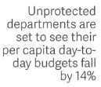
Spending plans for public services equate to austerity era levels of cuts by 2027/28, but this year’s general election makes it highly uncertain
Notes:
The major non-announcement was the Chancellor saying nothing about additional funding for public services. Elevated levels of inflation since the last Spending Review in 2021 have eroded the real terms value of the budgets of many government departments. With the OBR now projecting inflation staying higher for longer – the outlook for those budgets new look even worse.
As you can see from the reaction of some of these think tanks – this has significant consequences for public services
According to the Resolution Foundation departments such as DLUHC – responsible for funding local government, the home office and Department for Justice are set to see their per capita day-to-day budgets fall by 14 per cent – equivalent to a real-terms cut of £17 billion – between 2022-23 and 2027-28
“The scale of these cuts would be similar in scale to the peak years of austerity: for example, between 2009-10 and 2014-15, unprotected departmental budgets were cuts in real terms by 15 per cent per person. But the idea that there is as much scope to cut spending today as there was in 2010, given the deterioration of public services, is far-fetched”
But many have been sceptical that this or the next government would actually follow through with these plans – with a Spending Review due next year following the election its likely that the picture will change – the extent to which that happens will depend on who wins the election – but neither party is likely to be promising big increases in public spending

Slide 12
Summary
The charity sector in the region is relatively small in terms of organisations and income
Proportionally it is more dependent on income from government than any other region
Income from the public is proportionally lower than any other region
Modest economic improvement means income will recover slowly over the next few years
Policy decisions will provide a bit of relief, but welfare changes will leave some worse off
Government plans for public spending equate to austerity era levels of cuts
General election means that spending plans should be taken with a pinch of salt

