Slide 1
Transforming your organisation's approach to DEI

Slide 2
Agenda
Welcome
10.25: Danielle Walker Palmour. The Foundation Practice Rating
11.25: Comfort break
11.35: Penny Wilson. Getting on Board
12.35: lunch & networking
13.30: Fountains Church presentation
13.40: Panel conversation
14.15: Mohammed Kamran. The Phoenix Way
14.55: Closing statements
15:00: Close

Slide 3
Foundation Practice Rating
Year Three, 2023-24
Yorkshire Funders, November 2023

Slide 4
Who we are
A group of UK grant-making foundations. The project is convened by Friends Provident Foundation, led by Danielle Walker-Palmour, Director. Other funders are:
Barrow Cadbury Trust
The Blagrave Trust
Esmee Fairbairn Foundation
John Ellerman Foundation
Joseph Rowntree Charitable Trust
Joseph Rowntree Reform Trust
The research is by Giving Evidence.
Media partner is Civil Society Media.
Lankelly Chase Foundation
Paul Hamlyn Foundation
Power to Change
City Bridge Trust (now City Bridge Foundation)
John Lyons Charity
Indigo Trust

Slide 5
Purpose
To improve UK grant-making foundations’ diversity, accountability & transparency.
Our method is to incentivise improvement on those three areas, by creating and publishing annually an independent assessment of foundations’ practices in those three domains.

Slide 6
How it works
We rate UK grant-making fdns on their practices on: diversity, accountability & transparency
The ratings have four ‘bands’: ABCD. A = top.
Each foundation gets a rating on each of those three domains, plus an overall rating.
So they might be B (ABC)
This is a rating, not a ranking. Everybody can be top; everybody can be bottom.
We do this annually – each year with a fresh sample of foundations.
Throughout, we are as objective and as neutral as possible: using other people’s definitions wherever possible
Foundations have no control over whether they are included (unless they opt-in), the sampling, research or rating

Slide 7
The design and the criteria
We consulted with various experts, both inside & outside the voluntary sector, e.g., commercial bond ratings, the Times Higher Educational university ranking.
Our criteria were developed from external good practice standards, to minimise subjectivity. We ran a public consultation about our proposed criteria – both when we started (2021/22), for Year Two (last year: 22/23) and for Year Three (23/24).
We defined and published our criteria, in the three domains (transparency, diversity, accountability). There are ~90 questions, of which ~50 are criteria.
Criteria score: questions don’t score but are useful (e.g., what is the website?)
Many criteria one can argue into a different domain, or even into all three domains
We also publish guidance on ‘how to score well’ and various resources.

Slide 8
The data-gathering
Our sample is 100 foundations each year:
All foundations which fund the project
The UK’s largest five grant-making foundations
A stratified, random sample of the largest ~300 by grant value (based on ACF’s Giving Trends report) plus community foundations. That random sample is re-drawn each year.
We emulate a grant-seeker: so we use only public data: fdns’ websites and annual reports
Each foundation is researched by two researchers independently. Data are compared and discrepancies resolved.
We gather data about each foundation on each question & criterion. Where a criterion is not applicable to some fdn, the fdn is exempted from that criterion, e.g., publishing pay gap data.
Each included foundation has three weeks to check the accuracy of its data
Once we have a solid data set, we turn the data into ratings: for each domain and overall.

Slide 9
Timings
We announced the project in May 2021.
We published the Year One findings in March 2022.
For Year Two (2022/23) & Year Three, we re-ran the process – incl. a public consultation on criteria, fresh sample, and researched them all. Currently, all fdns included in Year Three have been sent the data about themselves to check.
We will publish the results, incl. with Civil Society Media Governance and Leadership. Expected March 2024.

Slide 10
Overall grades, Year One vs. Year Two
Y1
Y2
More here! – but still few
More here!
Fewer here! – but still a lot
Year One As: (in no particular order)
Wellcome, £27 billion
Blagrave Trust, £42 million
County Durham Community Fdn, £23 million
Year Two As:
Also Wellcome (large) + Blagrave (small)
Other endowed fdns
Again a community fdn
Notes:
23 foundations scored D overall, of which 17 scored D on all three pillars.
They spanned the size range (in terms of giving budget), with some in each quintile.

Slide 11
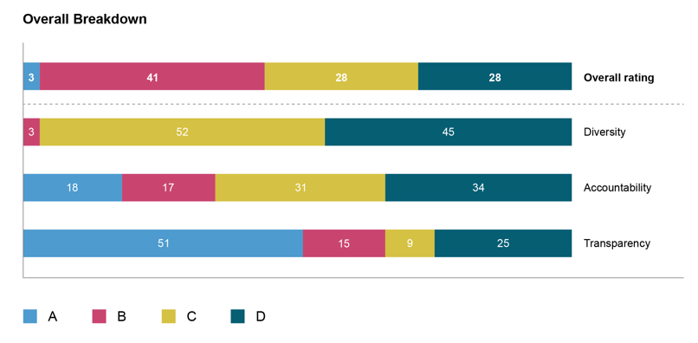
Results in Year One

Slide 12
Key findings in Year One & Year Two
Every criterion is present in at least one foundation: no criterion is impossible
Diversity was the weakest pillar
Lowest overall score
Most of the lowest-scoring criteria are about diversity
No relationship to overall score with foundation size by giving budget
But there is a relationship with number of staff and number of trustees: too few of either correlates to poor ratings: see www.giving-evidence.com/staff
More findings were discussed at the launch: see www.foundationpracticerating.org.uk/past-webinars/

Slide 13
Things we are mulling over…
How can we tell this is making an impact? How can we measure?
If this is sector infrastructure, how can it be sustainable?
Extending the reach of the FPR: those who do not want to be reached and to smaller trusts?
3 dimensions: are these still important to grant-seekers?
Community Foundations are better on ave on these dimensions than endowed trusts – should they be in this sample?
Can we use ChatGBT?

Slide 14
Q & A

Slide 15
More information
Website: www.foundationpracticerating.org.uk
Twitter: @FPracticeRating

Slide 16
Appendix

Slide 17
Criteria on which the sample collectively scored highest:
(none is on diversity)
Giving any information on who or what it has funded (T) | 91% did so
Stating an investment policy (A) | 90% did; note that this is a legal requirement for some fdns, but not all
Providing information on who made the funding decisions (A) | On average, fdns did so for 76-99% of their funding

Slide 18
Criteria on which the sample collectively scored lowest:
(all are on diversity)
having a plan to improve the diversity of trustees or board members with numerical targets (D) | Although 15 fdns had a plan to improve trustee or board diversity, only one (Blagrave Trust) had a plan with numerical targets, and that plan only had a target for young people, but not for ethnicity, disability or gender
having a plan to improve the diversity of staff with numerical targets and the types of characteristics in those targets (D) | 4.7% of possible points scored*: 3.1% of possible points scored
having various ways for contacting the foundation concerning malpractice (D) | 4% of possible points scored
*‘possible points scored’ takes account of the fact that some foundations are exempt from some criteria

Slide 19
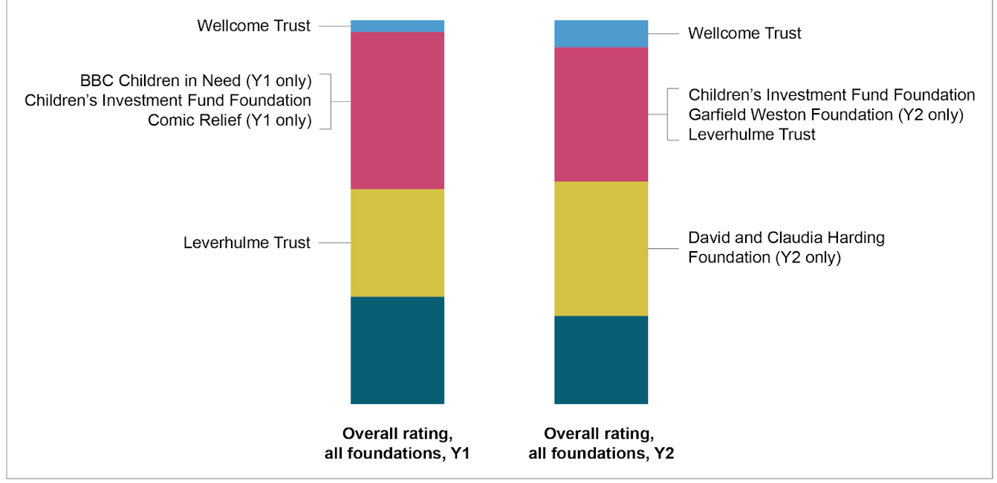
Large fdns performed broadly same as last year:

Slide 20
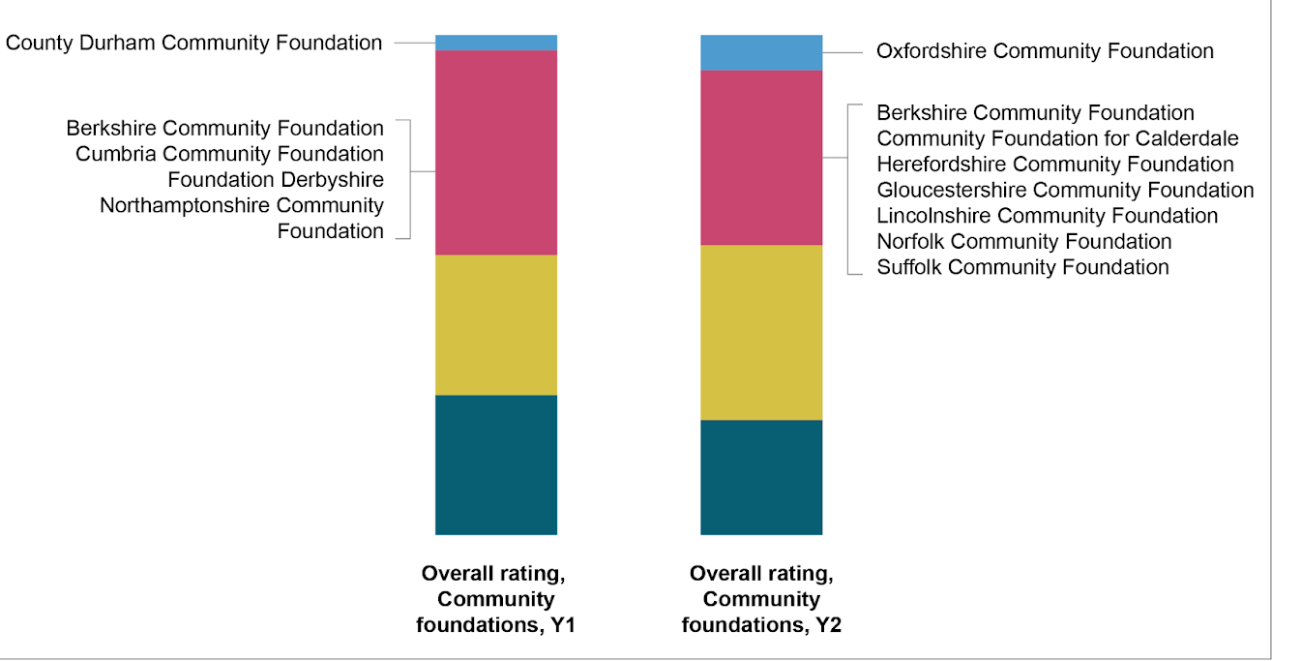
Community fdns were, again, broadly good: As & Bs ☺

Slide 21
Again, scores on the three pillars are not always correlated.
Accountability scores in Y2, with overall score indicated by colour:
C
B
Cs & Ds
Notes:
Taking accountability as an example.
This also happened in Year One.

Slide 22
Again, financial size does not dictate overall grade.
Fdns ordered by grant budget, with Y2 overall score shown by colour:
C
D
A
B
Notes:
Much the same pattern for net assets.

Slide 23
Diversity (which includes accessibility) is the weakest pillar – by far
Notes:
22 foundations scored nothing on diversity at all (up from 16 in Year One).
Encouragingly, whereas only one foundation reported diversity of its trustees in Year One, in Year Two, that had risen to five. On staff, whereas in Year One, only one foundation reported diversity of its staff, in Year Two, that had risen to six.

Slide 25
Making trustee boards more inclusive
Penny Wilson, CEO, Getting on Board
Notes:
Intro me and GonB – 15,000 trustees and charity managers, small to medium
Changing the face of trusteeship, by making trusteeship more accessible and by supporting trustees to be effective.

Slide 26
What we will cover today
Who is under-represented on trustee boards
What are the benefits and drawbacks to widening out board membership in funding organisations?
What are the barriers to people becoming trustees?
Practical trustee recruitment tips
What happens after recruitment?
Further help available
Notes:
0-5mins (11.35-11.40)
Housekeeping: What going to cover in 1 hour (not much time for a huge topic)

Slide 27
Who is under-represented on trustee boards?
Notes:
5-10mins (11.40-11.45)
These are sector wide – many of your orgs will have excellent practice.

Slide 28
Who is missing from charity boards? Skills and lived experience
Those with ‘professional’ skills, for example, finance, PR, fundraising, legal, digital, HR and marketing skills.
Service-users/those with “lived experience” of an issue. 59% of charities say that their boards are not reflective of the communities they serve.
Notes:
In practice - Homeless charity, or local charity whose board isn’t representative of the local community

Slide 29
Age and gender
The average age of a trustee is 60-62 and only 0.5% of trustees are 18-24, despite making up 12% of the population. 2/3 of charity trustees are over 50. 51% of trustees are retired.
Women are 36% of trustees.
Notes:
Stats for England and Wales from Taken on Trust 2017, commissioned by the Charity Commission. Would expect haven’t changed much and that similar picture in rest of UK. Sector wide, worse for foundations – not added here as don’t want to hammer home that point. Not commenting on their boards.
ACF stats – 32% women

Slide 30
Race and other protected characteristics
People of colour represent 8% of trustees (vs 14% of wider population).
Other minority groups: disabled people and other minorities are likely to be under-represented (but no stats are available).
Notes:
Yorkshire demographics
Funding sector, ACF stats: 99% white

Slide 31
Class
30% of trustees have a postgraduate education
60% of trustees have professional qualification
75% of trustees are from households above the national median for household income
Notes:
Trustee body is wealthier and more educated than wider society.

Slide 32
What do we mean by trustee diversity?
Protected characteristics (age, disability, gender reassignment, marriage and civil partnership, pregnancy and maternity, race, religion or belief, sex, sexual orientation)
Lived experience
Class
Neuro-diversity
Geography
? Relevant mix of skills, knowledge, soft skills, perspectives, protected characteristics, experience incl life experience, networks …
Notes:
Also older white professionals

Slide 33
What are the benefits and drawbacks to widening out board membership in funding organisations?
Notes:
10-25 mins (11.45-12.00)
Might be specific to your org, might be generic
If struggling on drawbacks, what are the perceived drawbacks?
Groups for 10 mins
Plenary for 5 mins:
APD
Drawbacks
Benefits

Slide 34
Why recruit for better trustee diversity?
Challenge and difference are at the very heart of effective governance.
Research shows that a relevant mix of people on our boards is one of the primary ways of building organisational resilience.
As trustees, it is our legal responsibility to do our best by our organisation and a lack of diversity on a board is a risk.
Boards should be close to the changing needs of current and potential service users.
Why miss out on all of that talent?!
Board diversity is essential for credibility.
Notes:
25-30
Our own strategies best starting points
Why did I ask this question?

Slide 35
What are the barriers to people becoming trustees?
Notes:
25-40 mins (12.00-12.15)
What are the barriers to a wider group of people becoming trustees?
no wrong answers
Groups – 5 mins
Plenary – 10 mins
Behind closed door recruitment – 90% of chs recruited most trustees through word of mouth and existing networks
2) Fixed idea as to what a good trustee looks like and the experience they might bring - the position they already hold in society and the type of experiences they might bring. Have a very narrow sense that already having held a senior position is only possible indicator of usefulness.
3) Inclusion – fear of not being heard, what current board looks like
4) Not knowing what it is, how to become one, counting themselves out
Approaching trustee recruitment remembering that most UK adults don’t know what a trustee is, that’s it’s open to them, how to become one, changes EVERYTHING about the recrt process.
Have control over these things.
What it generally isn’t is lack of motivation from potential trustees.

Slide 36
(Trusteeship is) “bestowed upon people when they have a lot of influence, power and success: I didn’t know you could apply to be a trustee”.
“I see it as an older white male scenario – I don’t fit into that category.”
Notes:
35-40mins quotes

Slide 37
Practical trustee recruitment tips
Notes:
40-50mins (12.15-12.25)
8 tips

Slide 38
Tip 1
Run an open recruitment process
Notes:
There is a direct correlation between rigorous, open trustee recruitment and success in recruiting a diverse board with the skills, knowledge and experience that a charity needs
75% of charities struggle to find the trustees they need.

Slide 39
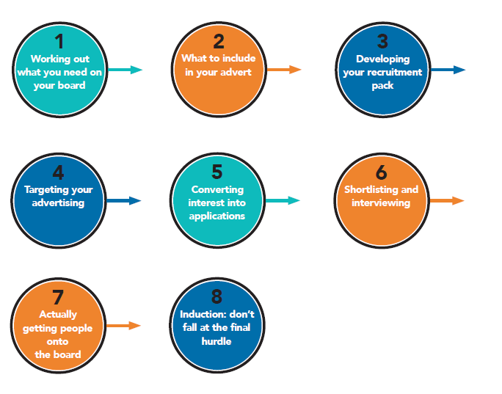
Notes:
Like recruiting staff and volunteers – timely, slick, organised.
Tell people where they in the process and how long it is going to last. What’s going to happen.

Slide 40
Tip 2
Recruit at the confluence of diversity and skills/knowledge/experience
Notes:
Sweet spot – work out what missing in terms of skills/knowledge/experience first
Intersectionality

Slide 41
Tip 3
Remove all unnecessary barriers
Notes:
So pool not restricted
You decide what is necessary

Slide 42
Remove barriers which will restrict your pool of applicants
Do they need board experience/a degree?
Do they need a detailed understanding of charity governance/an “understanding of their legal responsibilities” or can training be provided?
Use “at a senior level/significant senior experience” with care.
Practicalities: meeting times and locations, expenses
If high, does the time commitment have to be the same for everyone?

Slide 43
Tip 4
Get your advert right

Slide 44
“Ideally, we are looking for a professional with HR and/or Law experience and an interest in mental health. You have a strong track record in strategic and operational financial management and knowledge and experiences of current practices relevant to charities. The successful applicant will also have the ability to communicate effectively across all levels of the Charity.”
Notes:
3 real examples, excerpts, anonymous. Good for them for advertising.
What here would restrict applicant pool
Skills lists - or

Slide 45
“The Role
Support the Director in implementing the organisational vision and strategy.
Be a company director of xxx fulfilling all the statutory requirements of that role and complying with the requirements under the Companies Act 2006.
Actively fulfil the duties of a charity trustee and be familiar with these responsibilities…”
Notes:
Ad not role description
Chat pane:
What here would restrict applicant pool
Phrase “willing to learn” useful

Slide 46
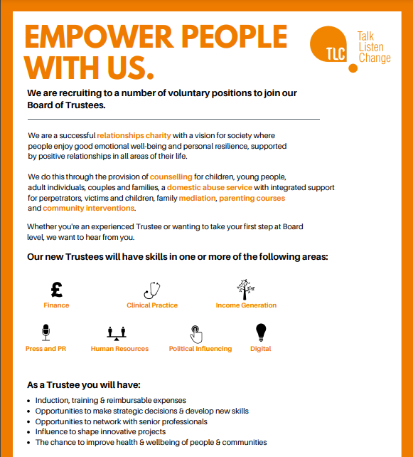

Slide 47
Tip 5
Do the leg work to advertise where your potential trustees will see it

Slide 48
Trustee listings websites
Reach: https://reachvolunteering.org.uk/charities-non-profits/find-trustee
Women on Boards: https://www.womenonboards.net/en-GB/Home
Action for Trustee Racial Diversity: https://atrd.group/
Young Trustees Movement: https://youngtrusteesmovement.org/
Charity job: https://www.charityjob.co.uk/
Notes:
All free

Slide 49
Other places to advertise
Your own website, social media, newsletter
Newsletters, e-magazines
Posters in hospitals, universities etc
Volunteer Centre / CVS / membership bodies
Twitter, Facebook, Linked In etc
Notes:
Local infrastructure orgs – Community First Yorkshire, Vol Action Leeds, Nova Wakefield, VAC in Calderdale, Community Action Bradford and District
Shortcomings of these – people have decided they want to be trustees (a positive there too!)
BUT THESE ARE STILL QUITE GENERIC. SO THINK MORE TARGETED TOO.

Slide 50
Where will you find trustees with the skills you need?
Workplaces/large local employers
Business parks
Business networks/membership bodies
Professional associations
Accountants - http://www.icaewvolunteers.com/
Treasurers - http://www.honorarytreasurers.org.uk/Vacancies1.html
Lawyers - https://www.barprobono.org.uk/
HR - https://peoplemanagement.haymarketrecruitment.com/register/
Publications, websites, online networks
Notes:
To get to people not already looking to be a trustee.

Slide 51
Example professional networks built around protected characteristics
Black Fundraisers Network: https://www.institute-of-fundraising.org.uk/groups/sig-black-fundraisers-network/
Women in Banking and Finance: https://www.wibf.org.uk/
Black Young Professionals: https://byp-network.com/
Black Solicitors Network: https://www.blacksolicitorsnetwork.co.uk/
International Association of Young Lawyers https://www.aija.org/en/
Notes:
To get to people not already looking to be a trustee
Gatekeepers
Many paid platforms too

Slide 52
Tip 6
Shortlist and interview fairly and objectively
Notes:
2 pitfalls:
Can revert back to type here – recruit great and good
Don’t recruit for fit.

Slide 53
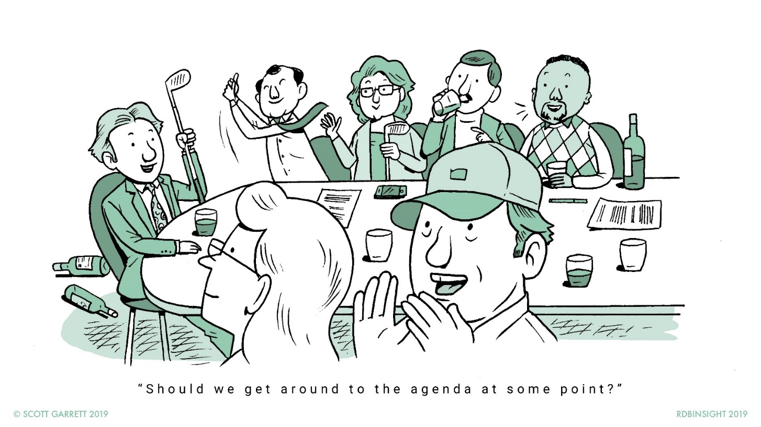
What should an effective board feel like?
Diana Garnham:
“The Good, The Bad and the Ugly of Board Behaviours”, 2019
Notes:
Effective boards don’t necessarily feel “cosy”. Challenge and difference are at the very heart of good governance. So if recruiting for diversity, likely to be proactively and intentionally recruiting for different perspectives.
Not recruiting for fit. Add.

Slide 54
Tip 7
Induct, induct, induct
Notes:
Induction – What would you include?
Buddying
Training – internal and external
Ask people what they need, don’t assume you know
Recruit multiple new trustees at once
Less work for you
More likely to speak out
Don’t treat people as “the BAME trustee” etc. People don’t always want to speak for their communities unless you are specific about that when you recruit (and clumping all people of colour together is a nonsense). Treat BAME trustee like a set role.
Also, don’t ask people to lead on D&I unless they offer or you have specifically recruited them under that remit/for their professional expertise in that area.
What can include:
Meet with board
Time with Chair
Meet with key exec staff
Experience organisation’s activities
Explain organisation’s history, work, current priorities/challenges, acronyms (!), key stakeholders, external environment
Docs:
Board terms of reference, roles and responsibilities, board code of conduct
Strategy
Governing documents
Recent minutes
Financial information / annual report and accounts
Signpost Charity Commission guidance

Slide 55
Tip 8
Just do it (thoughtfully)
Notes:
Concern re wrong terms, doing it wrong – best just to go for it.
Be honest that you are learning and encourage feedback.
Issue of guilt/defensiveness – lead from the front.
Whistle stop tour – further resources from GonB

Slide 56
What happens after recruitment?
Notes:
50-55 (12.25-12.30)
Means to an end
What matters is what happens when people are trustees
How do we equip people to contribute as trustees?
Without assumption that lacking in some extra way compared to other trustees
No trustee is the finished article
Different gaps
Work both for incoming trustee and sitting board members and staff

Slide 57
What can go wrong after recruitment?
Not taking members seriously
Views not valued
Time management – expecting to be available at short notice
Not making reasonable adjustments
One size fits all approach
Token appointments
Leaving people out of formal and informal discussions
People being asked to comment for their demographic, but nothing else
Potential discomfort and anxiety between people with different backgrounds

Slide 58
“Your voice is undermined and you feel like a minority. If you ask too many questions you feel like you are being demanding. It also just felt like a tick box exercise, I was like a silent member of the board. There were lots of power dynamics due to race issues.”
Notes:
Governance implications – recruit for compliance

Slide 59
‘Imposter syndrome is not all in our heads. It’s about what others think we are capable of or not.’
(Getting on Board research for Historic England into the Barriers and enablers to board diversity in the heritage sector, due out Jan 2024)

Slide 60
Further help available
Notes:
55-60 (12.30-12.35)

Slide 61
Support from Getting on Board
Guides
Trustee recruitment training
Trustee induction training
Board inclusion training
Transform trustee diversity programme
Bespoke support and consultancy
Notes:
For you and grantees

Slide 62
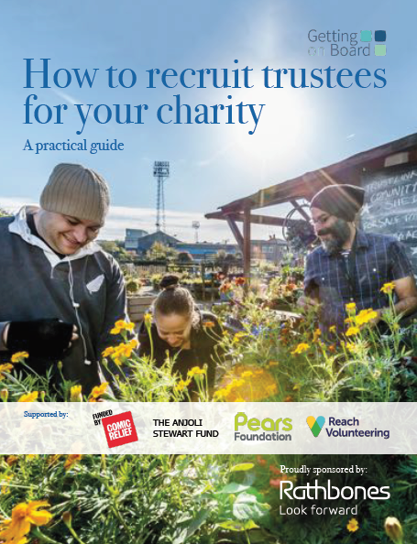
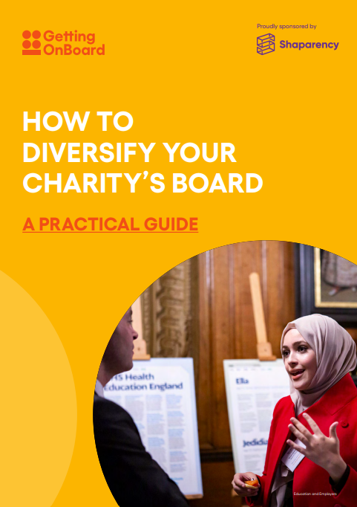
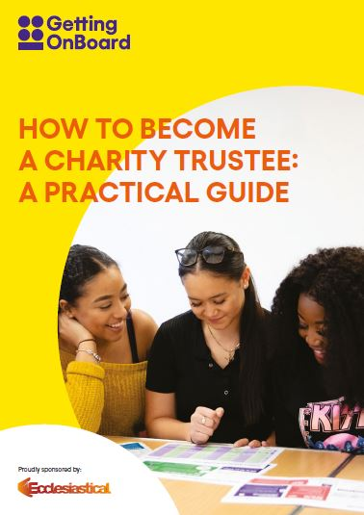
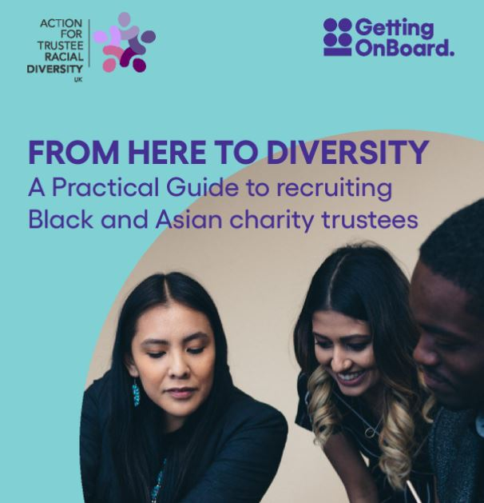
Free guides and resources
Sign up to our newsletter: https://www.gettingonboard.org/newsletter
Notes:
Also, templates and examples on our website, e.g. trustee ads

Slide 63
Other organisations working on trustee diversity
Action for Trustee Racial Diversity: https://atrd.group/
Young Trustees Movement: https://youngtrusteesmovement.org/
#QueerTrustees: https://twitter.com/QueerTrustees

Slide 64
Please feel free to get in touch:
penny@gettingonboard.org

Slide 65
Panel: Improving approaches to equity
Ross Grant – Chief Officer, Wakefield & District Society for Deaf People
Fozia Naseem – Partnerships Manager, Give Bradford
Morven Whyte – Chair, Sir George Martin Trust

Slide 66
The Phoenix Way
Mohammed Kamran – Chief Executive & Co-Founder – Impact Hub Bradford

