Slide 1
Overcoming the barriers to better grant-making
Presentation for Yorkshire Funders Online Forum
Jansev Jemal| September 2022

Slide 3
The Law Family Commission on Civil Society
The Law Family Commission on Civil Society is an ambitious programme of ground-breaking research into the potential for civil and how that potential can be unleashed.
Civil society is the nation’s vital third pillar – alongside business and the public sector
It plays roles neither of the others can provide, and is crucial to economic & social goals
But the sector is held back from achieving its full potential because…
It is undervalued, poorly understood and inadequately measured
…with insufficient or ineffective links with businesses and policymakers
…and weaknesses in the finance system underpinning its work and the sector’s own productivity and effectiveness

Slide 4
The power of good grant making
2018/19 the social sector received approx. £9.3 billion in grants
£4.8 bn from the government
£4.1 bn from the social sector
£0.5 bn from the National Lottery
Appetite and potential for good grant-making greatest
“They are almost unique in their currency. [Charitable foundation} grants can do things that other forms of funding cannot”.
Grants to the sector enable:
Experimentation and innovation
Building of capacity and developing relationships
Plan and invest for future growth
Can help to facilitate effective use of other/additional funding streams
Can be a more effective way of commissioning service provision than through procurement
Effective grant-making also benefits funders:
Lessening bureaucracy
Strengthening relationships with grantees
Enables them to work in new areas of activity

Slide 5
Current concerns around grant making
1. Short-termism
Length of time grants are offered
Prioritise narrowly conceived projects that focus on the present
2. Sub-optimal processes
Expensive and cumbersome application and monitoring processes
3. Reproduction of wider social inequalities
Some groups disproportionately suffer the consequences of challenges with the system, resulting in funds not always getting to where its most needed.
“As a charity, you’re in an endless roundabout of tracking down funding, applying for it, evaluating it, reporting on it. It just goes on and on and on and on… [During] the time that you should be working with the people, [which] you got involved with the charity to do, you end up getting stuck in this endless round of funding.”
“I’ve been looking at funding this week for a number of things. And all of it says ‘no, we don’t fund salaries, we don’t fund rent’. And yet, without that, the organisation can’t deliver what it wants to deliver.”
“So many donors are looking for something that’s new and bright and shiny and innovative, instead of something that’s been proven to work, which can be quite frustrating.”
“Funders have conditioned us to convince us that we are not good enough. Conditioned us to think we are not competitive or that it’s the quality of our bids, that just don’t make it through. I am talking to CEOs who have running organisations that have existed for decades. Suddenly, they are feeling like they don’t have the confidence to submit a funding application,.”

Slide 6
The barriers
Awareness and motivation
Some grant-makers are unaware of the effects of their processes and practices on grant-seekers.
Other grant-makers are unconvinced that their practices have a detrimental effect on grant-seekers.
Control over strategy
Grant-maker staff can feel hampered in responding to needs of grant-seekers with trustees having responsibility for setting the strategic direction.
Capacity
Grant-makers often resourced tightly, with few staff and little investment in skills and training; this can make it difficult to assess impact of their own practises, design more efficient processes, collaborate with others.
Engagement with grant-seekers
Some larger grant-makers feel that they intimidate smaller grant-seekers and deter them from applying.
While smaller foundations find that they lack the profile to reach them.
“No…I’m happy with the way we operate… I think we do things really well.”
“I don’t think it’s fair to say that these are not real problems. I think there are some problems with some funders, how’s that? ”
“Why are we doing this? We have the money. Why are we asking them their opinion?”
“My fear is that we are hollowing out our sector, because we’re putting everything on the frontline, and … the heart of the thing can be sucked out if people don’t have time to think and breather and time to be creative. And I think that goes for funders as well, yeah, 100%.”

Slide 7
The solutions
Charity Commission leadership
Opportunity for the Commission to set out what good grant-making looks like
Highlighting resources that improved good practice
Independent benchmarking
Grant-maker benchmarkers should look at expanding their scope to cover some of the areas covered in the report
Charity Commission should encourage greater participation in and use of benchmarks
Amplify the voice of grant-seekers
Potentially one of the most powerful levers for change, however…
Role for charity sector infrastructure bodies to speak out on behalf of the sector, drawing attention to challenges around existing practises, working with the Charity Commission and benchmarkers to define and promote better approaches to grant-making.

Slide 8
Cost of living – inflation (from a recent briefing with Charities Aid Foundation)

Slide 9
High inflation is expected for some time
Figure 1. CPI inflation forecasts
Source: OBR and Bank of England Inflation forecasts

Slide 10
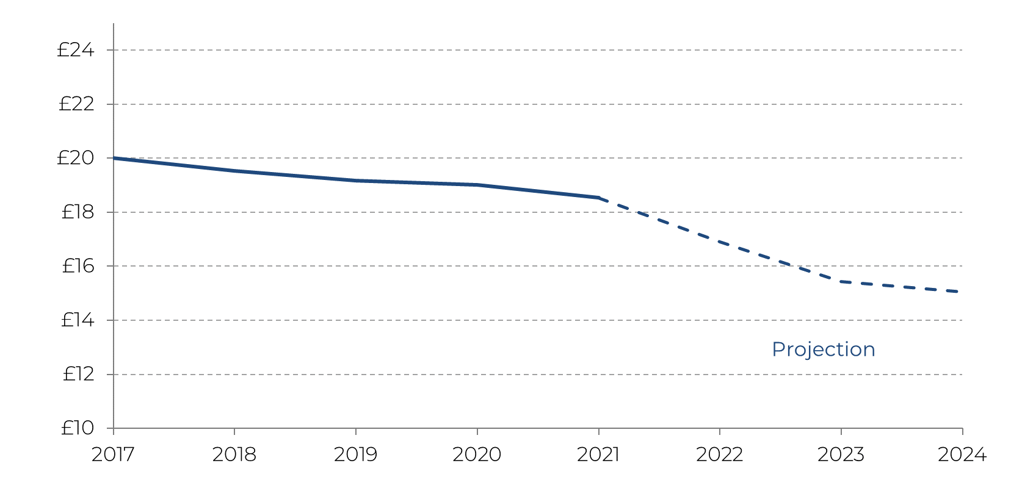
Inflation will eat away at the value of donations
According to CAF’s long-running UK Giving research, for the past five years the average donation made in the UK has been roughly £20 a month. This means that the average donation has not been keeping up with inflation, even during a period of relatively low inflation.
For charities, there is a behavioural challenge associated with this. If the donor population is in the habit of giving £20 as standard, charities will need to focus on changing that behaviour and creating a ‘new normal’, where the average donation is higher.
There is also an immediate technical challenge. It is estimated that 31% of all charitable donations are made via direct debit. Long-standing monthly direct debits fall in value over time, and this devaluation is a particular problem during this current period of high inflation. Using the Bank of England’s most recent inflation forecasts, we project that this £20 in 2017 will be worth a mere £15.30 next year and £14.90 in 2024.
As inflation also eats away at household finances, many people are likely to cut back on charitable giving. But encouraging supporters on direct debits to increase their direct debit levels will be an essential strategy for many charities, alongside encouraging donors to give more as standard where they can.
Figure 3. The ‘true’ value of an average donation in 2017 across time
Source: NCVO Almanac
Source: PBE analysis of Bank of England, MPC August projections
Further to this, the most recent data from CAF’s UK Giving research finds that total donations in the first half of this year were worth £5.7bn. We calculate that by the end of the year that sum will be worth £5.2bn, a reduction of 8.5% due to inflation.

Slide 11
Inflation will also eat away at reserves
Inflation also eats away at savings. For charities, this is particularly important in the context of reserves.
Many charities have lower reserves now than they did prior to the pandemic: nearly one in four charities used reserves to survive during the pandemic, and the number of charities with an income over £500,000 that have no, or negative, free reserves increased from 9% in April 2020 to 28% in February 2021. This was necessary in order to both survive and meet need, but it has left many charities less resilient as they now face the cost of living crisis.
Building back those levels of reserves and maintaining them at appropriate levels will be particularly challenging during a period of high inflation. If charity expenditure rises in line with the Bank of England's inflation forecasts, the value of reserves held by charities will quickly fall.
Prior to the pandemic, charities with income between £500,000 and £1m had on average 4.21 months of expenditure held in reserves as cash.
By 2023, those reserves would cover just 3.48 months of activity if expenditure by those charities rises in line with inflation.
This means that a typical charity with an income of £1m in 2021 would need to increase its reserves by £73,430 by 2023 to make up that gap. This doesn’t account for any reduction in reserves the charity might have experienced during the pandemic.
Prior to the pandemic charities with income between £1m to £10m had on average 3.78 months of expenditure held in reserves as cash.
By 2023, those reserves would cover just 3.13 months of activity if expenditure by those charities rises in line with inflation.
This means that a typical charity with an income of £5m in 2021 would need to increase its reserves by £329,650 by 2023 to make up that gap. This doesn’t account for any reduction in reserves the charity might have experienced during the pandemic.

Slide 12
Charities and donors can both take some action
The totemic issue of inflation is one that no charity and no donor can overcome simply or totally. But in order to continue to effectively support people and communities in these demanding times, both charities and donors can take some steps to be as prepared as possible to manage inflation.
CAF’s top tips for charities and donors looking to act on inflation’s impact are below.
Charities
Review your fundraising strategy
Overall charity engagement remains below pre-pandemic levels. Consider how you are fundraising post-pandemic and your digital journey for donors.
Consider how existing resources can go even further
Look at whether you could make savings on utility bills in the same way as households. Reassess how any cash reserves are held.
Focus on your existing donors
It’s typically cheaper to retain donors than it is to acquire new ones. Think about how you communicate your impact and need for support at this time.
Donors
Offer more flexible funding
Prioritise unrestricted donations or loosen some of your usual requirements for grants. Consider topping up previous donations to account for inflation or providing more flexibility with existing grants or loans.
Reassess your chosen causes and organisations
It may be time to reassess your giving strategy to ensure your funds are going where they’re needed most.
Individual donors should ensure they claim Gift Aid
Every year more than £560m of Gift Aid tax relief is left unclaimed, meaning it doesn’t end up with the charities delivering frontline services.

