Slide 1
Building an Age Friendly Sheffield
Vic Stirling
South Yorkshire Housing Association
Age Better in Sheffield

Slide 2
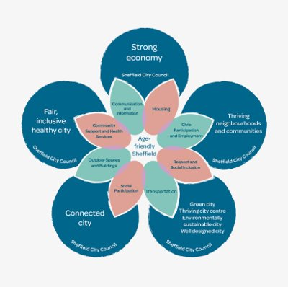
Overview
Age Better in Sheffield (ABiS) was 1 of 14 programmes to reduce social isolation & loneliness in people 50+
The co-governed programme developed a vision for Sheffield to become an age-friendly city as part of its legacy.
In 2021 ABiS approached Sheffield City Council to lead & govern Age-Friendly Sheffield

Slide 3
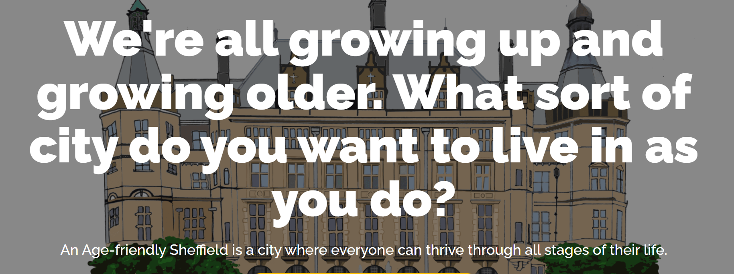
Micro-funding
Used small amounts of funding to influence at a strategic level
A diverse range of age-friendly projects and activities across different communities in Sheffield
These stories helped us to show what age-friendly meant to communities
Delivered alongside a campaign to gather ideas from people in Sheffield about what an Age-Friendly city means to them
Our micro-fund awarded £28k to 20 organisations – all projects awarded between £200-2k

Slide 4
Progress to date
Sheffield City Council are now leading on Age-Friendly agenda
Age Friendly work reports to the Strategic Equality & Inclusion Board, which is Chaired by SCC’s CEO, Kate Josephs.
Age Friendly Sheffield included in SCC’s Equality Impact Assessment – it asks ‘Tell us how this proposal will help Sheffield become an Age Friendly city – tell us how it will help people of all ages in Sheffield’
SCC looking to develop a ‘State of Ageing Report’ as a baseline for Age Friendly for next 3-5 years.

