Slide 1
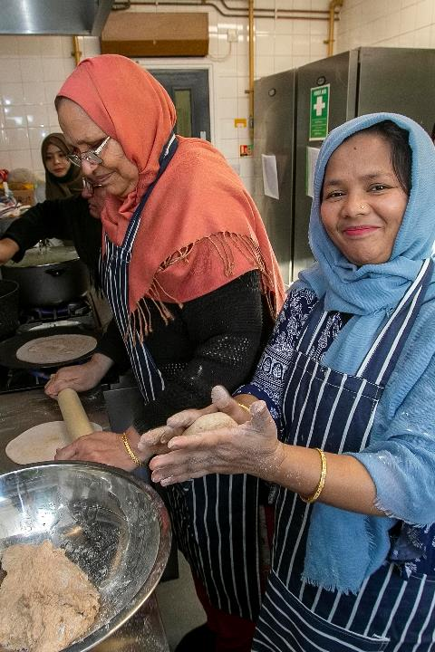
Get the basics right
Findings from the Funding Experience Survey
Emily Dyson
September 2022
Photo credit: Bangladeshi Women’s Association
and The Co-op Foundation

Slide 2
What is Open and Trusting?
Open and Trusting was launched in February 2021 and aimed to encourage funders to make grants in a way that reflects the realities facing charities now and for the foreseeable future
Over 100 funders have signed up to eight commitments to funding charities in an open and trusting way

Slide 3
The eight commitments
1. Don’t waste time
2. Ask relevant questions
3. Accept risk
4. Act with urgency
5. Be open
6. Enable flexibility
7. Communicate with purpose
8. Be proportionate

Slide 4
Holding funders to account
1. The Funding Experience Survey
2. Self-reflection
3. Peer review
4. Refresh commitments

Slide 5
About the Funding Experience Survey
How do charities experience funding from trusts and foundations?
What changes to funding practice would most benefit them?
What difference does it make when charities are funded in an open and trusting way?
Photo credit: Clean Break

Slide 6
Who we heard from
Location – 7% of respondents based in Yorkshire and Humberside
Size of organisation
Demographics
Funding

Slide 7
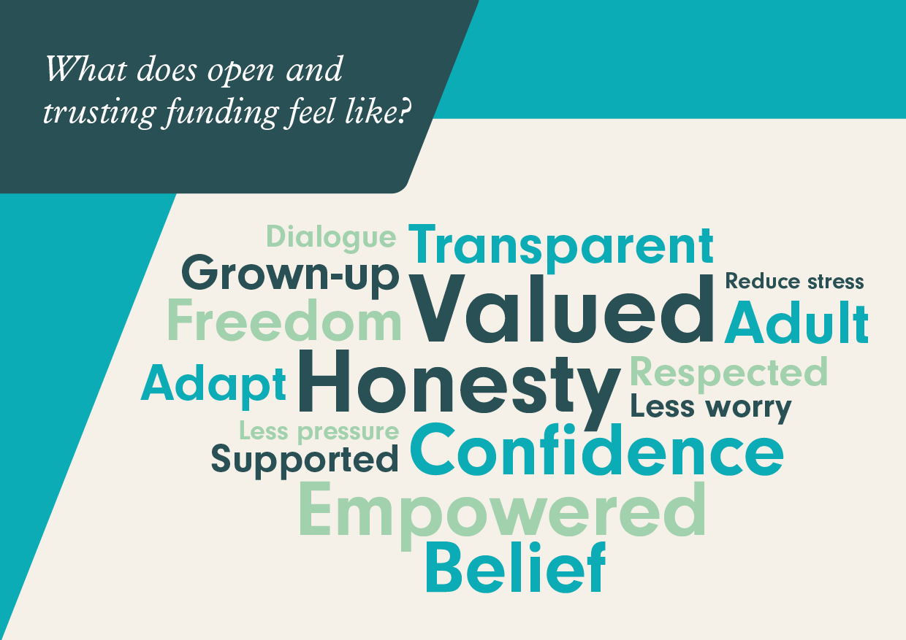

Slide 8
We found…
Charities understand funder constraints and challenges
‘How we do things’ really matters
Charities know what would make a difference

Slide 9
Making better use of everyone’s precious time.
Photo credit: Friends Provident Foundation

Slide 10
Applying for a grant
Making the best use of time and resources
Decision-making timescales and feedback to unsuccessful applicants
Equity of access

Slide 11
Managing a grant
Provide longer-term, more flexible funding
Reduce the demands of reporting
Be clear about the grant relationship

Slide 12
When a funder respects and supports the work of an organisation, everything is transformed. We are empowered to deliver our work.
Photo credit: Disability Resource Centre

Slide 13
It’s like a breath of fresh air and I feel trusted and believed in and supported in a very deep and meaningful way.
Photo credit: Damien Rosser / Eden Project Communities

Slide 14
Who open and trusting grant-making matters
As a result, charities are able to:
Be more responsive to their beneficiaries’ priorities
Be more agile in the light of changing needs
Focus more energy on mission and outcomes
Learn and share openly
Plan more effectively

Slide 15
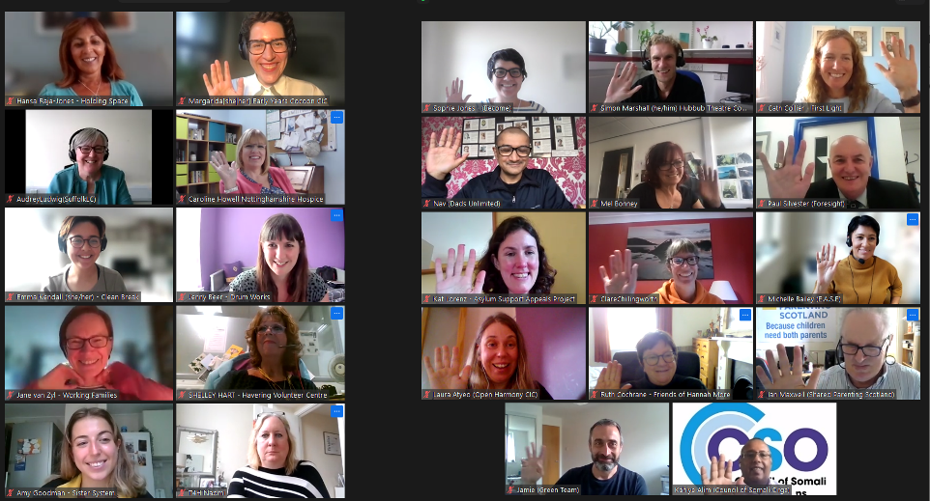
Meet our charity reviewers

Slide 16
What does all this mean in the context of the Cost of Living crisis?
Charities need:
Unrestricted funding
Flexibility
Clarity
Funders are:
Listening
Creating funds
Increasing grant sizes

Slide 17
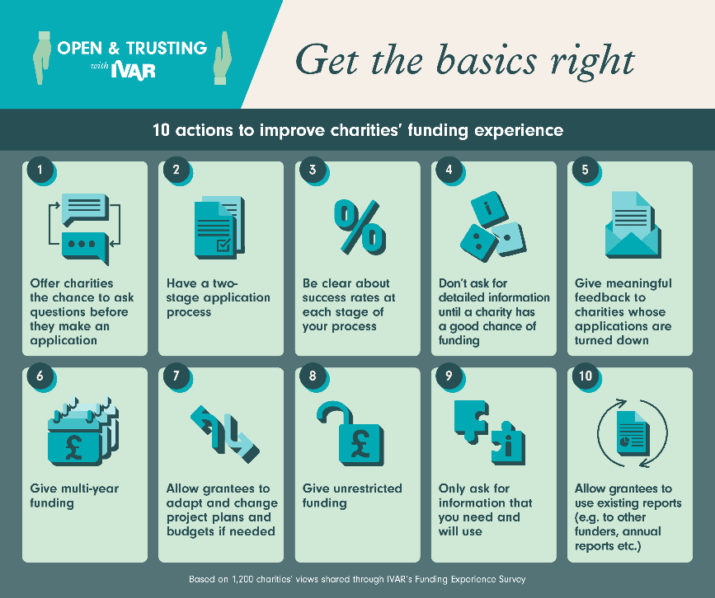

Slide 18
Ultimately it means that we achieve more, help more people, and make more of an impact.
Photo credit: Sport4Health

Slide 19
Read the Funding Experience Survey findings
The report will be available to download from 29 September:
bit.ly/3LlYVPd
You can access an advance copy of the report and our comms pack below, we’d be grateful if you could help us share it far and wide!
https://docs.google.com/document/d/1LlvgaSBGa8hHglMT3R8xMzpj4XgZ5N0A/edit

