Slide 1
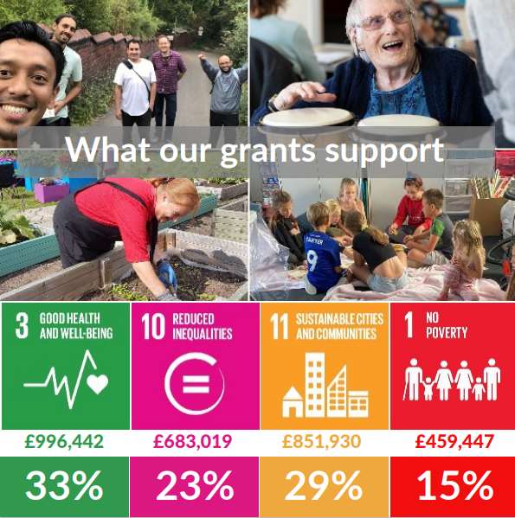

Current situation
Our grant making has rapidly increased - Distributed over £3m in Coronavirus grants in 2020/2021
Distributed £2.1m in grants in 2021/22
£4,500 average grant to groups
Noting a shift in applications – differences in need and complexity

Slide 2
Challenges & Opportunities
Post covid impact is significant as well as cost of living crisis
Reduction in public sector support resulting in charitable organisations facing high demand for services with limited fundraising and costs rising
Grassroots – the interpretation of this
What is statutory?
Certain communities and places most adversely affected – not always where the funding is available
Can our approach be inclusive and flexible yet robust enough?

Slide 3
Policy development
The development of a policy that supports the work we are doing, that feels like a live document and that can give us clear foundations for the work we do.
To use the same language as long-term plan and website etc
To have two parts – one is the more policy focused, part two how that impacts process
Learning from Participatory Grant making experience in York
Stakeholder feedback – broader than the usual suspects
56%

Slide 4
Areas for potential change - Policy & Process
Balance of flexibility – size of organization?
The stretch on what is statutory -
Organisational structures – funding running costs for CICs?
Funding organisations without bank accounts?
Monitoring – how we use if for learning?
56%

