Slide 1
Yorkshire Funders
June 2022
@LBFEW @PaulStreets_

Slide 2






Who we are
Lloyds Bank Foundation for England and Wales partners with small and local charities who help people overcome complex social issues. Through funding for core costs, developmental support and influencing policy and practice, the Foundation helps charities make life-changing impact. The Foundation is an independent charity funded by the profits of Lloyds Banking Group.

Slide 3

Our mission
To partner with small and local charities to help people overcome complex social issues and rebuild their lives
Our approach
1 2
We fund We develop
3
We influence

Slide 4
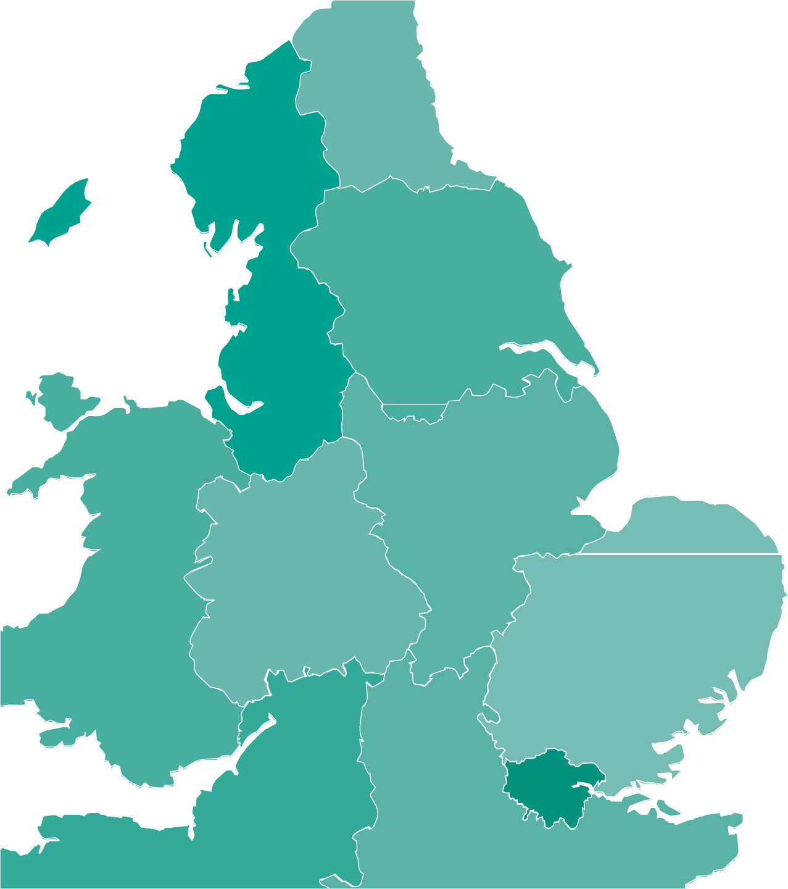

£5,920,223.66
committed to 78 charities in
Yorkshire and the Humber
Complex Social Issues (CSI) we supported include;
Young Parents, Trafficking and Modern Slavery, Sexual Abuse and Exploitation, Racial Equity, Offending, Prison or Community Service, Mental Health, Learning Disabilities, Homeless and Vulnerably Housed, Domestic Abuse, Asylum Seekers and Refugees and Addiction and Dependency in 2021
£950,000
In grants to 20 charities in 2021.
Complex Social Issues (CSI) we supported include;
Young Parents, Trafficking and Modern Slavery, Racial Equity, Learning Disabilities, Homeless and Vulnerably Housed, Domestic Abuse, Asylum Seekers and Refugees and Addiction and Dependency

Slide 5
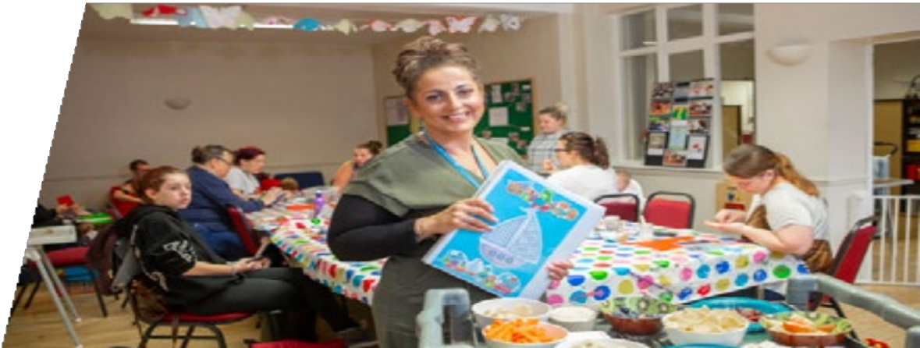
“
A lot of services in this area have ended and children’s services have seen budget cuts so we’re thankful to Lloyds Bank Foundation for their support. We’ve been there for young parents when others haven’t and the feedback we’ve had has been absolutely amazing. We want young parents to look back on their parenting experience positively. It doesn’t matter how old you are when you have your first child. With the right support, everyone can be a fantastic parent.
Keighley Healthy Living
£136,290
was awarded to
Keighley Healthy Living in
Yorkshire and the Humber
2021

Slide 6
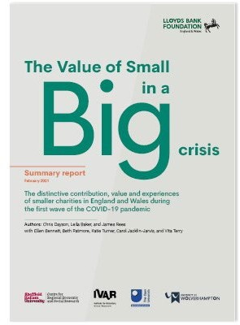
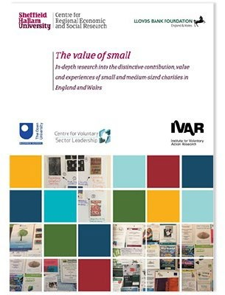

Slide 7
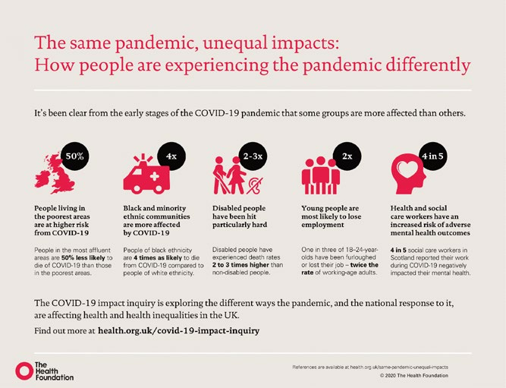

Slide 8
‘Funding is Getting Tight’.
d“emand has stayed at covid levels but funding opportunities have vanished”
As demand for our services and others increases, X Council is cutting funding. The Council is directing charities towards grant-making trusts but trusts are already reporting a huge growth in applications, particularly since community fundraising has been hit hard by Covid”
Homeless Charity
“
“
Many trusts are now only accepting applications from charities they have supported in the
past. This coupled with the local government cuts means the charitable trusts open for grants
are inundated with charity applications competition is fierce and the chances of success are
becoming increasingly rare”
LD Charity

Slide 9
Issues with Staff Morale, Recruitment and Retention.
“
Staff are on low wages, and the cost of living has increased leading to the risk of a lack of retention”
Sexual Abuse and Exploitation Charity
“
Staff are weary and we have had several facing mental health challenges this year, especially those
with a giving nature who feel frustrated that they cannot help everyone who comes to the door”
MH Charity
“
despite offering enhanced support for mental health within the organisation, we currently have 4 full time vacancies, which means we are unable to bring back all clients who would have attended with us prior to the pandemic’
MH Charity

Slide 10
Issues with Staff Morale, Recruitment and Retention.
“
Deterioration in staff and learner mental health and morale Due to the recruitment and staffing pressures: we are seeing a clear dip in morale and mental health’
Community Charity
“
staff retention and development is key. Against a background of rising prices and
reduced funding this is a significant challenge.”
LD Charity

Slide 11
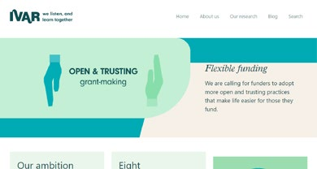
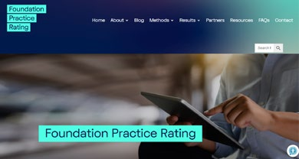
Foundation Practice – Carrots and Sticks

Slide 12




Lloyds Bank Foundation for England and Wales partners with small and local charities who help people overcome complex social issues. Through funding for core costs, developmental support and influencing policy and practice, the Foundation helps charities make life-changing impact.
During 2021, the Foundation awarded £16.3m to small and local charities helping people facing disadvantage. With the unprecedented circumstances of COVID-19 such charities have been never more needed.
The Foundation is an independent charity funded by the profits of Lloyds Banking Group.
lloydsbankfoundation.org.uk enquiries@lloydsbankfoundation.org.uk

Slide 13
Yorkshire Funders
June 2022
@LBFEW @PaulStreets_

