Slide 1

Developing your grant management system
Led by IAn bates, technical director at issimo consultancy

Slide 2
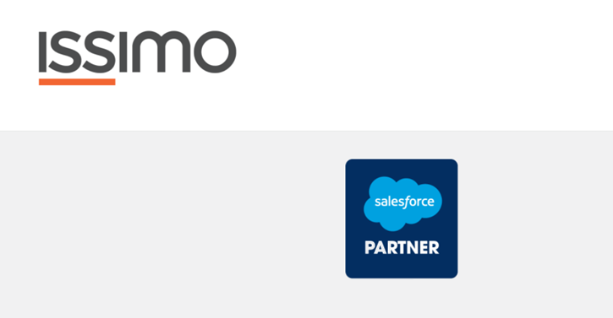
Ian Bate,
CEO & Technical Director
Notes:
Slide 1 (Ian) 3 minutes
About Issimo – 10 years ago Rob Lilley and Jacqueline Rae, grantmaking consultancy, selling Benefactor, Developed Salesforce product.
About me – developer, trustee, Salesforce for Case Management, freelanced for Issimo, partner, owner
Our Team - Ashley – Project Management, Training, Salesforce
James – Salesforce
Jaqueline – Grant Management consultancy and business development
What we do? Grant Management, Salesforce, Support
What sets us apart? Values – honesty, competitive and transparent pricing, Third Sector only, Grant Management specialists.

Slide 3
Why use a system to manage your grants?
Structured data
Duplicate data
Integrity and Consistency
Sharing
Analysis
Auditing and security
360 giving
Environment
Notes:
Slide 2 (Ian) 1 minute
Structured data v Document data
Duplicate data – each document has same organisation details
MOVE to top - Integrity and Consistency – Validation rules, data types, phone numbers, emails etc.
Sharing – other members of your organisation
Analysis – build up a history. Find patterns. Plan future. Measure performance
Auditing and security – changes to data can be recorded. Access to data can be restricted. Backup against loss/fire
360 giving – extract data each year for 360
Environment - paperless

Slide 4



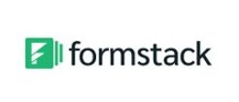
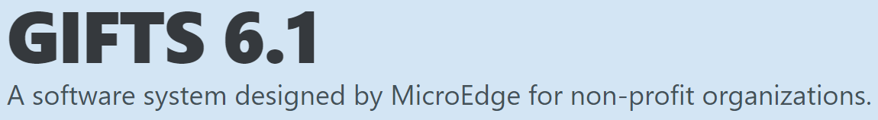



Online Form Builders & Surveys
Blackbaud/GIFTS
Bespoke
Salesforce
Notes:
Slide 3 (Ian) 1 minute
Online Forms – SurveyMonkey, Google Forms, spreadsheet data structure, not always possible to add files, duplication, no history by organisation
Blackbaud/Gifts/Benefactor – Expensive, ageing, BB built on SF, difficult and expensive to modify, large global organisations with consultancy
Bespoke – Expensive. Closed. Can be cheap – bad. Good if you have a very unusual process (but you’re not that special).
Salesforce – DIY – one of dangers is that it’s quick and easy to make a pig’s ear.
Salesforce – General consultancy
Salesforce - Specialist consultancy.

Slide 5

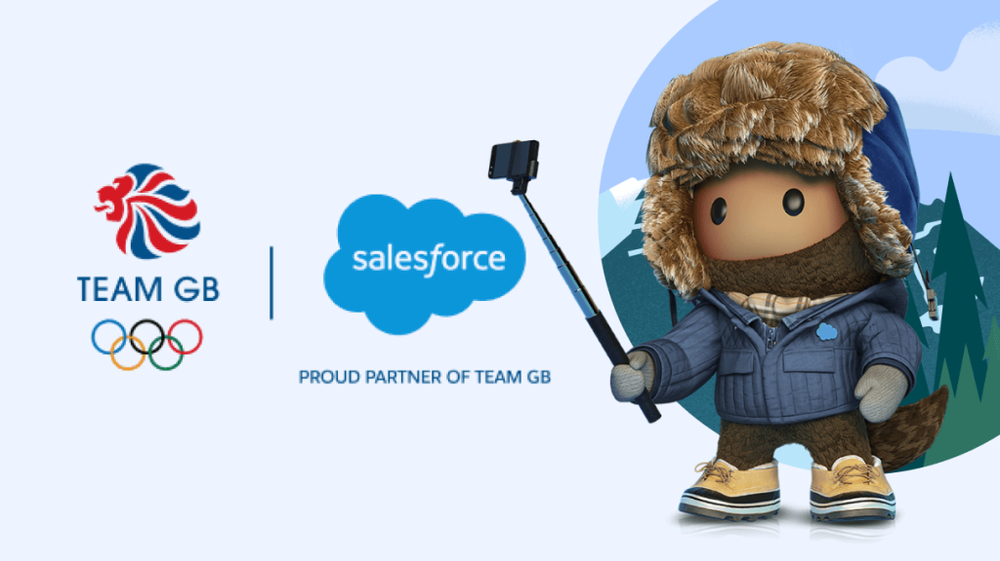
Why choose Salesforce?
Salesforce is open and flexible
Easily transferable support
Donated licenses
Powerful reporting tool
Mobile
Integrations with other systems
Notes:
Slide 4 – (Ashley) Why Choose Salesforce? 3 min
Easy, Open, Flexible – Access from the cloud, don’t install, access anywhere and anytime with the same experience. Salesforce as easy to use as websites you visit every day. You can login from anywhere, collaborate with your colleagues, and view and update data whenever you want.
Multitenant Platform means users share sale infrastructure and instance of the software. Allows for automatic and simultaneous updates while keeping data secure. Latest features with automatic, seamless upgrades 3 times a year.
With a robust and well-documented API, any integration is possible. This lets you map your business processes onto Salesforce more effectively and boost productivity.
App Exchange Eco-System – AppExchange in Salesforce allows you to develop and market your own app or get access to thousands of useful, secured and verified applications and integrations built by other users.
Mobile – Same experience on the go. One of the first companies to introduce concept of mobile CRM. Simply download the Salesforce Mobile App.
Support – You own the system and data. If you don’t like existing support you can find someone else who can help you manage your system. Hire a consultant or your own administrator Free support through Trailhead (training modules), Salesforce Documentation, Power of Us hub and Salesforce community. The community is always ready to help and support you, provide customisation services and gain access to rich pool of developer talent.
Easy to use Report Builder for analysing data. Analyse, Subscribe, Export and As long as you have the data in Salesforce you can build it.

Slide 6
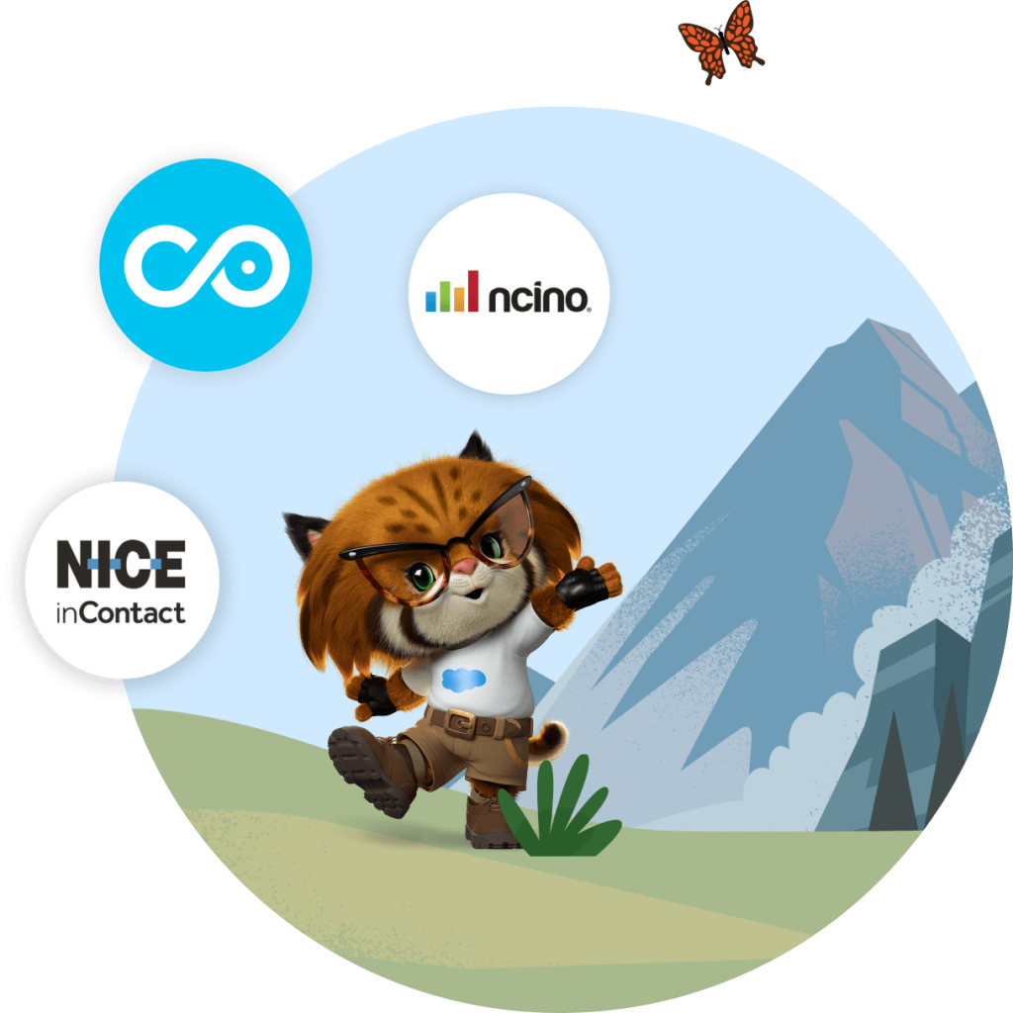

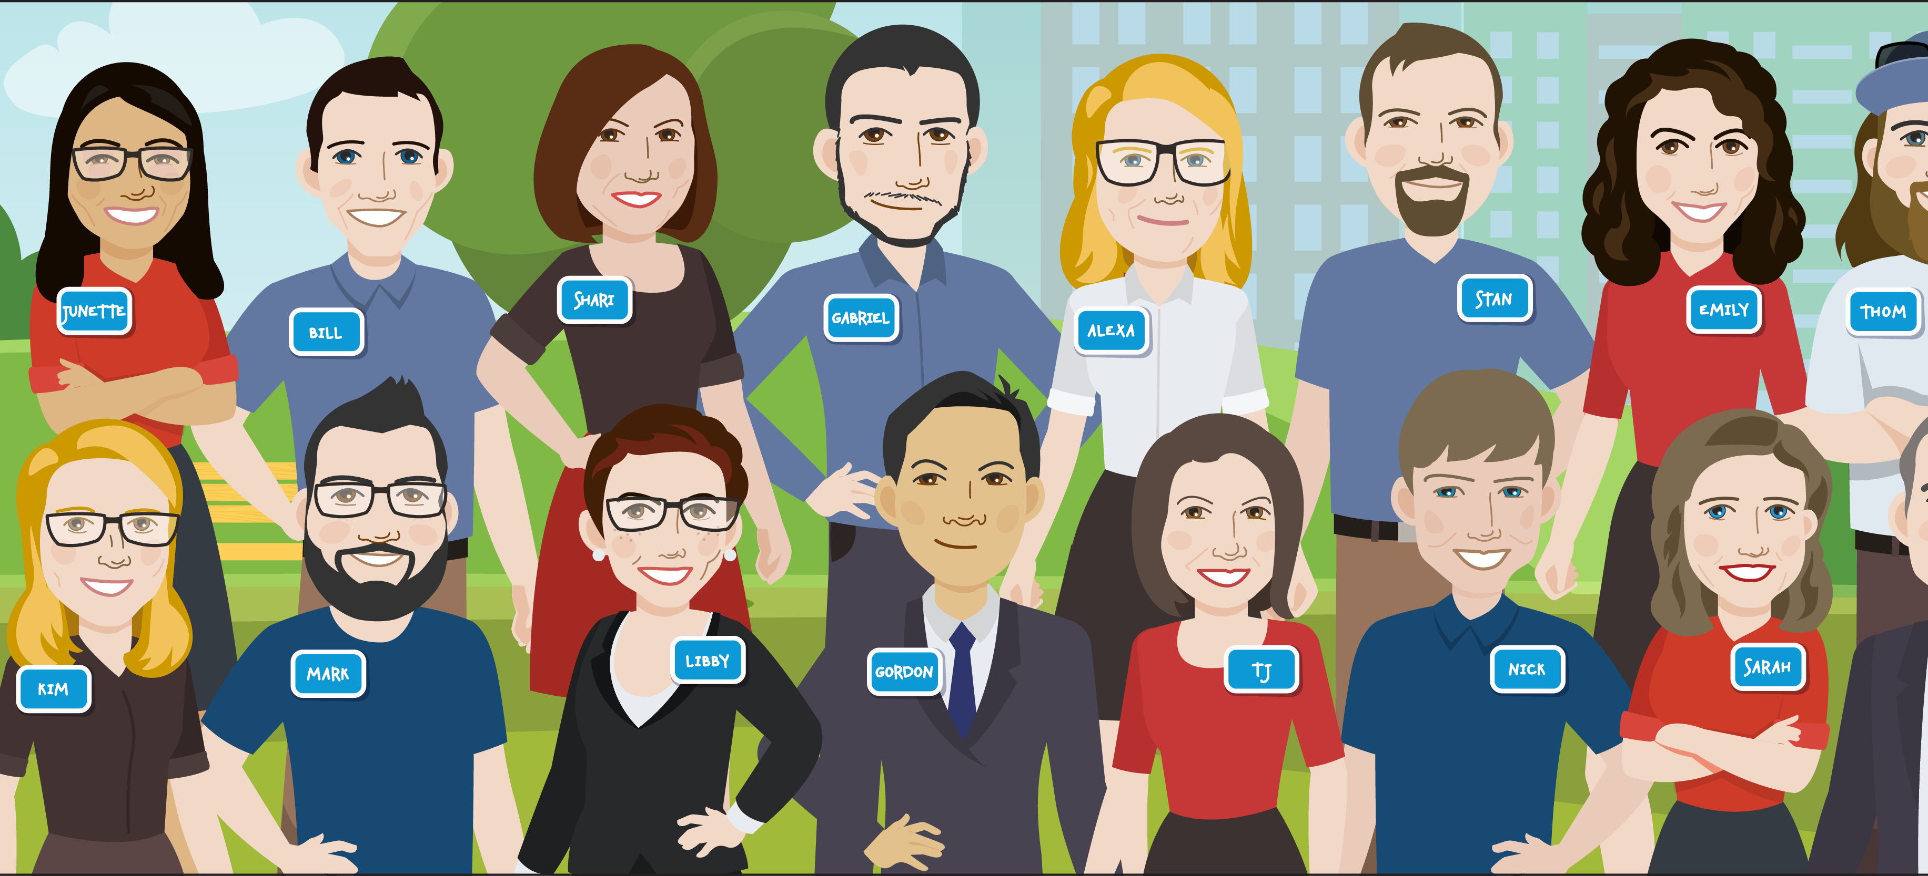
Salesforce for
Non-Profits
NPSP
Outbound Funds Module
AppExchange
Notes:
Slide 5 (Ashley) 2 minutes
Salesforce not only for businesses but also the right fit for Nonprofit organisations. Nonprofits can streamline operations at a much lower cost.
Donated Licenses – 10 free full salesforce licenses valued at £1500, additional Non-Profit discount, direct reflection of their ethos and the importance of Ohana or community to Salesforce
NPSP – Free package developed for Non-Profits with powerful fundraising and constituent engagement features. NPSP organises Constituent, Fundraising and Program Data for Non-profits. The Programme Management Module is a standard framework to track Programs, Services, Constituent or Cohorts’ programme Engagements and service delivery and extract meaningful outputs of data. Real-Time Reports and Dashboards to help drive decisions.
Outbounds Funds Module – Out of the box grant management system developed over 5 years in conjunction with non-profits, grant makers, partners and staff. A few objects with no Automation and needs to be heavily customised. Also US centric.

Slide 7
Notes:
FORMSTACK
We use a form builder tool called Formstack. You can pay £2400 per year to host your own account or allow us to host it for you at a reduced rate of £300. This includes Salesforce integration and Amazon S3 storage integration at no additional cost.
Ashley complete form while Ian talks about Formstack features including:
Data Validation, File Uploads, Single v. Multi page forms, Save and Resume, Email Notifications and Confirmations, Issimo Support
Switch to Salesforce to show data and files effortlessly in Salesforce
NEW APPLICATION
Show standard fields with data from Formstack, including Formstack Form Reference
Convert button (takes a minute) – when ready to commit data to Salesforce. Explain Duplicates and create New Account. Choose meetings (June 22) and then Convert.
REQUEST
After conversion, Data is now in the Request. Additional information can be added at this stage.
Path at the top of the page to track the journey of the Request. The path can be easily customised to your foundations processes.
Details Section captures converted information and new information. Quickly scroll down page and point out sections. Scroll back up page.
June 22 Meeting – Lets have a look at the meeting record we mentioned during the conversion process. This record captures a summary of all requests submitted and allows us to run Board Papers with an Opero docs subscription.
Activity Centre for capturing interaction with clients and customers:
Emails – Quick text and Email templates, can associate Sent email with Record and show whether opened, unopened, bounced
Outlook & Gmail Integration – Show what Outlook Integration looks like and how it works with Carla’s address
Tasks – yourself and others
Log Calls
Notes – associate with records and people
Files – any size, preview, any type
Decision made following June 22 Meeting. Clone Request. Then
Rejection: Choose reason. Open e-mail.
Approved: Different ways of collecting information from Trustees (You can have varying levels of access)
Screen flow where record is updated
Separate Assessment records
Voting Record whereby Votes are collected and rolled up to the Request
Approve ONE-YEAR request – make sure to point out status change
Grant Offer. E-mail Grant Offer. Click on Grant Offer Form (While Ian talking Ashley completing Form). Show details in Salesforce and Status updates.
When approved, if selected, payments and monitoring reports automatically created.
PAYMENTS
Discuss Scheduled and Actual Payments
Manual or Automated Grant Receipt Form when payment made
Click over to Budget.
MONITORING REPORT
You can select template or automate Report Due notice.
Status in Grant Being Paid.
Final report received stage changes to Grant Paid or Closed, whichever you prefer.
Show final stage.
HOME PAGE AND DASHBOARD
Use Report Builder to create any report and add it to dynamic dashboard for latest information relevant to you.
Subscribe to reports and export in right format.
360 giving report

Slide 8
How to get started?
Document your current processes, list your pain points, align your requirements with your business goals
Visit the Salesforce App Exchange to find a consultancy that is right for you
Apply for your free licenses through Power of Us - Salesforce.org
Customise, automate, integrate and migrate
Analyse and report on your data
Get training for yourself and your users
Setup ongoing support

Slide 9




How much does it cost?
Notes:
Slide 9 – Ian – 3 minutes
Interesting Question – hands-up exercise
Issimo start £6,000 - £10,000. Depend on number of forms, automation, data cleansing & migration. We give a fixed price.
Hyphen 8 – Grant Flex. You can watch the demo on their website. Typically for bigger funders starting at £15,000. They use Form Assembly.
Silver Softworks – Package at £8,000. No online forms. Install Outbounds funds module with limited customisation. Big list of what’s not included..
Any other Salesforce consultancy – search the Salesforce AppExchange – may be hard to pin down a fixed price. May get a budget range.

Slide 10

Questions

