Slide 1
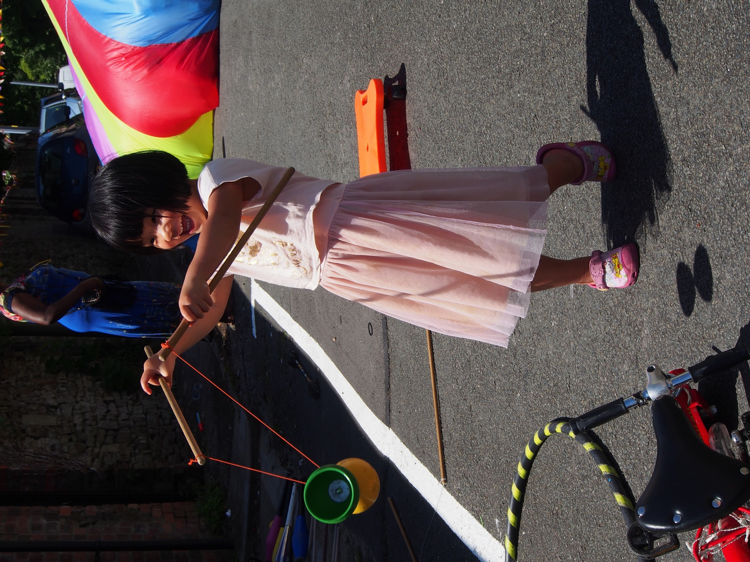
Grantmaking in 2022: Open, trusting and relational
Image credit:
Paul Coleman/Eden Project Communities

Slide 2
Workshop Outline
Part One: The context for charities and funders
Part Two: Application and assessment processes
Part Three: Reporting and learning processes
Notes:
Part One: What we know is needed (10 mins)
Part Two: Operationalising relational – application and assessments
Present 5 mins
Table discussion 15 min
Feedback 10 min
Part Three: Reporting
Present 5 mins
Table discussion 15 min
Feedback 10 min

Slide 3
What is life like for charities at the moment?
Five key pressures:
Funding
Increasing/changing demand
Going online
The welfare of staff and volunteers
Leadership

Slide 4
What helps charities cope?
Collaboration
Taking care of staff and volunteers
Embed joined-up working.
Ensure networks and trust established survive in the face of new challenges.
Inventive ways to support teams.
Providing spaces to unload.
Requires ongoing attention.
New ways to connect
Responsible, supportive funders
Pay careful attention to blended services and ways of working.
Digital exclusion also needs to be tackled nationally.
How might progressive practice from funders be sustained?

Slide 5
How funders can make a difference
Funding relationships
Funder commitments
There is no rule that stipulates that applicants or funded organisations should feel anxious, trying to second guess what is expected of them.
100+ foundations – of all sizes across the UK – have signed up to 8 commitments to make life easier and fairer and less burdensome for applicants.
Philanthropy’s role
‘Philanthropy's primary role is to fund, support, and advocate for the nonprofits and communities doing the hard work of making our communities and our society better. The more we let go in that role, the more others can lead. The more we let others in, the better our ideas and relationships become. That’s how we go from making incremental gains to quantum leaps.’

Slide 6

Eight Commitments
Over 100 trusts and foundations of all sizes across the UK have made eight commitments:
Don’t waste time
Ask relevant questions
Accept risk
Act with urgency
Be open
Enable flexibility
Communicate with purpose
Be proportionate
https://www.ivar.org.uk/flexible-funders/
Notes:
Emergency Responses: more trusting, lighter touch grant-making; ready to strip away complexity and work with urgency and flexibility
Questions of equity and power
Opportunity for a different kind of philanthropy: simpler, respectful, inclusive

Slide 7
Grantees’ work – as well as funders’ – became better as they shifted into relationships built on trust, openness, and respect for the distinct expertise and know-how of charities that are tightly connected and accountable to their communities.

Slide 8
Funders are thinking about…
Unrestricted funding (how and why)
Wellbeing grants
Application and assessment processes
Better reporting
Relational funding

Slide 9
Relational grantmaking
If funders call themselves relational and/or start adopting the rhetoric, it is crucial that they:
Are clear about what that means
Communicate it well to charities so they know what to expect
Are sufficiently aligned internally to be able to deliver on whatever they are promising
Notes:
Relational
We have noticed a sharp increase in references to ‘relational funding’ within and beyond the community of Open and Trusting funders. For some, the term is used to express longstanding commitments to principles of respect and mutuality; for others, while the precise language may differ, the approach to grant-making is similar.
At the same time, we have also observed a disconnect, where an apparent commitment to being more ‘relational’ does not appear to be backed up by appropriate practices). This risks, variously, confusion, disappointment and frustration on the part of applicants and funded organisations.
Recent work based on… ‘if funders call themselves relational and/or start adopting the rhetoric, it is crucial that they:
• are clear about what that means
• communicate it well to charities so they know what to expect
• are sufficiently aligned internally to be able to deliver on whatever they are promising’.
1. Human
2. Meaningful ‘People shouldn’t feel like they have to come along’; ‘How not what’
3. Responsible
4. Proportionate
5. Power and resetting the dynamic
Trust – long term, unrestricted, you / the donor holding rks/doing the work
We want to be able to leave and trust people with that money’.
‘The understanding, knowledge and learning that we get from working in this way is hopefully quite deep and influential’.
Need to consider
• Resource & capacity – time and money Can be a significant time investment for sometimes quite small (e.g. £500 micro grants to residents) grants.
• Continue to challenge your own assumptions and ‘check in’ lots of different sources to build composite picture
• You cannot be a relational funder for every fund. Scale, context, management all part of whether appropriate.

Slide 10
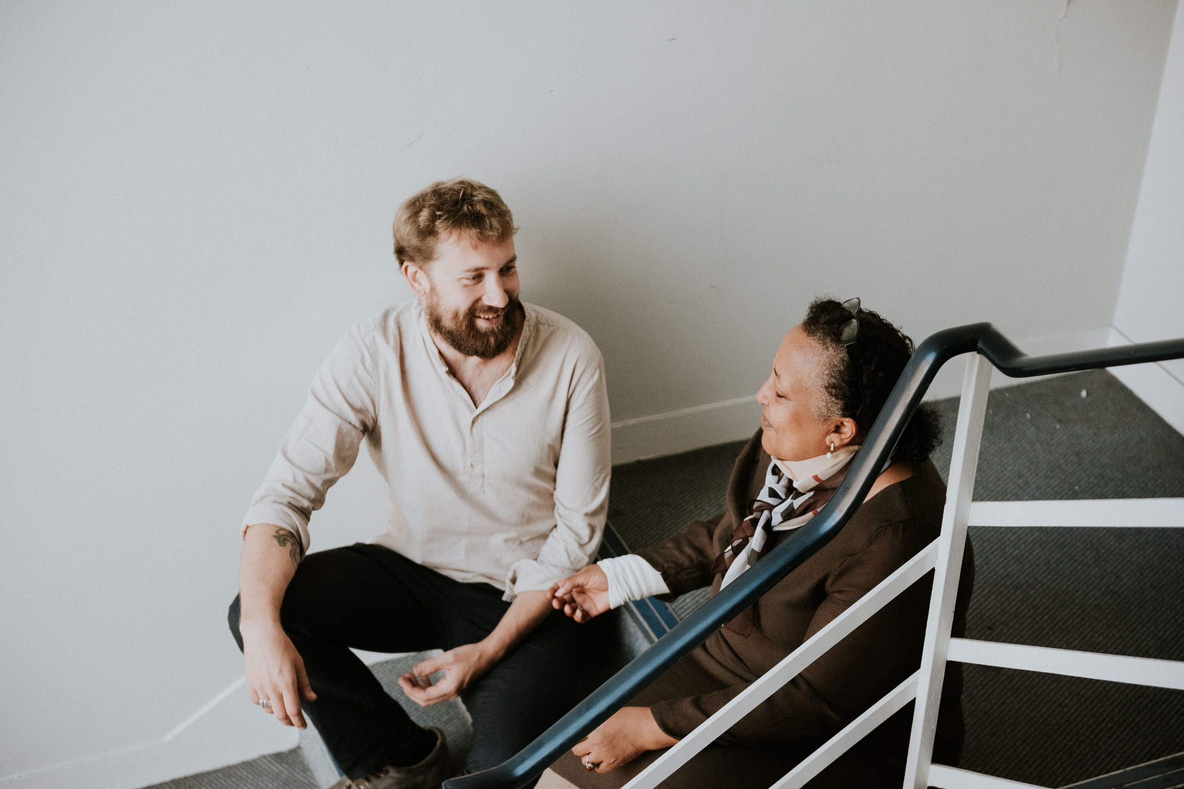
Application & assessment processes
Image credit: Groundswell
Notes:
So, lets turn to look at this within two ends of grantmaking process – applications and reporting

Slide 11
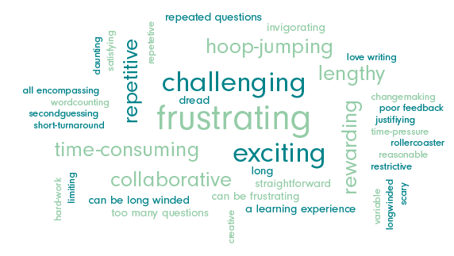
What does applying for funding feel like?
Notes:
In May last year, we conducted a series of sessions with charities as part of our Open and Trusting work. These sessions focussed on what applying and being assessed for funding felt like for charities- what was the emotional toll of doing this work? We spoke to 22 charities who said that while the work was exciting, rewarding and creative, dealing with constant rejection was really difficult.
Here is a word cloud of the other words they used to describe what applying for funding feels like (pick out a few keys words)

Slide 12
Applying for funding can feel like a teenager plucking up the courage to make the call and then putting the phone down when you get to the last number.
Notes:
‘

Slide 13
How can funders help?
Continue the flexible, open and trusting funding practices that many adopted during the pandemic
Be more transparent with eligibility criteria and share decision-making processes
Consider different requirements depending on the size of grant
Ringfence funding to support specific groups or communities
Create opportunities for open dialogue
Notes:
Charities mentioned that five things funders could do to help was:
Continue the flexible, open and trusting funding practices that many adopted during the pandemic
Be more transparent with eligibility criteria and share decision-making processes.
Consider different requirements depending on the size of grant. For example, video applications, use publicly held information (e.g. financial information from the charity commission
Ringfence funding to support specific groups or communities (e.g. small charities, community-led groups, ethnically diverse charities). Smaller organisations and those that support marginalised communities are often competing with larger organisations that have more resource and a paid fundraising team. Ringfencing funding could help.
Create opportunities for open dialogue.
We reached out to four funders who have signed up to the Open and Trusting initiative- The Blue Thread, Caretech, Joffe Trust, Texel Foundation- are opening up their applications and assessments in an open and trusting way.
IF ASKED: These include only asking for information you need, including grantees in drafting application forms, allowing for other application formats (e.g. video applications) and centering ‘being human’ in the application process.
Their approach towards applications have been written up into case studies and a report, together with insights from six of the charities they fund, who agreed to share anonymised views on their experience of applying to one of these funders.
What we learnt across these funders can be split into six key principles:

Slide 14
Six principles
1. Don’t waste time: Be honest about priorities and prospects
4. Ask relevant questions: Streamline application forms
2. Accept risk: Challenge established assumptions
5. Pay attention to how the process feels
3. Create a chance for charities to shine
6. Encourage meaningful feedback and act on this learning
Notes:
Focus in on two principles; 2 and 5
2. Accept risk: A number of charities talked about the need for a new attitude to risk amongst funders because 'organisations with fewer credentials and less reputation' will continue to be excluded’ . One funder in particular puts a lot of effort into evaluating their appetite for risk because that informs what info they ask from their grantees to reduce the burden
5. Pay attention to how the process feels. Charities in our previous work indicated that applying for funding felt like you were just communicating with a person behind a screen, and that funders didn’t really understand what applying for funding felt like. Funders that we spoke to really tried to stay connected to that side of it. Many of them used to be fundraisers themselves, and recommended that funders visit their grantees, see what it is like on the ground and volunteer for the sector themselves.

Slide 15
Table discussion: 15 minutes
What could you do to make your application processes more open, trusting and relational?
What challenges might you encounter?
What could you do to overcome them?
What have you already tried that could inspire or help a peer on the table?
Each group to feedback three actions.

Slide 16
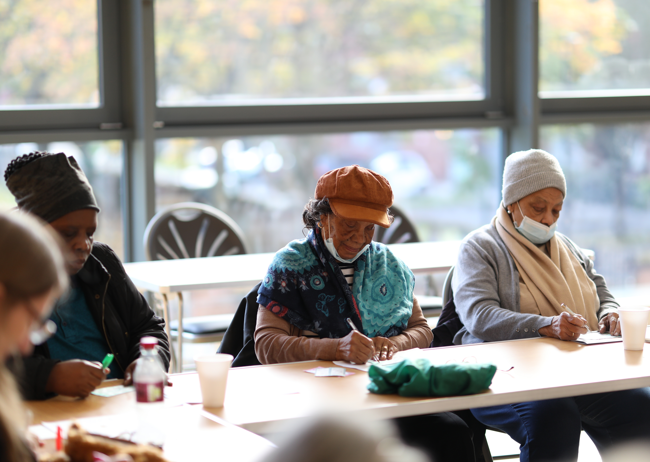
Learning and reporting
Image credit:
James O. Jenkins/
Help On Your Doorstep
Notes:
You know that both funders and charities/social organisations exist to make a difference. To do this both need time, data and intelligence to support their efforts to reflect, learn and improve. The flow of reporting from charities to their funders should make a positive contribution to these efforts. But too often it sucks energy, is disproportionate, burdensome and unhelpful… requirements that are poorly aligned with charities needs and funders frustrated by overly positive accounts of progress and performance.
Grant reports generally serve one or more of three main purposes.
Accountability – ‘What have you done with this money?’ This first level of reporting is concerned with compliance, providing assurance to trustees that a foundation’s resources are being used responsibly and in line with the terms of the grant. If funders start from a position of confidence in their own application and assessment processes and in the integrity and skills of the charities they are supporting, the responsibilities of good stewardship can be exercised very lightly. Funders are not auditors. And the trustees of the charities they support have their own duties of responsible management under charity law.
Impact – ‘What has been achieved? Everyone cares about making a difference. But foundations are far from uniform in their understanding of what impact looks like, whose impact they are judging and what they want to know about it. Some are concerned with tangible outputs – the number of activities provided, the number of people reached and so on. Some want to understand direct outcomes from the work – the short-term changes that it has delivered or contributed to. Others are concerned with impact in its formal sense – the progress that is being made towards longer-term systemic change (of which the work they are supporting is usually a very small part). Each makes different demands on funded organisations and calls for different behaviours from funders in agreeing, realistic and meaningful reporting agendas with them.
Learning – ‘What can you tell us that will help us to do a better job?’ A commitment to more flexible, lighter-touch reporting does not mean Open & Trusting funders are giving up their responsibility to make purposeful, intelligence informed decisions about strategy and practice. But it does mean they are not ‘pushing down the responsibility for “Are we doing a good job?” to the people we are funding’. Rather, they are taking responsibility for thinking deeply about what they need to understand in order to improve their contribution to the complex ecosystem they inhabit – of being a partner in the process of social change, respecting the expertise and intelligence of the organisations they support rather than setting and imposing rigid agendas and sharing what they have learned. Within this framing, reports from funded organisations may make a valuable contribution to the ‘basket of different type of intelligence’ that they need to support judgements about ‘what next?’, as well as adding value to the organisations that produce them

Slide 17
How do we use this moment as a catalyst … to shift the relationship between funders and funded organisations?

Slide 18
It's very important to consider the burden we are placing on organisations. We also need to think about who benefits most from certain processes.

Slide 19
It’s conceptualising risk as all about potential abuse of funds which creates our insatiable appetite for information gathering. But our starting point should be the risk of the money not supporting the difference we want to make.

Slide 20
What can funders do to make reporting more useful, relational and meaningful?
1. Be respectful
4. Be more flexible about timing and method for reporting
2. Be clearer and more transparent
3. Be useful to both
Notes:
We asked charities what funders can do to improve grant reporting – how to make it useful and meaningful for all. They raise five key messages:
Be respectful: Respect the demands on beneficiaries. Heavy reliance on project funding means that charity monitoring and evaluation systems have to speak to many different funder targets and outcomes. This makes them cumbersome for operational staff and volunteers and frustrating for beneficiaries, who often feel ‘assessed to death’. Funders could look for overall performance of an organisation not just their funded bit
Be clearer and more transparent: What you are asking for and why. Explain it. harities need funders to be upfront about what they expect from the work and how they judge success. This means being clear about when you are monitoring performance OR interested in learning about challenges and progress. And they want to know what funders do with their reports.
Be useful to both. Charities have many funders. Their different demands and requirements too often force charities to focus on ‘what the funder wants’ at the expense of ‘what our organisation needs’. It makes a big difference when funders take account of this wider context in determining their own reporting needs
Be more flexible about how and when reports are made: Funders can reduce inefficiencies by tailoring their reporting dates with charities’ own cycles. But a greater willingness to share control of the reporting agenda is needed. Particularly when communicating progress and impact, charities can feel constrained by traditional reporting methods and by having to translate their activities, outcomes or the experience of beneficiaries into ‘funder language.’ Having more choice about how and when to report helps the process add value to charities rather than simply taking up time.
Clarity and transparency
Funders explain why they have awarded/ not awarded a grant.
Funders only ask for the information they need and use, and question whether they need bespoke reporting.
Funders give feedback on any grant reporting they receive, and share their thoughts on the progress of the work.
Funders describe what they do with the information they obtain from funded organisations.
Funders are clear about the type of relationship they would like to have with funded organisations which enables funded organisations to make informed judgements about how best to manage it.
All information provided by funders is written in a simple, accessible and non-jargon way.
Utility
Funders ask at application stage for funded organisations to express a preference for monitoring and reporting format. e.g. written, conversation, collective conversation, storytelling, video, visits, sharing reports that are produced for other funders, or a combination
Funders provide more choice about when to submit reports to support the process rather than simply taking up time.
Funders gather learning about the direct experience of delivering funded work through conversations.
Funders take responsibility to assess the monitoring and reporting data to inform how they want to support/ respond to this. Funders set up groups to analyse the collated monitoring and reporting information in order to spot trends to inform how funders want to support/respond to these.
Proportionate
Micro grants do not require any reporting.
Small grants only require a short report and accounts.
For all of core funding grants funders only require the organisation’s annual report and accounts.
When funders ask for more detailed monitoring and reporting, funded organisations are offered additional costs in recognition of the time that it takes to administer.
Respect / being human
Funders ask funded organisations to review their reporting practice/ process.
Funders encourage monitoring and reporting to be focused on learning, what works and what doesn’t, rather than driven by accountability.
Funders create an open forum for funded organisations to share learning with their peers as well as feedbacking any learning from their overarching assessment of monitoring and reporting information.

Slide 21

How might greater empathy and alignment between learning staff and boards support long lasting change?
Image credit: Melissa Hogan
Notes:
Traditional ways of collecting and reporting data have to evolve. But this is creating some anxiety, especially when it comes to trustee expectations and the shift in roles required for working in an emergent and complex environment: [to quote] ‘If you accept [that] the degree of uncertainty is relatively permanent, then your own expectations of what can be achieved through funding need to be framed in that different context’. Changes in data collection and reporting require the shifting of certain expectations and roles, especially in relation to trustees.
At board level, established habits around reporting and learning may no longer feel fit for purpose. Concerns centre around:
Making the case for more diversity of data: [to quote] ‘We want to use the resources in the local area – and partners are producing stuff all the time. But none of it is quite what the board wants. We don’t want to go out and ask questions that we already know the answers to – so how do we collate all this informal learning into something that trustees recognise as valid?’.
Achieving alignment about ‘what we can learn’: [to quote] ‘We’re not so much learning about outcomes, but about what can be accomplished. And that can be difficult with some trustees. So much of this does come back to the appetite of trustees to see stories of contribution and achievement as being valuable, useful and worthwhile’.
Learning staff have a central role to play here, translating and presenting data in a way that is useful for trustees, while at the same time encouraging them to spend less time looking at performance against projected outcomes and more time thinking about ‘so what and what now’. This is ‘not something that can be done by stealth’, but rather by understanding trustees’ motivations and capacity, and what they want to learn about and why. It may also call for simple, honest discussion about the new realities: [to quote] ‘Speaking truth to power and telling your trustees that, actually, the things they're expecting from you are no longer possible or realistic’ .
From our conversations with foundation learning staff, as well as recent work with Carnegie UK Trust and The Robertson Trust, three things stand out as being essential for boards committed to putting learning at the heart of a foundation’s practice and decision-making.
First, developing a shared understanding of what we mean by learning. This is especially important given the tendency of boards to default to a focus on narrow, quantifiable matters, and steer away from more open-ended, reflective conversations. When we talk about ‘learning’ at IVAR, we are talking about the process of collecting and converting many types of data – formal evaluations, individual reflections, research, impact studies, statistics, qualitative and quantitative outcome data, case studies, structured surveys, partner feedback and more – into usable lessons and insights that will enable us to make intelligent and evidence-informed decisions about how to be more effective in a complex environment, and thus to make the best possible contribution. Good learning is not a product, or set of information: it is a transformation in thinking and action.
Second, embracing the concept of ‘strategic learning’. For trustees, the concept can help to reconcile concerns about a possible tension between ‘formal governance’ and ‘learning’ – a familiar tension, often predicated on two unhelpful notions. First, that learning is, somehow, a ‘nice to have’ luxury and, second, that governance is exclusively about oversight and monitoring. Recognising that the development and guidance of strategy is at the heart of a board’s governance function can help trustees adjust their focus towards strategic learning, enabling them and staff to approach complex work with a spirit of curiosity and adaptation.
Third, creating new routines and conversations in board meetings. To enable this transformation, boards need to develop clarity about – and perhaps a separation between – ‘the oversight space’ and the ‘learning space’ (although, ideally, there is a virtuous circle created between the two).

Slide 22
Table discussion: 15 minutes
What would it take to make your reporting and learning processes:
    More respectful
    Clearer and more transparent
    Useful to both funders AND charities
    More flexible (i.e. about how and when reports are made)
What role does risk play in your thinking here? What concerns you most and why?
In the current context (uncertainty, volatility, instability), could you take more risks and how?
Each group to feedback three actions.

