Slide 1
Smarter giving in turbulent times
Yorkshire Funders 2022 Conference
Danielle Walker Palmour
Director
Friends Provident Foundation
15/06/2022

Slide 2
Friends Provident Foundation
Based in York
Whole of UK funder
“Fair Economy, Better World” – creating a fair and sustainable economic system

Slide 3
Friends Provident Foundation
Redesigning and rebalancing the economy
System change:
Monetary policy – Bank of England Citizens Panels
Changing economics education: in UK now US
Net zero energy transition
Local economies:
Our Zero Selby
Community energy England
Wessex Community Assets: making ownership real

Slide 4
The problem

Slide 5
3 areas of concern
Diversity:
o 92% of foundation trustees are White.
o Men outnumber women 2:1 as trustees.
o 60% of trustees are over 65 years old.
o Two thirds of foundation trustees are recruited informally by board members
Transparency and accountability
Of more than 10,000 charitable foundations in the UK (ACF, 2020) only 225 publish on 360 Giving;
Many foundations have not discussed to whom or what they are accountable. Beyond legal requirements (Charity Commission).
Effectiveness is grounded in Transparency & Accountability

Slide 6
A labour of love & frustration..
The Foundation Practice Rating
To improve UK grant-making foundations’ diversity, accountability & transparency, by creating an independent, public framework to assess practice and incentivise change.
Hence funded by 10 UK grant-making foundations

Slide 7
Three principles
Perspective of the prospective applicant
Publicly available material only – website or charity regulator information.
Time limit for collecting data
Rating NOT a ranking
Absolute, it doesn’t measure foundations relative to one another
All foundations could end up in the top rank.
Objectivity
Existing definitions used from the literature
Exemptions for non-relevant criteria

Slide 8
What we have done
Rated 100 UK grant-making foundations on their diversity, accountability & transparency.
Used only publicly available information.
Foundations have no control over the sampling, research or rating processes.
Developed criteria: derived from external good practice standards, thus minimising subjectivity.
Consulted the wider sector testing criteria & amending

Slide 9
Our method
All foundations were assessed using the same criteria – where a criterion was not applicable, the fdn was exempted from it (e.g. reporting pay gaps)
Sample =
Top 5 largest UK grant-making trusts
The 10 funding foundations
Random stratified sample of the largest ~300 grant-making foundations by grant-value + community foundations.

Slide 10
Findings

Slide 11
(in no particular order)
Wellcome, £27 billion
Blagrave Trust, £42 million
County Durham Community Fdn, £23 million

Slide 12
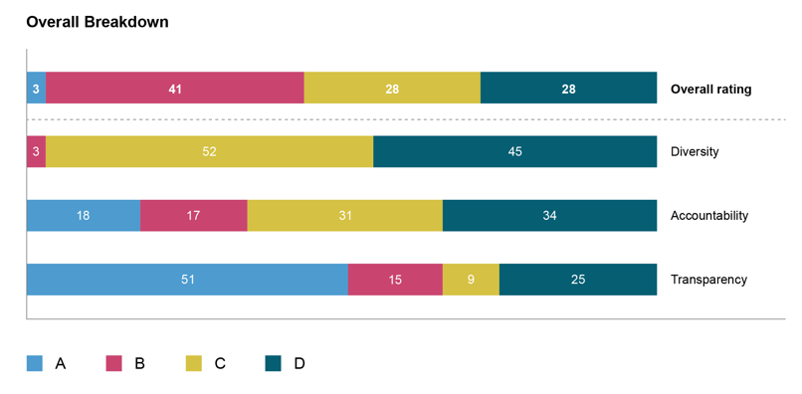

Slide 13
Three key findings
1. Every criterion is present in at least one foundation: no criterion is impossible
2. Diversity is the weakest pillarLowest overall score
Most of the lowest-scoring criteria are about diversity
3. No relationship to overall score with foundation size by giving budget

Slide 14
Other findings
‘Do as I say not as I do’
Many foundations require complaints procedures for their grantees but do not have them themselves
Many foundations require grantees to commit to paying a Living Wage, but do not report that they do so themselves
Many foundations require grantees to consult with the communities that they serve but provide no evidence that they do so themselves

Slide 15
Examples of good practice
An appeals process for rejected applicants
Website accessibility tools, equipped with ReciteMe software
Good complaints policy including how it will respond and a confidentiality statement
Impact report containing good analysis of effectiveness
Pay gap data provided for a relatively small foundation
Clear evidence provided for how it would increase type/ range of grants from effectiveness analysis
County Durham
Community Fdn
Lankelly Chase
Islamic Aid
National Gardens
Scheme Charitable
Trust
Barrow Cadbury
Trust
Clergy Support
Trust

Slide 16
Conclusions
Fdns have much work to do on all three areas, particularly diversity / accessibility
There is some good work going on that isn’t disclosed publicly. That pulls some scores down – and will confuse / deter some prospective applicants
More foundations should have diversity plans – esp. with targets – and report the diversity of their staff and boards
Most foundations could be much more accessible
E.g., most have few ways to contact them, and present their information in only one or two ways
Many fdn websites could be much clearer and easier to navigate

Slide 17
Key recommendations for improvement
Get a website!
And ensure that it’s clear
Have multiple ways to contact you, e.g., British Sign Language,
text relay
Disclose diversity of your staff (if >50 staff members)
Disclose diversity of your board (if >10 trustees)
Have & disclose a plan for improving (maintaining?) diversity, incl. targets
Do things yourself that you ask others to do
These are actions related to the criteria. Clearly there are many others related more directly to effectiveness.

Slide 18
Smarter funding…
Give beneficiaries the information to make good choices about if and how to apply

Slide 19
Help your foundation serve more of the community, more accessibly and transparently
Enable
Enable people to get in touch in multiple ways – email, phone
Tell
Tell people what has been funded in a transparent way – 360 Giving, a grants list on your website
Disclose
Disclose your diversity, your targets & other steps to improve it
Encourage
Encourage a culture of openness about diversity – DEI data standard and the Funders Alliance for Race Equality have excellent resources.

