Slide 1
Yorkshire Funders 2022 Conference
What does the future hold for investments & the growing importance of ESG
15th June 2022
David Ellis, Governance & ESG Integration
Oliver Jones Davies – Client Investment Director

Slide 2
Agenda
Market Overview
Everyone is talking about Sustainability, but what is it?
What matters to you?
Asking the right questions of your manager
Impact of legislation
Discussion

Slide 3
Market outlook
Market volatility can be expected to continue as investors react to economic and monetary policy news and to unpredictable developments surrounding the war in Ukraine.
Inflation should peak in late 2022, but is likely to remain above target rates for some time. Consumer and business costs will remain above levels seen before the current spike, even after the rate of price increases begins to decline.
The major western central banks – the US Federal Reserve, the Bank of England and the ECB – will continue to tighten monetary policy by reducing their asset holdings and raising interest rates.
The pace of tightening will be influenced by emerging economic data. The stronger US economy will allow the Fed to tighten faster and further than others. Eurozone and UK economies are at greater risk of recession.
Divergence in interest rates will contribute to currency movement, with the US dollar likely to continue to strengthen relative to sterling and the euro.
The outlook for bonds remains weak as rising yields put downward pressure on valuations.
Although we expect returns to be more muted than in recent years, for long-term investors we continue to favour selective allocations to risk assets: equities, alternatives and property.
We retain our focus on quality, growth, valuation and sustainability. Companies with lower exposure to rising costs, which have pricing power and strong balance sheets remain well placed.
EXPIRED
DRAFT
Source: CCLA as at May 2022.
The market review, analysis, and any projections contained in this document represent the house view and should not be relied upon to form the basis of any investment decisions.
Notes:
Compliance approved 18 May 2022: MAR002938

Slide 4
COIF Charities investment fund
Asset allocation
Dynamic approach
Willing to take robust strategic views e.g. zero fixed interest holdings
Use of alternative asset types providing contractual cashflows
Doctors’ surgeries
Sustainable energy
EXPIRED
DRAFT
Overseas Equity | %
North America | 44.55
Europe ex UK | 14.41
Asia Pacific ex Japan | 3.61
Japan | 0.75
Other | 0.81
Total: | 64.13
Source CCLA, as at 31 March 2022. Asset allocation is subject to change.
Infrastructure and operating assets refers to investments that facilitate the functioning of society with the potential for steady cash flows
(e.g. energy-related and social).
Contractual assets refers to investments that generate contracted cash flows over a specific period and are typically secured against assets.
Notes:
SUB-TOPIC 2: INVESTMENT APPROACH Slide 2
Key best practice features
Title and Strapline giving overall message of slide
Effective graphic and uncluttered content
Delivery guidance
This slide demonstrates the point made on the previous slide i.e. you are not bound by a conventional benchmark (or comparator). You understand the importance of diversification but seek out alternative sources of contractual income in order to avoid locking in low returns on mainstream fixed interest securities.

Slide 5
COIF charities investment fund – equity positioning
Sector allocation (%)
Diversified technology portfolio with exposure to several key global trends including digital payments, cloud adoption & semiconductor content. CCLA prioritises established businesses with strong FCF generation and reasonable valuations. Examples include Mastercard & Microsoft.
In financials, a preference for market infrastructure businesses and alternative asset managers alongside selective banking exposure. Examples include S&P Global & Partners Group.
The healthcare portfolio favours life science & medical equipment business with clear long term growth drivers. Examples include Danaher & Agilent.
Within industrials we prefer high quality professional services business with high recurring revenue, alongside niche capital goods business over deep cyclicals. Examples include Relx & TransUnion.
In consumer discretionary we have exposure to high quality consumer facing businesses where there is limited risk of disruption. Examples include Nike and Intercontinental Hotels.
EXPIRED
DRAFT
Source CCLA as at 31 March 2022.
*Equity comparator – 75% MSCI World Index.
Sector allocation is subject to change.
The market review, analysis, and any projections contained in this slide represent the house view and should not be relied upon to form the basis of any investment decisions. Past performance is not a reliable indicator for future results.

Slide 6
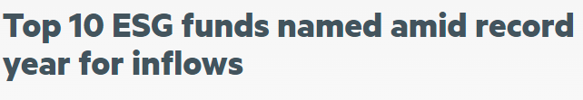

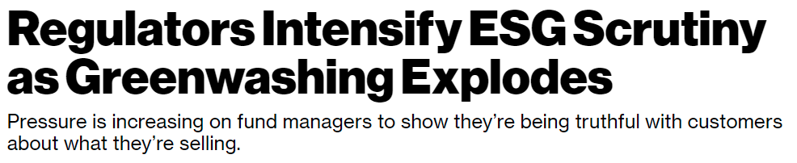
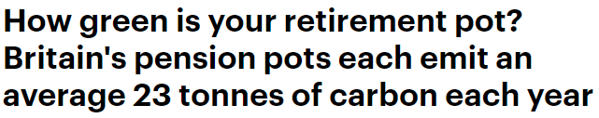
The jargon jungle is getting thicker …
Interest has increased, among:
Investors
Fund managers
Regulators
Campaigners
So have jargon
and confusion!
Source: Financial Times 20 October 2020, The Guardian 11 December 2013, Bloomberg 1 September 2021, This Is Money 26 July 2021, Financial Times 26 July 2020

Slide 7
GETTING TO KNOW YOU
Sustainability:
Ethical and responsible investment policies are very important to us
We just want to avoid risks to our reputation
We avoid constraints because they can result in weaker performance

Slide 8
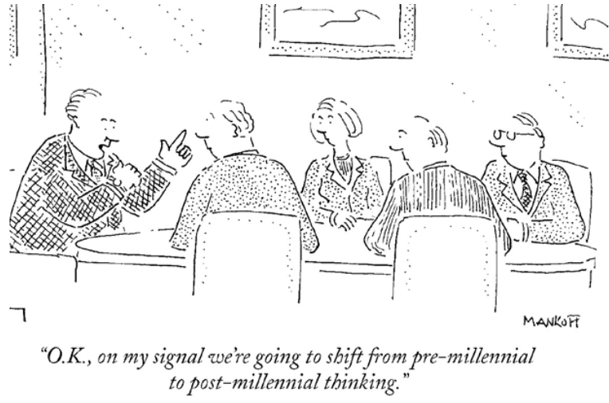
THE ESG EXPLOSION
‘ESG investing’ has moved from the margins to the mainstream
  Everyone is talking about it
  $35 trillion, globally, is managed in ESG Funds*.
  Bloomberg are estimating that this will exceed $50 trillion by 2050
Source: *Global Sustainable Investment Association via Bloomberg
Notes:
Context of why we are giving this presentation. No longer ignore it. Big in market, big in charity market especially.
Get on top of this because the charity commission will do something to alther this at some point.

Slide 9
WHAT MATTERS TO YOUR ORGANISATION?
Trustees are expected to consider ethical and responsible investment when reviewing policy, but what are the priorities for your organisation?
Reputational risk?
  Screening out investments that would conflict with your objectives
Portfolio resilience?
  Incorporating ESG risks in investment decision-making
Driving real world change?
  Harnessing the power of asset ownership to influence policy and behaviour

Slide 10
SUSTAINABLE Investment – complementary approaches
Everyone should be
doing this
Responsible Stewardship
Ethical Restrictions
Meaningful engagement
Voting
ESG
Resilience
Environmental risks
Social implications
Alignment
Screening
Governance ratings
  Good managers
  will be doing this
This is about alignment with YOUR organisation’s mission and values

Slide 11
ASKING THE RIGHT QUESTIONS
How confident can you be that a particular manager, portfolio or fund will behave as you expect?
Reputational risk
  Screening out activities that would conflict with your objectives
  If applying screens, make sure they are applied consistently
    Using clearly explained criteria – focus on issues, not names
    If your portfolio includes pooled funds, do the same standards apply there?
Portfolio resilience
  Incorporating ESG risks in investment decision-making
  Does the manager have the data and processes to assess companies’ ESG standards?
  How do they use these ESG assessments in investment policy choices?
  Do portfolio managers have discretion to override ESG filters?
Driving real world change
  Harnessing the power of asset ownership to influence policy and behaviour
  Commitment and transparency in engagement priorities, activity and reporting

Slide 12
Act, Assess, Align - Our Approach to Sustainability
ACT
Because investment markets can only ever be as healthy as the environment and communities that support them.
ASSESS
Because a combination of legislation, regulation and changing societal preference will impact the most unsustainable assets.
ALIGN
Because we are the guardians, not the owners of the assets that we manage.
EXPIRED
DRAFT

Slide 13
WHAT ABOUT ‘POSITIVE INVESTMENTS’?
Investment in ‘green’ businesses or funds may be consistent with portfolio objectives
But it does not have real world impact unless new capital is involved
Example – with reference to climate change:
Approach | Portfolio Impact | Real World Impact
‘Low carbon’ portfolio | YES Increased resilience to legislation & regulation | NO Carbon intensive assets continue to exist
Engagement | NO Most engagement does not impact upon portfolio | YES Alters companies’ environmental performance
Hold existing ‘positive investments’ | YES Benefiting from environmental trends | NO Does not increase ‘environmental capacity’
Primary capital to environmental solutions | YES Provides exposure to environmental trends | YES Increases environmental capacity

Slide 14
The USA: A Contested environment
Securities and Exchange Commission
Proposal: Standardized Climate-Related Disclosures
Registrants should disclose:
the governance of climate-related risks
how climate-related risks are likely to have an impact on the business & financial statements
how climate-related risks will affect the strategy
the impact of climate-related events and transition activities on the financial statement
Scope 1 and 2 Greenhouse Gas emissions
American Legislative Exchange Council
Model Policy Protects Retirees from Politically Motivated Investment Schemes
“Every state employee should have full faith and confidence that their retirement funds are being invested for maximum growth and not being used to promote a political agenda”
Vs.

Slide 15



“Red STATEs” and esg ACTIONS
“Government entities – including pension funds – prohibited from investing with companies that ‘take any action that is intended to penalise, inflict economic harm on or limit commercial arrangements with fossil fuel firms”
“ESG Standards and scores pose a threat to individual freedoms and the US Constitution”
“This new ESG rating system is just the beginning of a new wave of judging states – and their people – not by valid financial metrics, but by the preferred political views and outcomes of a select global elite”
Riley Moore, State Treasurer, About S&P Global’s State Level ESG Rankings

Slide 16
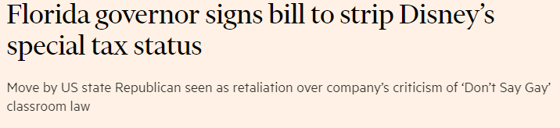
“Don’t say gay” & Walt Disney
“Disney and other woke corporations won’t get away with peddling their unchecked pressure campaigns any longer”
Ron DeSantis, Florida Governor
Florida “Don’t Say Gay’ Law bars schools from ‘instruction on sexual orientation and gender identity in lower grades and other issues that are not age appropriate or developmentally appropriate”
Bob Chapek, CEO, signed a formal statement condemning the Bill. Disney suspended political donations to DeSantis and supporters of the Bill.
New bill signed that will see Disney lose longstanding special tax status in Florida
Source: www.rubio.senate.gov

Slide 17
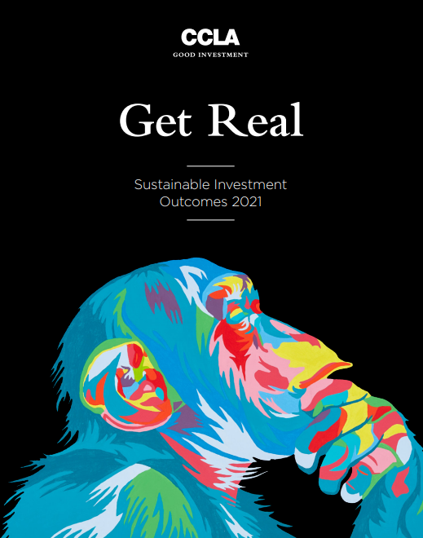
Summary
We think it is important to Get Real about Sustainability. This means:
  Driving Change to address long-term risks
  Taking steps to avoid the most unsustainable companies to boost your resilience
  Protecting your reputation by aligning your portfolio with your values
Ask your investment manager what difference sustainability really makes to their work

Slide 18
Discussion
Discussion

Slide 19
Disclaimer
This document is a financial promotion and is issued for information purposes only. It does not constitute the provision of financial, investment or other professional advice. To ensure you understand whether a CCLA product is suitable, please read the Fund Factsheet document and the Scheme Particulars/Information or Prospectus. CCLA strongly recommends you seek independent professional advice prior to investing. Investors should consider the risk factors identified in the Scheme Particulars /Information or Prospectus.
Past performance is not a reliable indicator of future results. The value of investments and the income derived from them may fall as well as rise. Investors may not get back the amount originally invested and may lose money. Any forward looking statements are based upon CCLA's current opinions, expectations and projections. CCLA undertake no obligations to update or revise these. Actual results could differ materially from those anticipated.
Investment in a CCLA managed Fund is only available to charities within the meaning of section 1(1) of the Charities Act 2011. The CCLA managed Fund is approved by the Charity Commission as a Common Investment Fund under section 24 of the Charities Act 1993 (as has been replaced by the Charities Act 2011) and is an Unregulated Collective Investment Scheme and an unauthorised Alternative Investment Fund.
The company CCLA Fund Managers Limited (registered in England & Wales No. 8735639 at Senator House, 85 Queen Victoria Street, London, EC4V 4ET) is authorised and regulated by the Financial Conduct Authority and is the manager of the COIF Charity Funds (Registered Charity Nos. 218873, 803610, 1046249, 1093084, 1121433 and 1132054).
All names, logos and brands shown in this document are the property of their respective owners and do not imply endorsement. These have been used for the purposes of this presentation only and its intended audience. This document is not for wider distribution.
For information about how we obtain and use your personal data please see our Privacy Notice at https://www.ccla.co.uk/our-policies/data-protection-privacy-notice.
Notes:
2fe8ee5f-b6ed-4fea-8f85-f71c2f67d883

Slide 20
EXPIRED
DRAFT
www.ccla.co.uk
  CCLA Investment Management Limited (registered in England No. 2183088) and CCLA Fund Managers Limited
  (registered in England No. 8735639) at registered office, Senator House, 85 Queen Victoria Street, London EC4V 4ET,
  is authorised and regulated by the Financial Conduct Authority.

