Slide 1
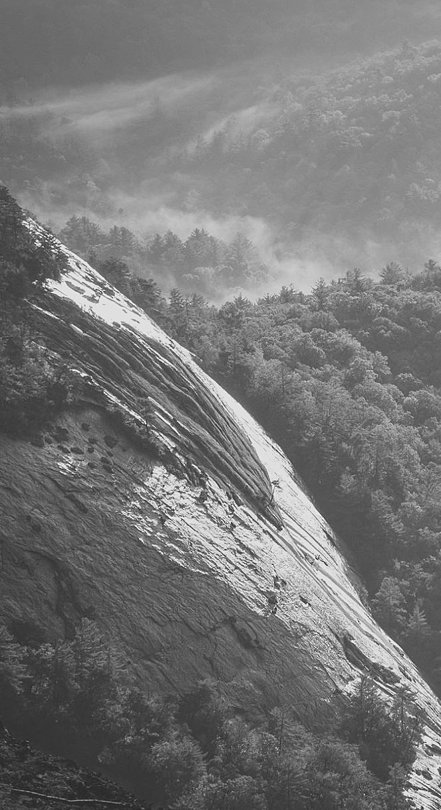
Our journey
Cathy Stancer
Lankelly Chase
2nd December 2021

Slide 2

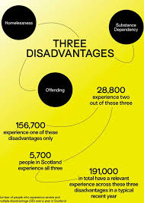

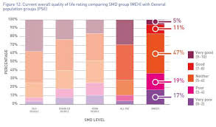

How to be a foundation promoting change v.1
(of many)…

Slide 3
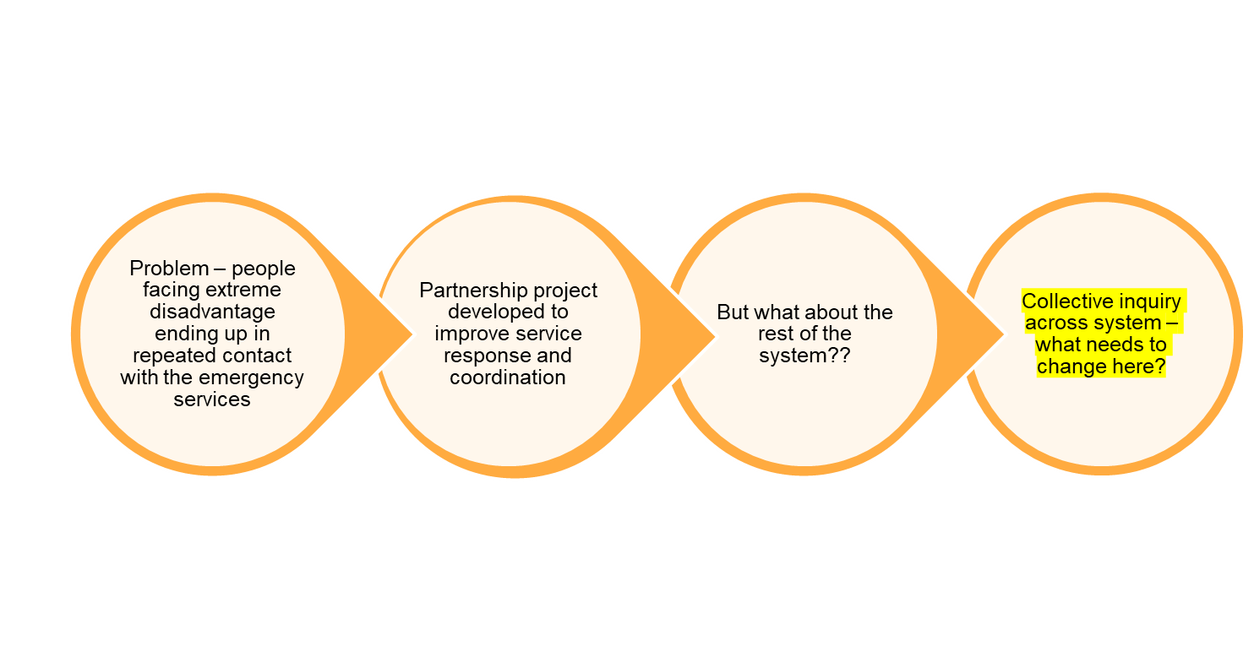
We’re not seeing the shift we wanted… a parallel example from York

Slide 4
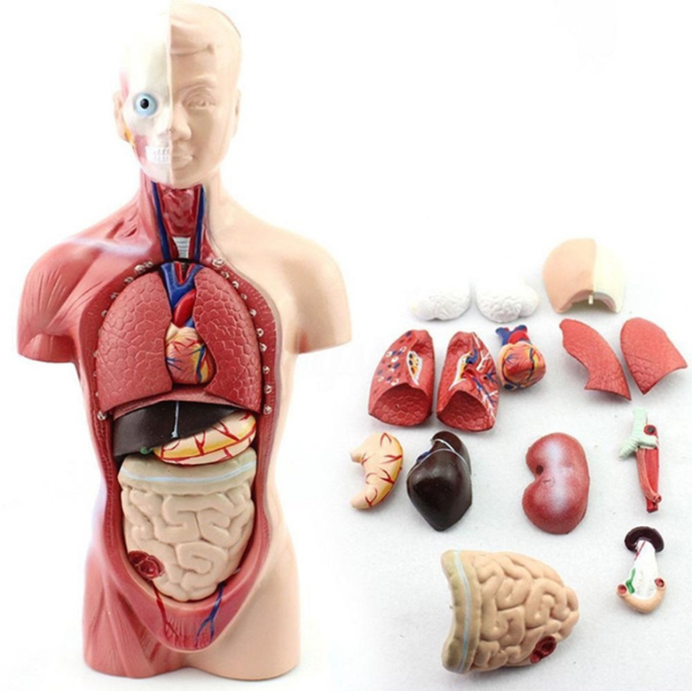
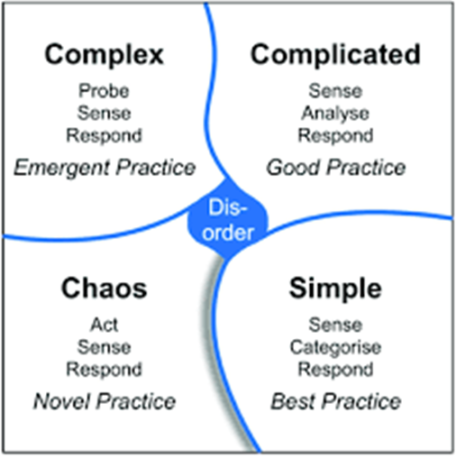
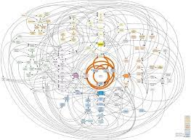







Getting used to a different way of thinking

Slide 5
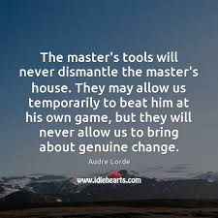
Key realisations for us…
Engage with reality as it really is
2. Accept you are part of the problem
3. Think about how to change the underlying conditions

Slide 6
Healthier underlying conditions?
Perspective
People see themselves as part of an interconnected whole
All people are viewed as resourceful and bringing strengths
There is shared purpose and vision
Power
Power is shared and equality of voice is actively promoted
Decision making is devolved
Accountability is mutual
Participation
Open, trusting relationships enable effective dialogue
Leadership is collaborative and promoted at every level
Feedback and collective learning drive adaptation

Slide 7










Some examples

Slide 8
At our best we…
Help create and hold the space for the work to happen - make sure there is an authorising environment so people can pursue what’s important to them
Put money at the service of those in the work and use it to unblock problems in an agile and tactical way
Don’t over-specify at the beginning but allow the work to unfold, driven by principles, and continual learning and adaptation
Make sure the people involved are supported and have time and space to learn and reflect together
Allowed ourselves to be led by those people closest to the work (partly by being deeply in relationship with the people involved)

Slide 9
But sometimes we get it wrong…
Confusing, messy and hard to engage with (especially as we’re continually learning and changing)
Exclusive
Unintentionally misuse power (avoidance?)
Centre ourselves
Moments of overwhelm and paralysis
Learning and adaptation critical

Slide 10
Our mission now…
Is to challenge injustice and create the conditions for much healthier systems to emerge.
We have a particular focus on those systems of oppression and injustice that result in the mental distress, violence and destitution experienced by people who are subject to marginalisation in the UK.

Slide 11
What’s next…
Going further to change our ‘business as usual’ – who has influence, who makes decisions, who is on our board and how it works, how our investments are held, how we structure ourselves as an organisation
Going deeper to understand how we individually and collectively reproduce systems of oppression
Being clearer about our commitment to the idea of justice – redistribution, control of resources and agendas, not just philanthropic benevolence

Slide 12
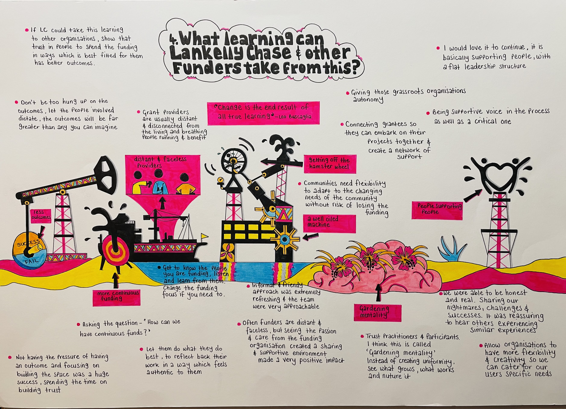

Slide 13
Some reading
A few things we’ve found useful:
- Peter Senge: The Dawn of System Leadership and The Water of Systems Change
- Explanation of structural, systemic and enabling approaches in ‘Transformations to Sustainability’
- Donella Meadows: ‘Places to Intervene in a System’ (and other work)
- ‘Embracing Complexity’ and other work by Jean Boulton
- Overview of the Cynefin Framework
- How to Organize a Children's Party | Dave Snowden – YouTube
- A Handbook on Systems Convening

