Slide 1
Poverty post-pandemic
Yorkshire Funders Forum
Katie Schmuecker, Deputy Director Policy & Partnerships
Twitter @KatieSchmuecker
2nd December 2021

Slide 2
Poverty pre-pandemic
Impact of the pandemic
The picture in Yorkshire
Questions for funders
Notes:
Introduce JRF – social change organisation with a mission to solve poverty in the UK.
Today:
Poverty pre-pandemic
Impact of the pandemic
Quick look at Yorkshire
End with a few questions from the point of view of funders

Slide 3
Poverty pre-pandemic

Slide 4
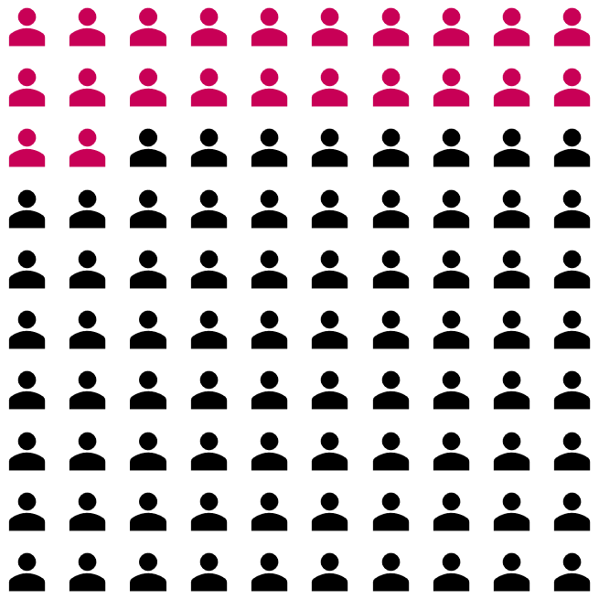
Poverty pre-pandemic
22 in every 100 people were in poverty
But big differences:
31 in every 100 children were in poverty
27 in every 100 people in a family containing a disabled person were in poverty
40 in every 100 people in households headed by someone of Black ethnicity were in poverty
Notes:
We went into the pandemic in bad shape.
2019/20 data – 22% people were in poverty overall, but big difference in risk
Children – 31%
Families containing a disabled person – 27%, 31% if you don’t count benefits for extra costs as income.
BAME – 40%, and higher still for certain ethnic groups eg Bangladehi households 55%
Overall changes have been very muted for more than 15 years, with trends since 2012/13 broadly worsening for children and pensioners (despite pensioners previously being a major success story).
And while the overall trend has been fairly static, there’s a lot of movement beneath the surface – deepening and intensification of poverty at the bottom; lots of people moving in and out of poverty in a given year as circumstances change.

Slide 5
Families with children
Who is most likely to experience child poverty?
Source: Family Resources Survey 2018/19
*These figures are three year averages for 2016/17 to 2018/19
Notes:
Focusing in on families with children, more likely to be in poverty when….
you’re a young parent
A lone parent
Children are very young
If you have a large family (3+ children)
From a BAME background
Someone in the household is disabled
Nearly half of children in lone parent families live in poverty, compared with one in four of those in couple families.
The child poverty rate for children in families with three or more children is almost twice as high as the rate for children in one or two child families (47% vs 24%). [HBAI 2019/20]

Slide 6
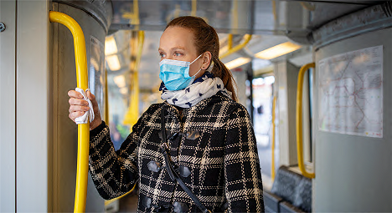
““We feel if jobs work for everyone, it will promote better health in people, both mental and physical. It will promote better relationships, at work and at home, as less stress will be taken home from work. And families will have more flexibility in their social life and be able to attend social events and enjoy themselves, creating a happy, healthy work–life balance.”
Notes:
Work and poverty

Slide 7
In-work poverty & poor job quality
Low pay, not enough hours, and high insecurity leave people exposed to in-work poverty
People on the lowest incomes are under the most pressure from insecure work.
Notes:
We all think work should be a route out. But 75% children in poverty are in a working household.
Low pay, not enough hours and high levels of insecurity leave people exposed. There have been some good things - a rising minimum wage, very recent improvements to in-work UC – but there a lack of attention to job quality and cuts to social security contributed to a decade of stagnant pay, poor productivity and rising in-work poverty.
Graph: insecure contract types. How can you plan family life and budgets when you don’t know how much or when you’re working. A particular problem for low earners – unsurprisingly occupations with higher levels of insecurity also tend to have higher in-work poverty rates (eg hospitality, retail, care)
Flexibility at work is also key, especially for parents. Take a low paid job to get flexibility you need then find yourself stuck.

Slide 8

“I'm one rent review away, one complaint away from being homeless. It's as simple as that… it's exactly how it feels… I wake up with it every day, I go to sleep with it every night.”
Notes:
Housing and poverty

Slide 9


More private renters, high poverty rates
More private renters
1998/99
2018/19
…with high rates of private renters poverty in poverty
Notes:
The combination of high housing costs in the private rented sector and falling support from Housing Benefit has created a strong current pulling low-income families into poverty. A third of children in poverty now live in the private rented sector. This has risen from 17% in 2005/6.
The proportion of households in the UK’s private rented sector has increased dramatically in the past 20 years, doubling from around 1 in 10 in 1998/99 around 1 in 5 in 2018/19. Around a third of these households were in poverty. Fewer households are renting social housing as this option is often unavailable, and fewer people are buying with a mortgage, because they can’t afford to.
Lack of social housebuilding over the past decade has meant that fewer of those who need it can access an affordable secure home in the social rented sector. Between 2010/11 and 2018/19, the number of homes built for social rent in England as a proportion of new homes fell from 33% to 3%, with just 7% of the number of social rents needed in a year built.

Slide 10
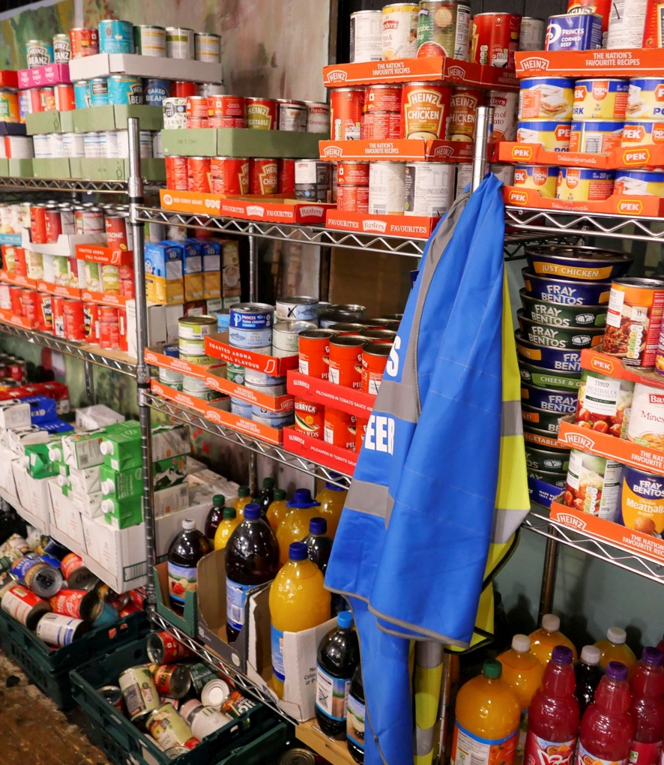
Benefits give limited protection
“Social security should allow people to be able to live, to be able to have enough to live on so we don’t have people going to foodbanks. It makes you feel degraded when you go there sometimes.”
Man at food bank, London
43% of households on UC food insecure vs 8% of UK population
24% of working-age families on income-related benefits unable to keep up with bills/regular debt payments
Over half of people in receipt of income-related benefits were in poverty and almost 2 in 5 were in deep poverty.
Almost 90% who were workless due to unemployment were in poverty and 70% in deep poverty, despite receiving benefits.
Notes:
Social security and poverty – protection is too limited as seen by the number of people PRE PANDEMIC struggling to afford enough food, getting behind with bills, experiencing poverty despite getting help from social security (especially if they’re out of work.)
The visible rise in food bank use – even before the pandemic – the most visible manifestation, but there is a growing sense of unease among the public that systems we all expect to protect us through difficult times may have become too weak.
Early in the pandemic the Government recognised that levels of social security support were not sufficient – hence the increase to UC. But the cut to UC brings the main rate of out-of-work support to its lowest level in real terms in 30 years, its lowest ever level as a proportion of average earnings. Income replacement rates in the UK remain some of the lowest among OECD countries.
[All data is DWP HBAI 2019/20. Food insecure means they don’t have enough food, or not sufficient and varied enough food to facilitate active and healthy lifestyles.]

Slide 11
Impact of the pandemic

Slide 12

“A lot of families are really struggling and getting into debt… Times are hard, food is expensive now, the cost of everything is going up.”
Notes:
Impact of the pandemic

Slide 13
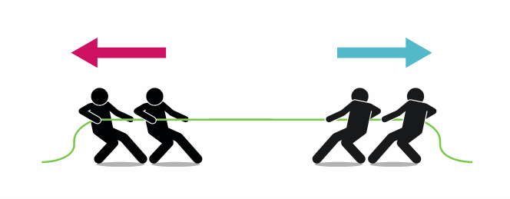
Poverty during the pandemic
Higher benefits and additional Government support​
Lower median incomes
Higher unemployment​
Lower earnings​
Notes:
What is the picture of poverty at the start of 2022, coming up to two years after a global pandemic struck? To an extent the picture is unclear: we don’t yet have official poverty data covering the pandemic period.
The coronavirus storm battered the labour market, with increasing unemployment and reducing earnings. But the Government responded with an unprecedented range of labour market support and temporary benefit increases. The Coronavirus Job Retention Scheme and Self-Employment Income Support Scheme were hugely significant and successful.
But a lot of people still took a hit to their incomes so average incomes will have fallen as benefits were boosted, meaning the rate of relative poverty may well have fallen.
And the story will look different for different parts of the population following the SR/Budget
Significant measures for people in working poverty - National Living Wage up, increases in the Universal Credit work allowance and reductions in the taper rate
No such luck for those out of work. Incomes cut by £20 if they’re on UC, faced with a government narrative about work despite disproportionately hitting people who aren’t working because they’re sick, disabled or caring for others.
We are at real risk of a two tier recovery – in addition to the above, the impact of the pandemic has layered on top of pre-existing inequalities…
Sectors that already had high rates of working poverty – like hospitality and retail – were hit hard.
Others – like care workers and taxi drivers – carried on working but put their health at risk by doing so.

Slide 14
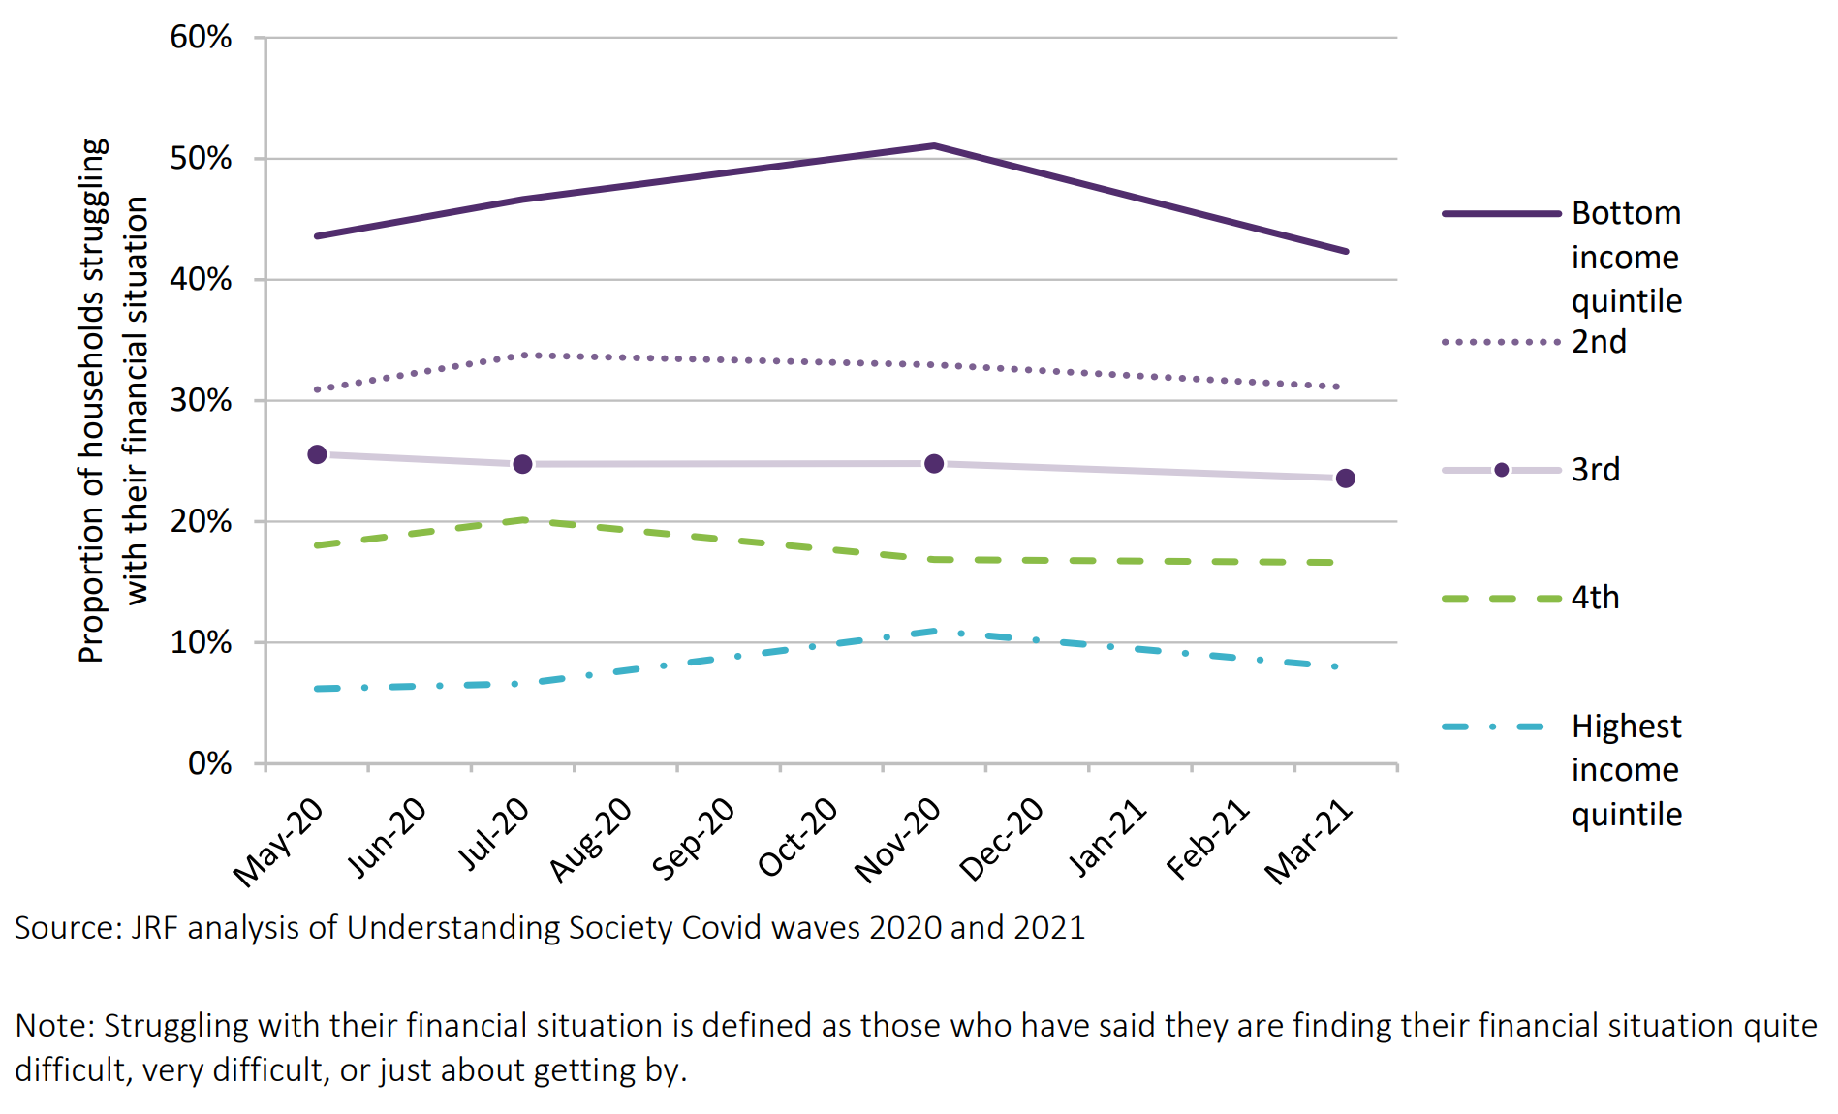
Unequal financial impacts
Low-income households were more likely to be struggling with their financial situation throughout the pandemic than higher-income households
Notes:
During the pandemic, low-income households’ financial situations have suffered far more than those on high incomes.
Working age households in the bottom 20% of incomes were almost twice as likely to have seen a fall in earnings than the top 20% (27% of households compared to 14%)
Graph - Bottom 20% much more likely to say they were finding their financial situation quite difficult, very difficult or just about getting by, peaking at over ½ in November 2020.

Slide 15
Debt overhang
3.8 million
% of low-income households in arrears
33%
11%
Pre-pandemic (2019/20)
Post-pandemic (Sep/Oct 2021)
Notes:
Unsurprisingly this has manifested in a significant debt over hang.
Better off households: forced savings and asset values increased
Worst off households: ran down saving, got behind on bills and built up debt.
This autumn: 3.8 million low-income households (33%) in some form of household arrears, and 4.4 million low-income households (38%) have taken on new borrowing or increased their existing borrowing during the pandemic. There is significant overlap between these two groups [69% HH taken on new or increased lending during the pandemic are also in arrears].
A large majority (87%) of low-income households now behind with their bills report they were always or often able to pay all their bills in full and on time before the pandemic, underlining the pandemic’s extraordinary hit to household balance sheets.
Many of these households are behind on multiple types of bills, and debts owed to the state feature heavily for those in multiple kinds of debt.
[Findings from a JRF large-scale study of households on low incomes (the bottom 40% of equivalised household income) conducted in September/October 2021]

Slide 16
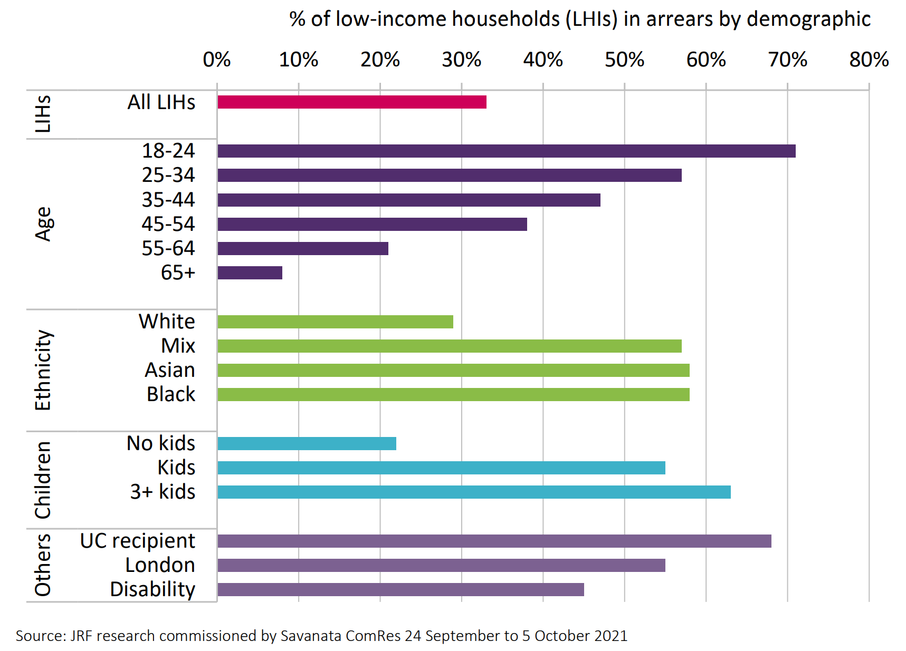
Unequal debt overhang
Households are disproportionately more likely to be in arrears if they are young, BAME, have children in their household, live in London and are a UC recipient
Notes:
Looking among low income households, some were more exposed than other:
Working age people in general, young people in particular
BAME
People with children
UC recipients
Londoners
Disabled people
Deeply concerning given the current cost of living pressures – cold and hunger this winter

Slide 17
The picture in Yorkshire
Notes:
High rate of poverty in the region – generally a couple of ppts above the UK and English average.
1/4 overall;
1/3 children;
23% w/a adults – so nearly 1/4
18% pensioners - getting on for 1/5

Slide 18
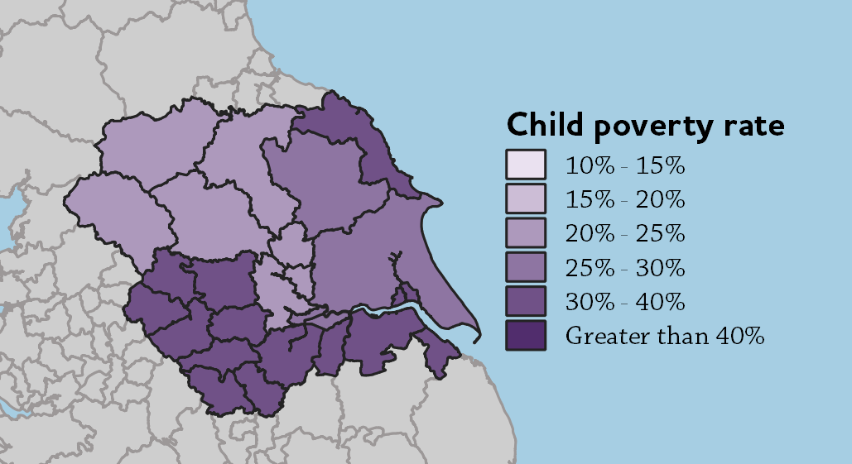
Child poverty rates in Yorkshire
Notes:
Local authority map – no where is in the >40% category (although Bradford came close!)
Bradford - 38
Hull, Kirklees, Sheffield - 36
Leeds, NE Lincs, Doncaster - 35

Slide 19
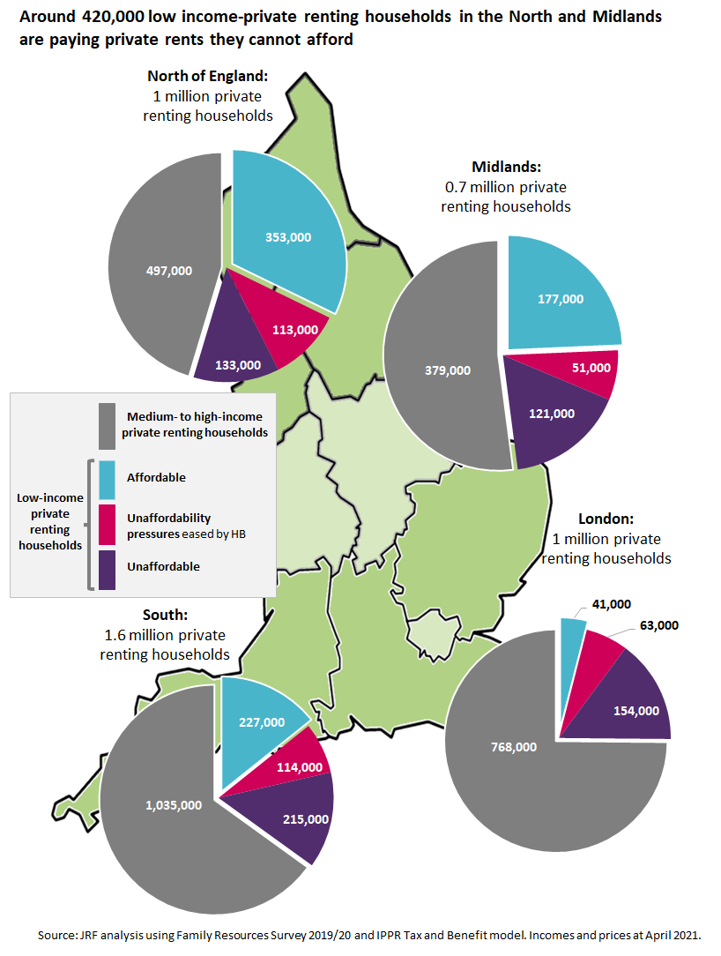
PRS affordability in Yorkshire
Notes:
We’re quite accustomed to talking about the labour market challenges that contribute to this picture, but perhaps talk abut housing pressure less frequently. Housing costs aren’t just an issue in the Greater South East
Colour segments = proportion of people in each region that are low income >> highest in the North
Pink and purple segments = low income and affordability pressure / unaffordable >> not as big in the North, but still significant.

Slide 20
Areas for change

Slide 21
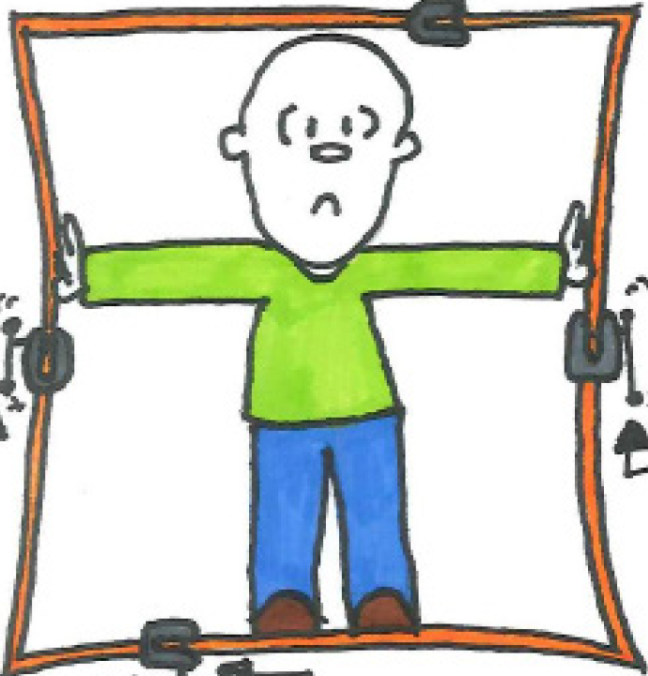
Drivers of economic insecurity and pressure
Expensive housing
Inadequate social security and financial support
Low paid insecure work
Relationships and family pressures
Notes:
We have seen that families and households face a squeeze from a range of pressures that limit their options and trap them in economic insecurity.
Key pressures we focus on here are:
The interaction between relationships, material resources and financial pressures
Low paid and insecure work
An increasingly threadbare social security lifeline
Expensive housing
Thinking about person and family centred services that prevent poverty and destitution and support people to build firm foundations to move on when things do go wrong.

Slide 22
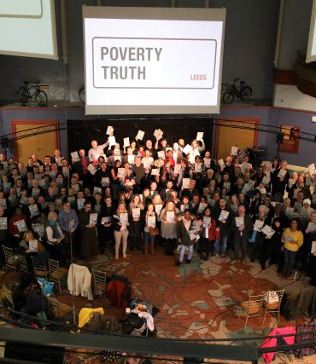
Questions for funders
How to share power?
Palliative, remedial or preventative?
Change in the here and now or longer term radical shift?
Notes:
Not going to tell you what to fund (!) but 3 questions to think about:
Sharing power: are we drawing on all the expertise available to understand problems and think about solutions? JRHT’s York Committee has an Advisory Group of people with experience of poverty who review a select grant applications, offering their advice and guidance to the Committee to help with their decision-making. There are lots of other models that could be used.
2 & 3. What sort of responses are you funding? No right answers here but between us we should be delivering a mix.

Slide 23
Thank you!
Katie Schmuecker, Deputy Director Policy & Partnerships
Joseph Rowntree Foundation

