Slide 1
Risk – Due Diligence vs. Flexibility’
Yorkshire Funders Forum, 20th October 2021
Ben Cairns

Slide 2
Workshop Outline
Part One: Context: what we’ve been through, where that leaves us, and what can help (15 minutes)
Part Two: Thinking about risk: appetite, anxiety, action (35 minutes)
Part Three: Balancing flexibility with demand with budgets (35 minutes)

Slide 3
What we’ve been through and where that leaves us
Five key pressures that voluntary organisations have faced:
Funding
Increasing/changing demand
Going online
The welfare of staff and volunteers
Leadership

Slide 4
What we’ve been through and where that leaves us
Where we are right now
‘It feels like we are at the tipping point of burn out, and our organisation is on a knife edge.’
‘There is a powder keg – of stress and depletion and running on empty – that is ready to explode.’
‘It’s a question of when, not if, the financial squeeze comes.’
‘A story of extraordinary resilience and adaptation.’
‘Learning from the crisis will stand us well in the future.’

Slide 5
What can help us to flourish and thrive
Four things that have helped organisations cope
Collaboration
Taking care of staff and volunteers
Embed joined-up working.
Ensure networks and trust established survive in the face of new challenges.
Inventive ways to support teams.
Providing spaces to unload.
The importance of this is not going away.
Discovering new ways to connect
Responsible, supportive funders
Pay careful attention to blended services and ways of working.
Digital exclusion also needs to be tackled nationally.
How might progressive practice from funders be sustained?

Slide 6
What funders can do now to make a real difference and how we can support this
A tipping point?
Funding relationships need not be an ordeal
Funder commitments
There is no rule that stipulates that applicants or funded organisations should feel anxious, trying to second guess what is expected of them.
80 foundations – of all sizes across the UK – have signed up to 8 commitments to make life easier and fairer and less burdensome for applicants.
Philanthropy’s role:
‘Philanthropy's primary role is to fund, support, and advocate for the nonprofits and communities doing the hard work of making our communities and our society better. The more we let go in that role, the more others can lead. The more we let others in, the better our ideas and relationships become. That’s how we go from making incremental gains to quantum leaps.’

Slide 7
Grantees’ work – as well as funders’ – became better as they shifted into relationships built on trust, openness, and respect for the distinct expertise and know-how of charities that are tightly connected and accountable to their communities.

Slide 8
8 open and trusting commitments
1. Don’t waste time
2. Ask relevant questions
3. Accept risk
4. Act with urgency
5. Be open
6. Enable flexibility
7. Communicate with purpose
8. Be proportionate
View our campaign page: https://www.ivar.org.uk/flexible-funders/
Join the conversation: #FlexibleFunders

Slide 9
What funders can do now to make a real difference and how we can support this
Three danger signs
Changing the norm
Timing
This movement calls for change in the bureaucratic requirements that have become the norm across the sector.
Actual change lags behind the rhetoric.
Shifting power
A trusting relationship between funders and charities is ultimately about shifting power, not shifting paperwork.

Slide 10
It's very important to consider the burden we are placing on organisations. We also need to think about who benefits most from certain processes.

Slide 11
It’s conceptualising risk as all about potential abuse of funds which creates our insatiable appetite for information gathering. But our starting point should be the risk of the money not supporting the difference we want to make.

Slide 12
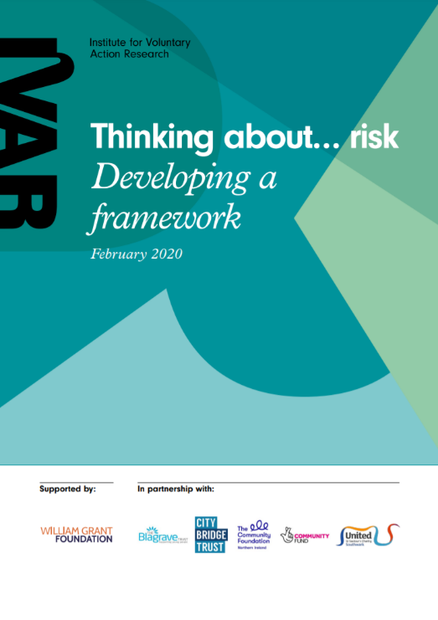
Thinking about risk
The framework encourages funders to think about risk in relation to:
Attitude to innovation
Expertise
Clarity and certainty of outcome
Data
Capacity and capability
Financial risk
Public Opinion
Read more: https://www.ivar.org.uk/our-research/funders-and-funding/thinking-about-risk/

Slide 13
Thinking about risk
Read more: https://www.ivar.org.uk/our-research/funders-and-funding/thinking-about-risk/

Slide 14
In pairs, for 15 minutes
Discuss the IVAR Risk Framework:
When you think about risk within your foundation, what matters/concerns you most, and why?
How does that translate into your processes?
In the current context (uncertainty, volatility, instability), could you take more risks and, if so, how?

Slide 15
We make small grants and give generic guidance. But, in practice, we do have priorities depending on what we’ve funded and what we’re learning about need in the community. So, we’ve started to add a sentence to our guidance to say: “in times of high demand we prioritise applications that do x, y, z”. That’s helped, as it’s made us feel like we’re not having a conversation behind closed doors and gives us language to tell people why they’re not accepted.

Slide 16
It may be a minor reason – for example, some other situations just felt more urgent. But it’s important to treat them like adults and tell them the truth.
I came to this role “from the other side” and have always tried to give more feedback. It can be difficult as you don’t want to hurt people’s feelings. Sometimes it’s well received and other times not. But it is useful – and important.

Slide 17
In groups of three, for 15 minutes
Think about the tension between flexibility, demand and budgets:
What are the obstacles to being more flexible?
What could you do to overcome them?
Each group to feedback three actions.

