Slide 1
Financial information for decision making
Stephanie Dunnill
Two Ridings Community Foundation
Notes:
Good morning
Thank you for inviting me to join this meeting
Finance Manager at Two Ridings
also former Finance Manager of a frontline advice charity
former trustee of 2 charities.
Try to bring those perspectives to inform our thinking.

Slide 2
‘People are at the heart of what we do’
Relationships with stakeholders & applicants are key
Aim is to support people making a difference in their local communities
Want to help people access our funding
Help organisations present their application to give them the best chance of success
Better decision making for the funder
Better outcomes for the applicant
Notes:
Start by explaining our approach
Similar to many others in the room
Want to help
Not looking to trip people up
Help people to make clear, well planned applications

Slide 3
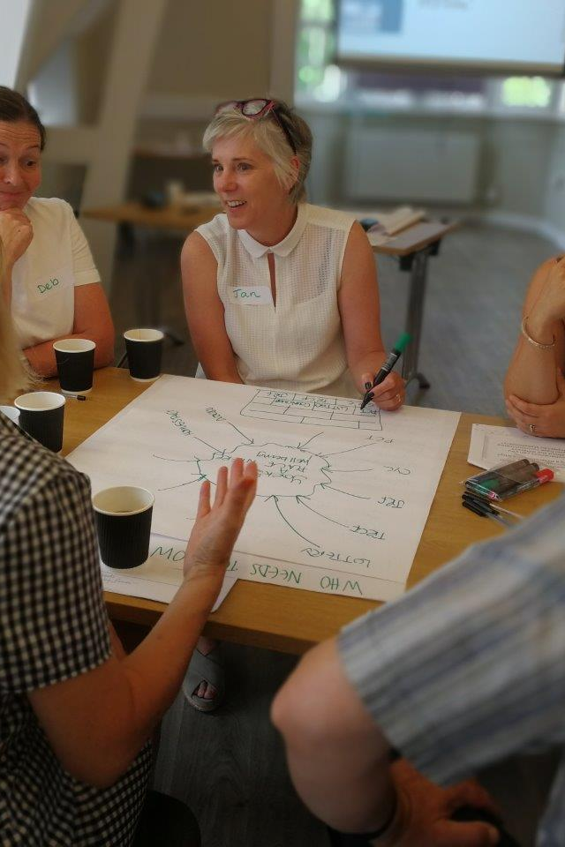
Pre pandemic….
Funding workshops – grants and finance support
Hints and tips for applicants on preparing a project budget
Guidance on full cost recovery
Notes:
Before we come to this year I just wanted to rewind to Pre pandemic
A few years ago we started working more closely with groups…
We welcome a ‘Full cost recovery’ approach
Costs of overheads are shared across all their projects/activities
We provide a worked example
Keep it simple - avoid time consuming or over complicated allocation methods

Slide 4
Finance Hints & Tips for Applicants
Planning & Preparation
  Check organisations eligibility & criteria for the fund
    Eg turnover thresholds, or excludes capital costs
  Check that the budget reflects the narrative in the project bid
    Especially if more than one person is involved in the application
  Show funders that their grant will make a difference
    For small grants consider identifying a specific part of a larger project
Identify costs
  Include all costs
    Salary on costs (employer NI and pension)
    Full cost recovery – a share of organisation overheads
    Make sure estimates are reasonable – research or get quotes
    One off start up costs
Notes:
These are some of the Hints and Tips that we would provide for groups

Slide 5
Finance Hints & Tips for Applicants
Submitting application
  Check budget adds up
  Annual Accounts & Trustees Annual Report
    Opportunity to showcase what they do and explain about anything unusual
Afterwards
  Many grants are restricted funds – so only spend as agreed
  If circumstances change – let us know
  End of grant monitoring – stories & case studies
  Keep in touch

Slide 6
2021 - Where are we now?
Huge demand – 3 fold increase in grant making
Flexibility about use of existing grants and timescales
Straightforward application process
More emphasis on supporting core costs
Light touch monitoring and reporting
Aim to be responsive, flexible and light touch
Notes:
So back to the present
Along with most other funders we’ve adapted what we do to support frontline groups

Slide 7
Decision making issues in current climate
Limited funding – difficult decisions
Annual accounts backward looking and out of date
  But can still provide useful indicators…..
  Income & Expenditure showing net surplus or deficit
  Track record compared with previous year
  Cash at bank
  How much do they owe (Creditors)
  How much is owed to them (Debtors)
  Reserves – unrestricted funds – ‘free’ reserves
  Notes to the accounts - can be source of useful additional detail
  Trustees Annual Report
          Details of reserves policy
          Future plans
          Explanations of unusual activity
  Audit report
Notes:
Demand has been huge and the further on we go the harder the funding decisions
In many cases groups are telling us that the funding issues are less about this year and more the funding impact in this coming year
Our appeal funds become more limited so need to prioritise and take difficult decisions.
In the past the key financial information is annual accounts

Slide 8
Decision making issues
Some of our funds were aimed at supporting groups at most risk due to the pandemic
  Needed to be able to assess risk and prioritise
  Help those in most need
  Make a difference to their sustainability
Other government funding had onerous clawback clauses and evidence requirements
  So also needed to identify strong, well managed groups
Looking for current and forward looking financial information to aid decision making
Notes:
For many of our quick response grants we’ve taken a light touch but for some funds we needed more information;
York small charities, Harrogate Local fund
Aimed at groups that are struggling for survival
Balance – want to help those in most need but also need to know that funds will make a difference in helping their sustainability
DCMS

Slide 9
Additional Financial information requested
Budget summary for current year
Latest forecast for current year
  Based on changed circumstances since the pandemic
  Including any other Coronavirus support received (grants or government support)
Levels of reserves
Cashflow
  Dependent on fund and size of grant
Notes:
For some funds we asked for additional information
Dependent on fund and size of grant
For some funds its optional but encouraged particularly where they are applying for core cost funding due to lost income.
Helps build up a picture of the group especially if they are new to us

Slide 10
Key financial information template
Name of Organisation: |  |  |  |  |  | Please complete the green cells.
 |  |  |  |  |  | ** PLEASE COMPLETE WITH FIGURES FOR YOUR WHOLE
Financial Summary |  |  |  |  |  | ORGANISATION - excluding the project you are applying for
 |  |  |  |  |  | unless it is core costs you will incur anyway**
 |  | Prior year | Last year | This year | This year | Notes
Year ending (dd/mm/yy)
 |  | Published | Draft/final | Original | Latest | ( Please use this space to explain key issues, risks or significant
 |  | Accts | Accts | Budget | Forecast | changes due to Covid19 or other reasons )
INCOME |  | £ | £ | £ | £
Grant Income
Covid19 funding | Two Ridings
(grants & gov support) | Other
Trading income
Donations/fundraising
Other Income
TOTAL INCOME |  | - | - | - | -
EXPENDITURE
Salaries (incl NI/pensions)
Rent & utilities
Other
TOTAL EXPENDITURE |  | - | - | - | -
Surplus/Deficit |  | - | - | - | -
Funds at year end
Restricted funds
Unrestricted funds
Total funds |  | - | - | - | -
Notes:
Example
Asked groups for information about their income
Grants
Coronavirus support
Contracts
Donations and fundraising
Space for notes and explanations
Costs – salaries, rent, other
Tried to keep simple

Slide 11
Cashflow Template
Name of Organisation: | Anyplace Charity
Cashflow
Please complete the green cells with your best estimate of your 'cash in' and 'cash out' over the next few months. Some lines may not be applicable to your
organisation.
** PLEASE COMPLETE WITH FIGURES FOR YOUR WHOLE ORGANISATION - excluding the project you are applying for unless it is core costs you will incur anyway**
At the bottom please add your opening bank balance at 1st April 2020. All the other cells should calculate automatically.
 | Apr - Jun 20 | Jul-20 | Aug-20 | Sep-20 | Oct-20 | Nov-20 | Dec-20 | Jan-21 | Feb-21 | Mar-21 |  | Total
 | £ | £ | £ | £ | £ | £ | £ | £ | £ | £ |  | £
INCOME
Grant Income | 8,000 | 5,000 | - | 5,000 | 1,000 | 1,000 |  | 2,500 |  | 9,000 |  | 31,500
Other Income | 2,100 | 300 | 1,100 | 700 | 1,100 | 700 | 700 | 700 | 1,600 | 600 |  | 9,600
TOTAL CASH IN | 10,100 | 5,300 | 1,100 | 5,700 | 2,100 | 1,700 | 700 | 3,200 | 1,600 | 9,600 |  | 41,100
EXPENDITURE
Salaries (incl NI/pensions) | 6,000 | 2,000 | 2,000 | 2,000 | 2,000 | 2,000 | 2,000 | 2,000 | 2,000 | 2,000 |  | 24,000
Capital Expenditure |  |  |  | 3,000 |  |  |  |  |  |  |  | 3,000
Other Costs | 3,300 | 2,500 | 1,600 | 600 | 1,900 | 500 | 500 | 2,000 | 400 | 600 |  | 13,900
TOTAL CASH OUT | 9,300 | 4,500 | 3,600 | 5,600 | 3,900 | 2,500 | 2,500 | 4,000 | 2,400 | 2,600 |  | 40,900
Movement in period | 800 | 800 | (2,500) | 100 | (1,800) | (800) | (1,800) | (800) | (800) | 7,000 |  | 200
Opening Bank Balance | 5,123 | 5,923 | 6,723 | 4,223 | 4,323 | 2,523 | 1,723 | (77) | (877) | (1,677) |  | 5,123
Closing Bank Balance | 5,923 | 6,723 | 4,223 | 4,323 | 2,523 | 1,723 | (77) | (877) | (1,677) | 5,323 |  | 5,323
Highlights how this charity is going to have cash flow difficulties in the period December - February.
Notes:
Example cashflow that we provide
Income and costs added by month
Opening bank balance
On the surface this charity looks like it is making a small surplus so could think they have nothing to worry about
Looking at cashflow highlights they are going to have cashflow difficulties in the period December – February
Enables them to take action – could change the timing of the Capital expenditure
Apply for an overdraft
Seek additional grant funding
Helps them demonstrate their case

Slide 12
What are we looking for?
Income
  How reliable are income streams – grants, contracts or fundraising
  Do they have diverse income streams or heavy reliance on a few
Expenditure
  How flexible is the cost base
  Can they adjust their spend to adapt
  Surplus/deficit on unrestricted funds
Reserves
  Level of reserves
  How many months of ‘free’ reserves
  Could group reasonably use their own reserves
Cashflow
  Any negative cash flow periods? How are they managing this?
  Realistic assumptions? Reliance on single large receipt?
Notes:
Free reserves – unrestricted funds excluding fixed assets – so only including funds that readily available
Income – grants or fundraising or income from activities that have stopped
Cost base – salaries or sessional staff

Slide 13
Benefits
Consistent format – easier to interpret
Up to date information
Latest forecast highlights groups that have lost income
…..and those that have gained from emergency grants & support
Cashflow highlights where groups have a difficulty and when it might happen
Enables groups to identify issues and make plans to address them
Enables us to prioritise need and assess risk
Notes:
Benefits of this approach
Enables assessors to prioritise and assess risk
Can see which groups are running out of funds
Assess how long they could keep going from the ending cashflow balance

Slide 14

Just one piece of the jigsaw…
High risk doesn’t necessarily exclude from a grant
Assessors comments
Knowledge of the group
The story behind the figures
Enables an informed decision
Notes:
The other pieces of the jigsaw are vital
In some cases those with the highest risk are those doing fantastic much needed work and just need a helping hand through a difficult patch
We can take a calculated and informed decision
We might mitigate the risks but still award the grant
Add in extra monitoring
Pay in instalments

Slide 15
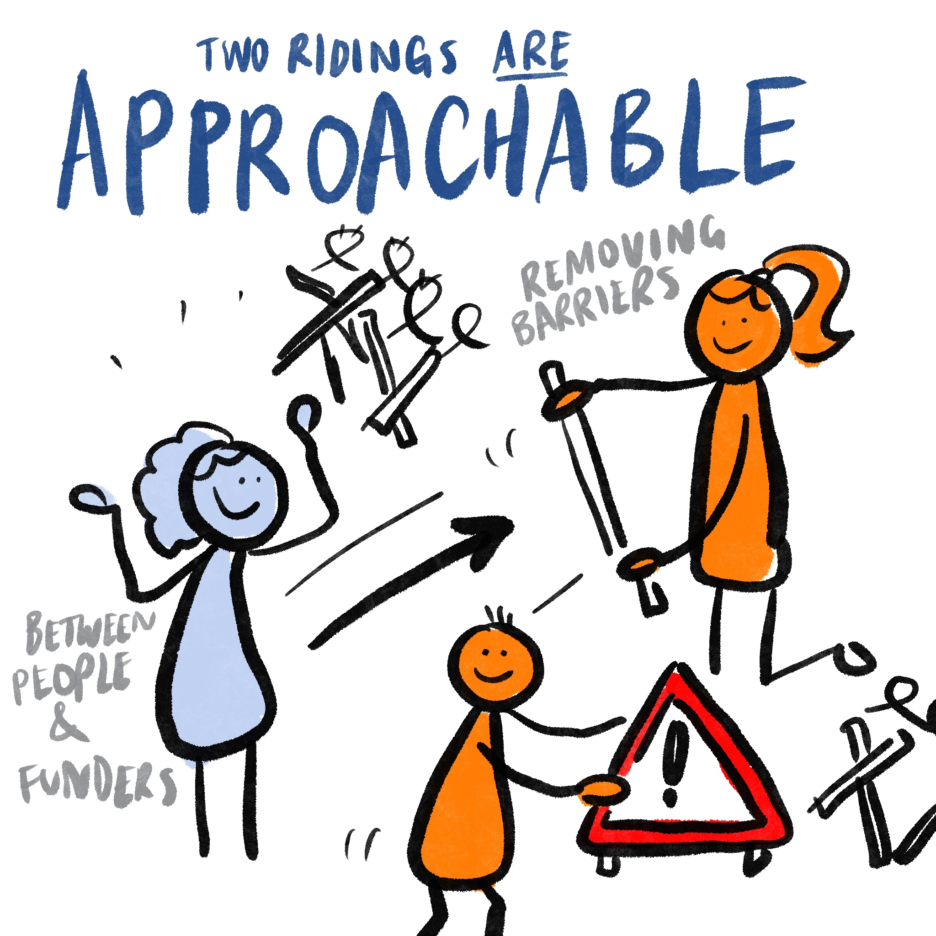
Learning and other support
Cashflow might be new for some organisations
Potential barrier for small groups – but does provide both them and us with a useful tool
Held workshops to help groups with completing forms
‘How to…’ Video presentation – useful option for website
Zoom drop ins
  Group and 1-1 Q&A
  Build relationships
  Human face to funders
No one size fits all – a useful tool for some funds but not all !
Notes:
Finally - this is not a perfect solution and we recognise that we’ve got learning to do too
Video presentation on website is a handy tool for groups who missed the workshop but also an option for funders who have limited resources – easy way to reach a lot of people
Zoom drops ins held in January were very popular and positive feedback
Representatives from Grants team and finance
So – no one size fits all – but can be a useful tool in the right places.

