Slide 1
Covid Charity Tracker Survey
Anoushka Kenley,
Pro Bono Economics
Yorkshire Funders Forum
March 2021

Slide 2
Pro Bono Economics
PBE projects
Helping charities measure, understand & communicate their impact
PBE policy
Undertaking research and policy work to inform and shape the public debate
Advice
Analysis
Advocacy
Research
Policy
Comment
Social change and wellbeing improvements

Slide 3
How PBE works with funders
Grant Plus
Direct work with funders
Advice (theory of change, what to measure & how to measure it)
Advocacy (size & scale of the problem - for campaigns)
Analysis (evaluating programme impact)
Programme design & your measurement strategy (measuring your impact, size & scale of problem, your theory of change)
Evaluating grant applications
Design a measurement framework for grantees
Review the impact of your grants (feeding into next cycle)
The level of support we offer is proportionate to the size of the grant and the organisation you’re supporting. More info at: projects@probonoeconomics.com

Slide 4
Covid Charity Tracker survey 2020/21
Pro Bono Economics has run the Covid Charity Tracker Survey since April 2020, with Charity Finance Group and the Chartered Institute of Fundraising.
The Tracker provides live insight into the impact of the crisis on charities, from client demand for their services to their own financial situation and how they are adapting to the challenge.

Slide 5
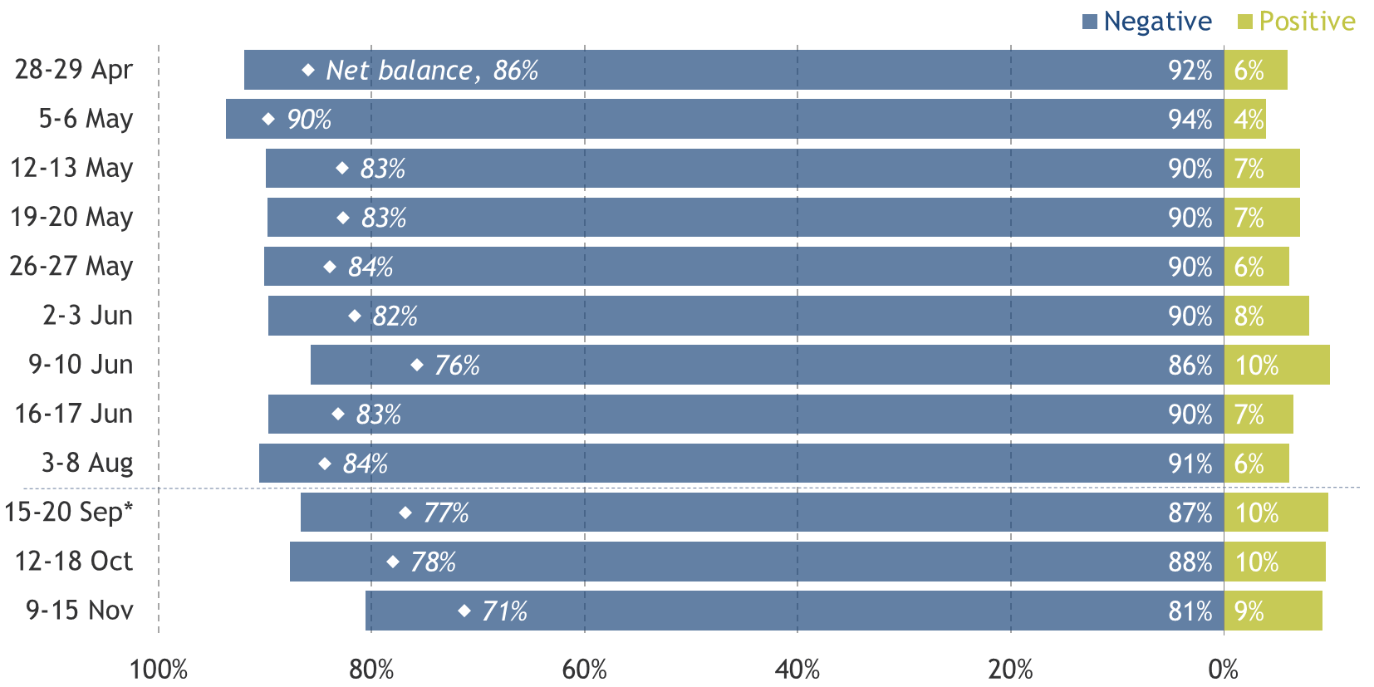
Sector pessimism didn’t shifted much over the course of 2020
How do you expect Covid to affect your charity’s ability to deliver on its objectives in the next six months?
2020
Notes: *From this point on, question refers to next twelve months. Sample size ranges from 126 to 455, and averages 279. Residual not shown covers “No impact”. Source: PBE Covid Charity Tracker survey, 2020

Slide 6
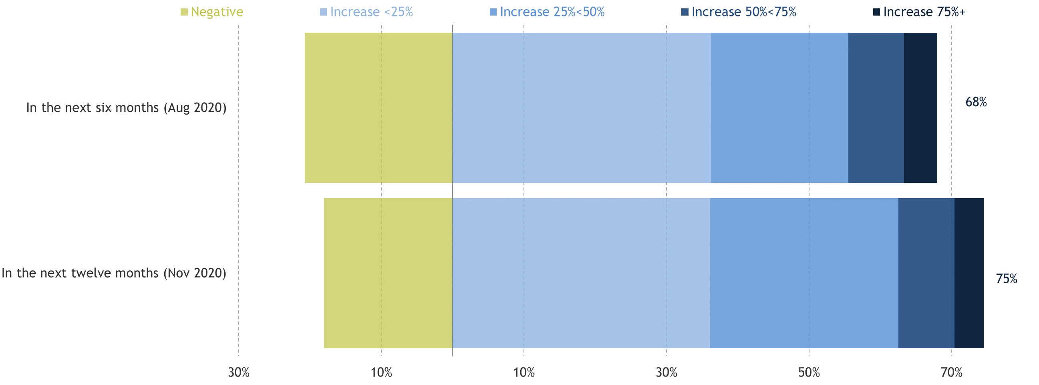
Charities expected demand for their support to increase substantially
Relative to pre-crisis expectations, what impact do you expect Covid to have on demand for your organisation’s help?
August and November 2020
Notes: 9-15 November 2020 (n = 216) and 3-7 August 2020 (n = 455). Residual is “no impact”.
Source: PBE Covid Charity Tracker survey

Slide 7
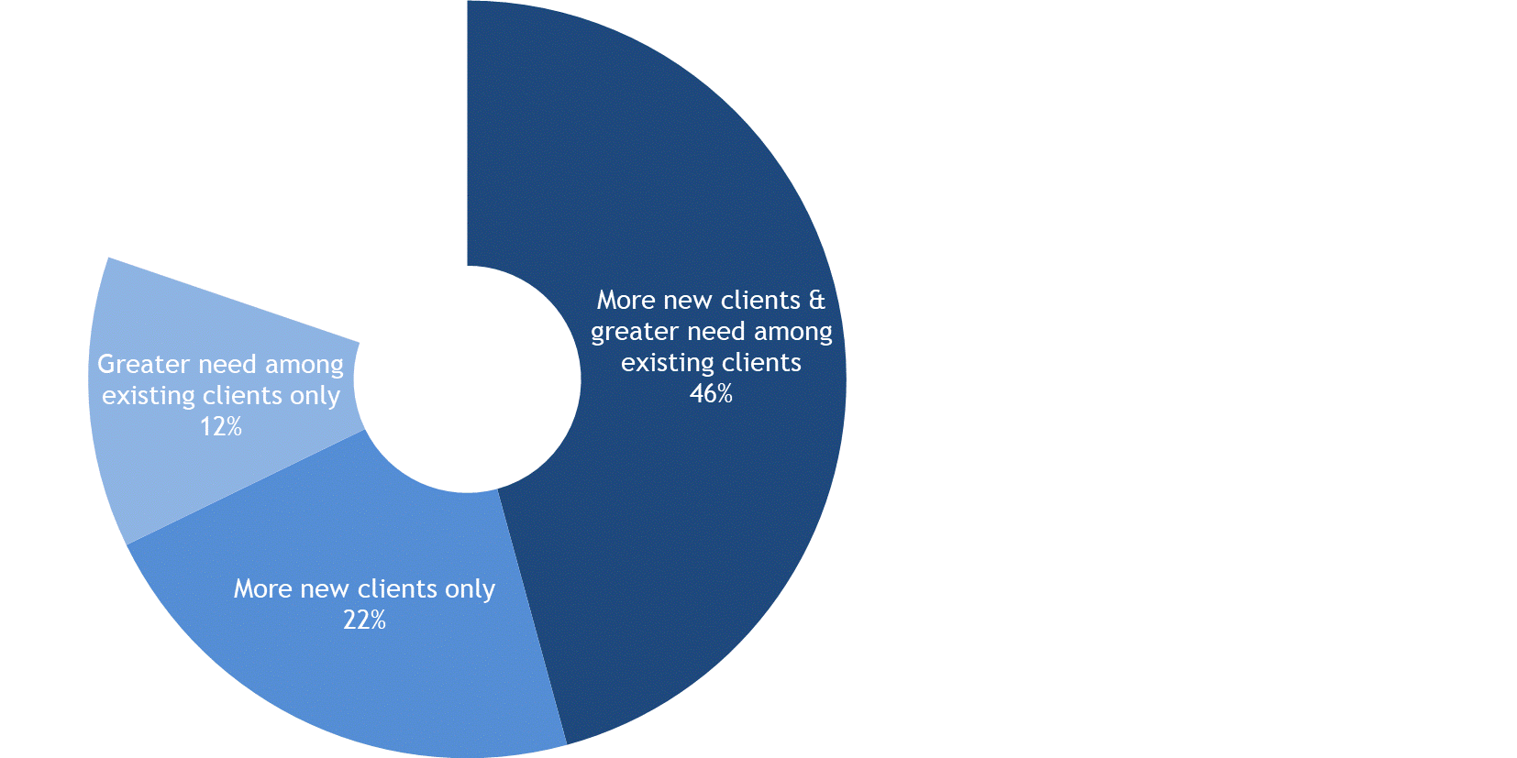
Charities have faced both new demand and more intense demand from existing clients
In the last six months, has any increase in demand for your services as a result of the Covid crisis been from…?
November 2020
Notes: Excludes charities that do not deliver frontline services to people in the UK. Residual is those reporting no increase in demand. 9-15 November 2020 (n = 216).
Source: PBE Covid Charity Tracker survey

Slide 8
They forecasted struggling to deliver their services adequately in Q1 2021
What do you expect to happen to demand for your services over the first quarter of 2021, compared to the last quarter of 2020?
January 2021
Note: Excludes “don’t know”
Source: PBE survey, 11-18 January 2021. n = 248

Slide 9
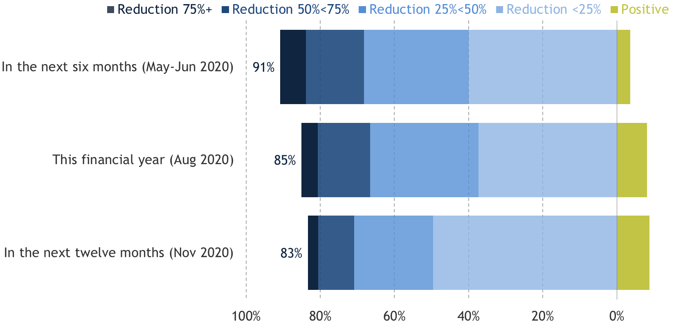
Throughout 2020, charities forecasted serious financial challenges
Relative to pre-crisis expectations, what impact do you expect Covid to have on your organisation’s income?
2020
Notes: 9-15 November 2020 (n = 216), 3-7 August 2020 (n = 455), average of surveys in May/June 2020 (cumulative responses 1,727).
Source: PBE Covid Charity Tracker survey

Slide 10
And this did play out in reality, although not to the extent forecasted
What was your total income in 2020 compared with 2019?
January 2021
Note: Residual is “about the same” and “don’t know”
Source: PBE survey, 11-18 January 2021. n = 248 of which 156 larger charities (pre-Covid annual income of £500k+) and 91 smaller (pre-Covid annual income of <£500k)

Slide 11
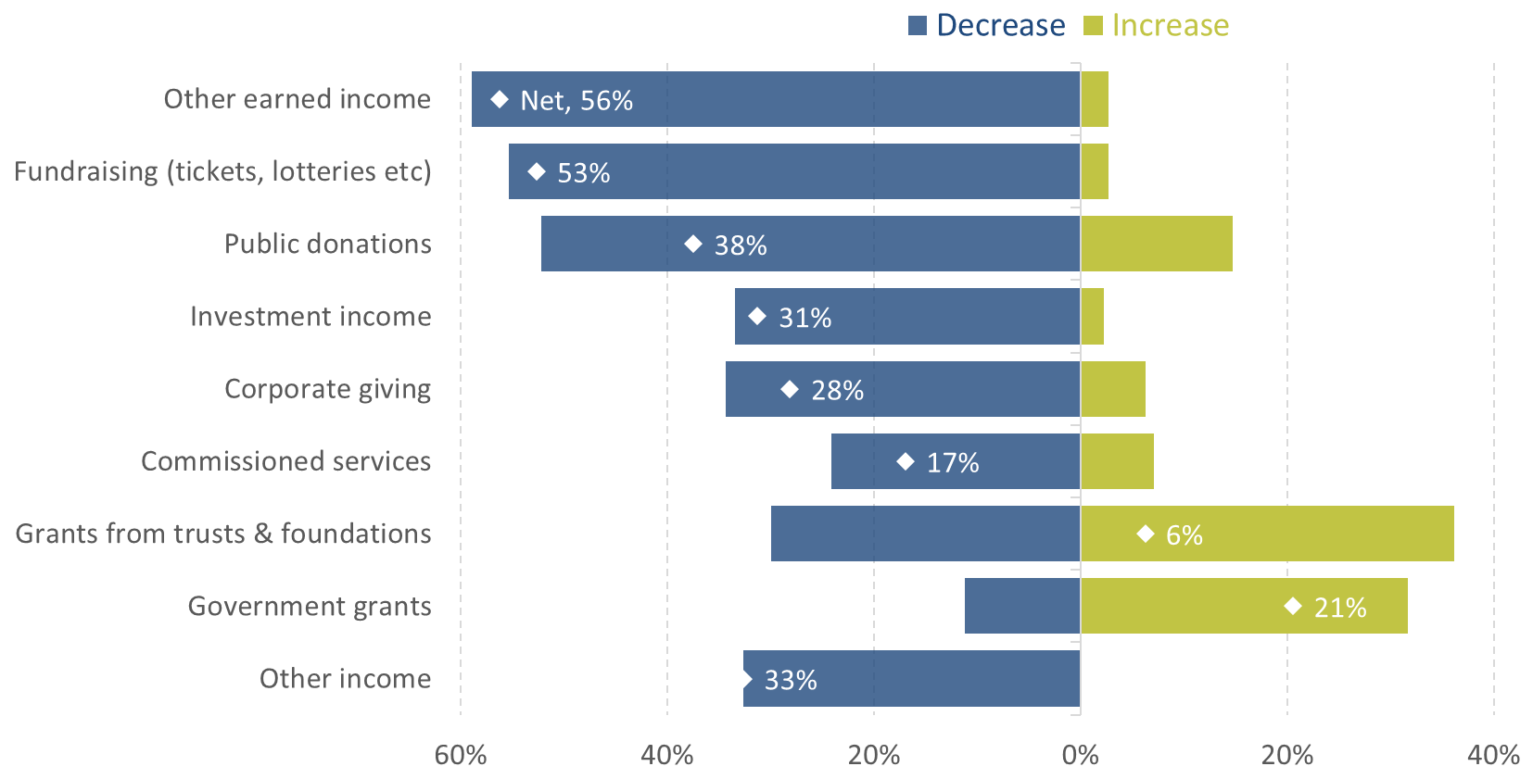
Losses were driven by reductions in a number of funding sources
How have each of these sources of income been impacted by Covid?
September 2020
Notes: n = 224. Residual not shown covers “no change” and “don't know”.
Source: PBE, Covid Charity Tracker, September 2020

Slide 12
And earned income being a particular challenge over Christmas
How much did you raise in November and December 2020 in the following activities compared to the year before? January 2021
Note: Residual is “no change”, “don’t know”, and charities which did not receive income from these sources in 2019 and 2020.
Source: PBE survey, 11-18 January 2021. n = 248

Slide 13
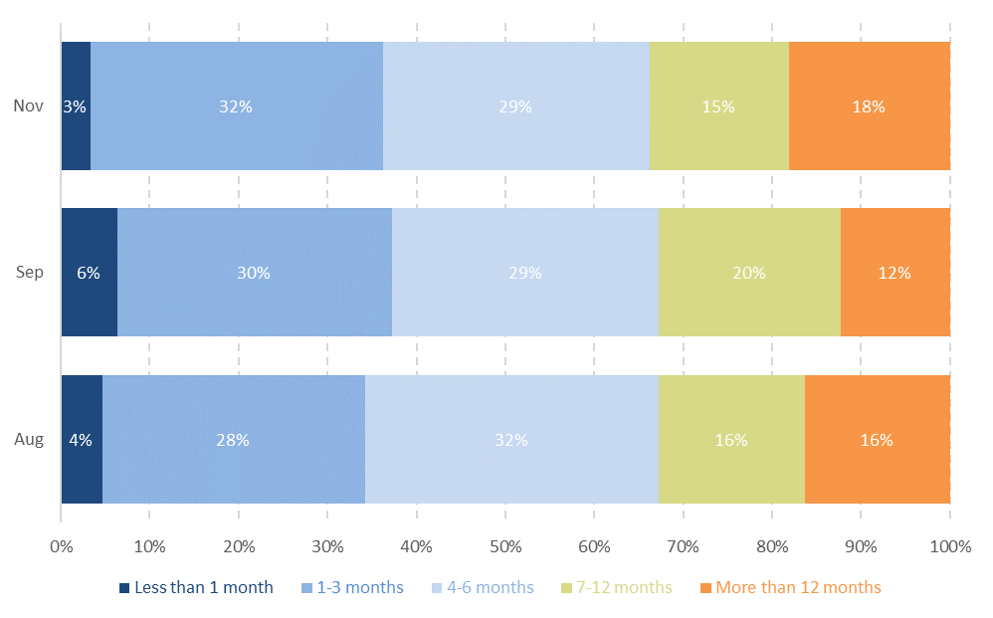
But reserves have looked broadly steady since August
How many months’ reserves do you currently hold?
(August-November 2020)
Notes: 9-15 November (n = 216), 15-20 September (n = 224), 03-07 August (n = 448). Excludes "don't know".
Source: PBE Covid Charity Tracker survey

Slide 14
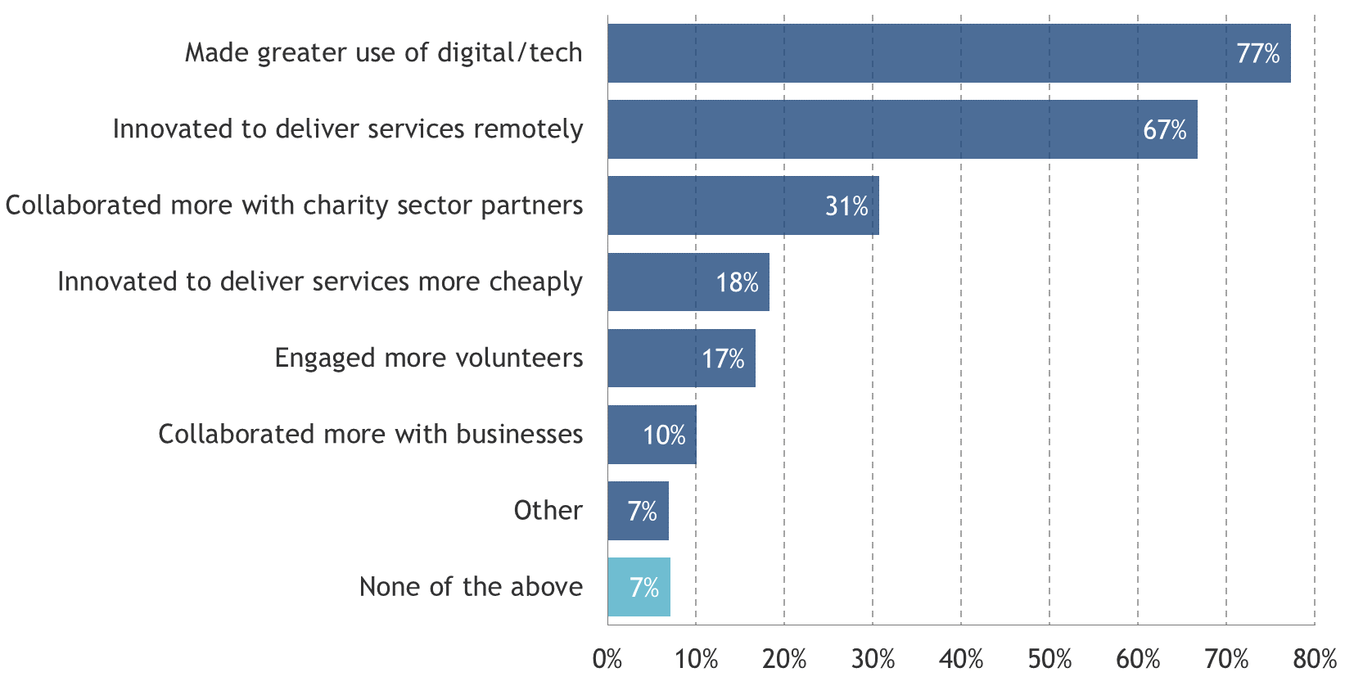
Many charities have adapted and innovated
Which of the following actions have you taken as a result of Covid-19?
August 2020
Notes: 3-7 August 2020, (n=455).
Source: PBE Covid Charity Tracker survey

Slide 15
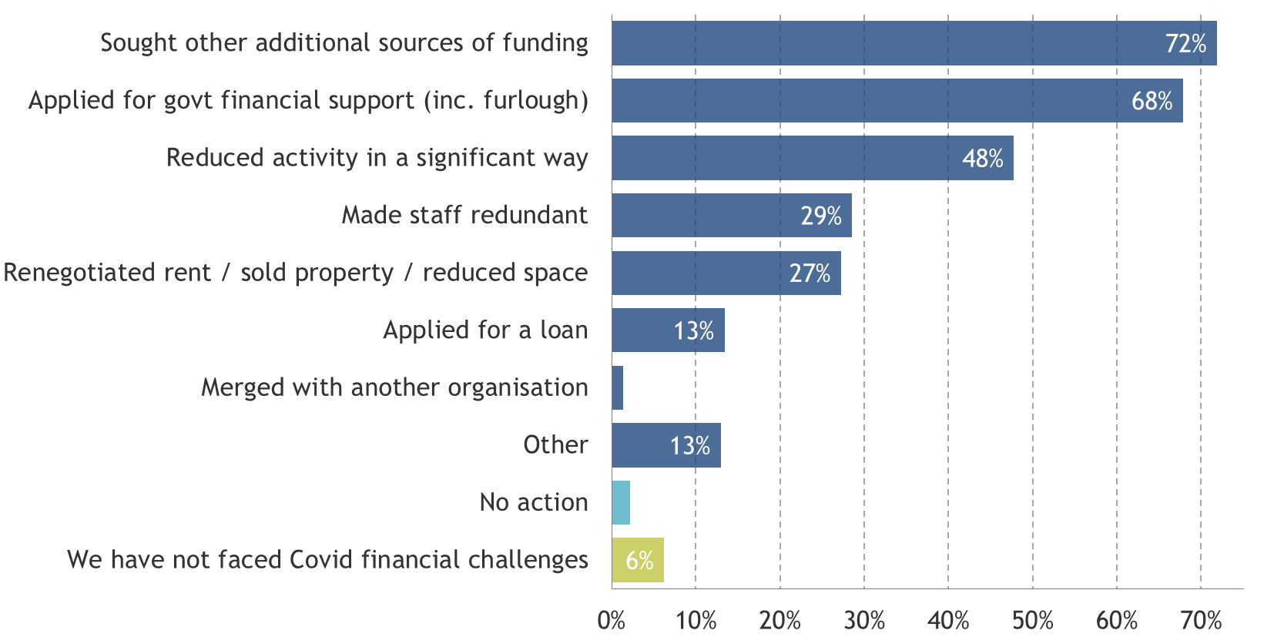
But they have had to make some tough decisions as well
What actions have you taken in response to any financial challenges presented by Covid?
September 2020
Notes: 15-20 September 2020, (n=224).
Source: PBE Covid Charity Tracker survey

Slide 16
But they have had to make some tough decisions as well
What actions have you taken in response to any financial challenges presented by Covid?
September 2020
Notes: 15-20 September 2020, (n=224).
Source: PBE Covid Charity Tracker survey

Slide 17
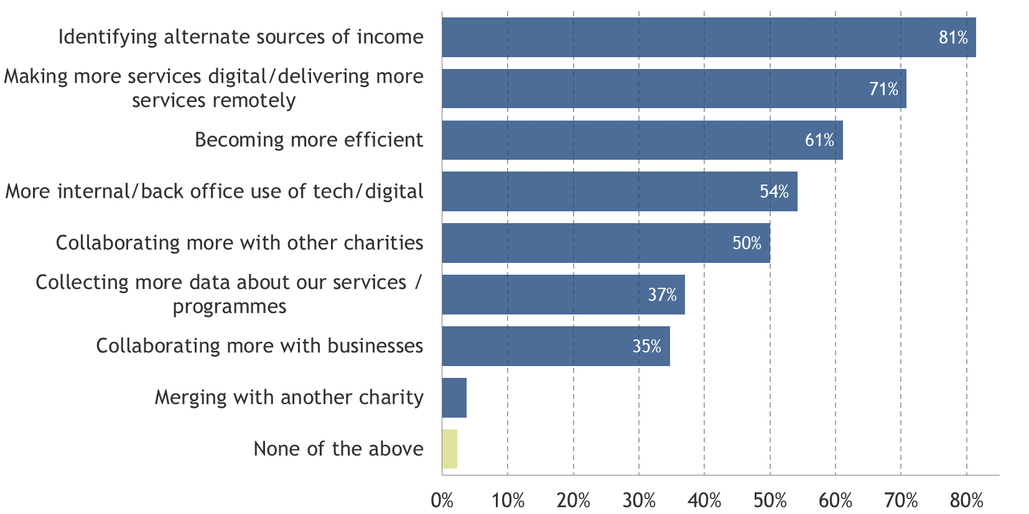
Looking forward, more changes are planned in 2021
Which changes do you want to make to your working practices over the next 12 months?
November 2020
Notes: 9-15 November 2020 (n = 216).
Source: PBE Covid Charity Tracker survey

Slide 18
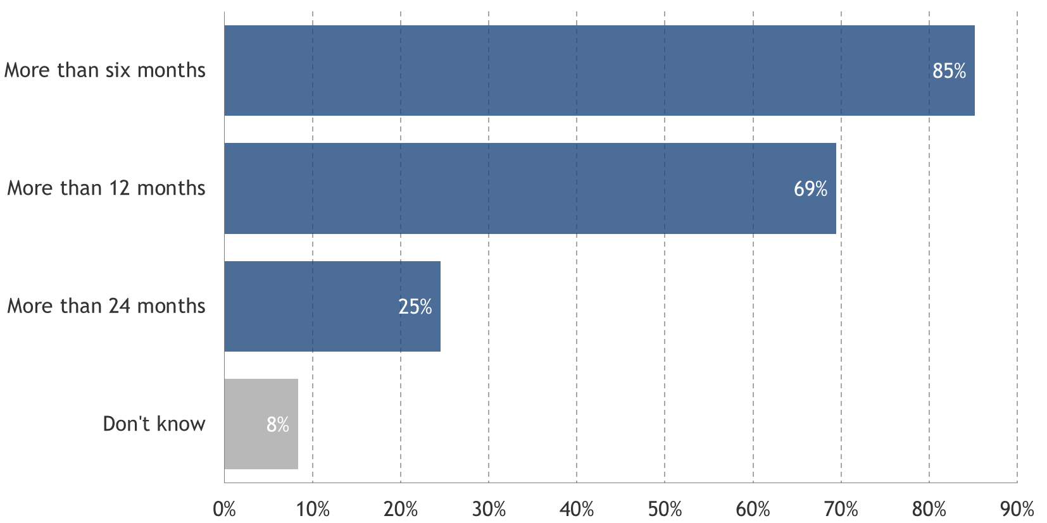
The tough times are expected to persist for some while
How long do you expect it will take your organisation to return to pre-crisis income levels?
November 2020
Notes: 9-15 November 2020 (n = 216)
Source: PBE Covid Charity Tracker survey

Slide 19
Overall, a sector under pressure
Charities are facing growing demand for their services, from new and existing clients
This growth in demand has been underpinned by a reduction in income, across many funding sources
Charities more dependent on earned income and fundraising events may be particularly hard hit
As a result, charities have had to adapt their services, including delivering more online, as well as seek alternate sources of funding
Some have also had to make reductions in their services and make staff redundant
Many are making greater use of tech and collaborating more with others
It could be 1-2 years before many are back to where they were before Covid
But we won’t know the full extent of the damage for some time

Slide 20
For more information
PBE’s Covid Charity Tracker Survey
www.probonoeconomics.com/Pages/Category/covid-19-charity-tracker-survey
Contact me: anoushka.kenley@probonoeconomics.com

