Slide 1
YORKSHIRE FUNDERS FORUM
The legal perspective - 18 November 2020
Sue Greaves and ian potter

Slide 2
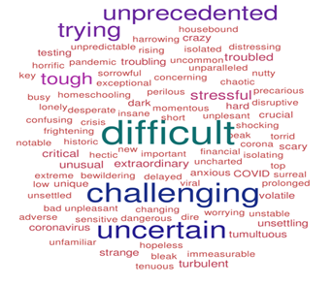
Current issues for funders and grant recipients
Unusual and unprecedented times
Immediate and short-term changes
Longer term changes – what do you keep?
Chronology of an application

Slide 3
Meetings
Decision making in a crisis!
How to best make decision in the longer-term?
What does your constitution say?
Covid-19 specific legislative provisions – Corporate Insolvency and Governance Act 2020

Slide 4
Decision-making – what are your constraints?
What CAN you do? What SHOULD you do? What do you WANT to do?
Which applications CAN you consider - legal constraints?

Slide 5
Objects
What do your objects say?
What restrictions do they contain?
You can choose to go narrower; you cannot choose to go wider
No room to make COVID exceptions

Slide 6
Duties
Trustee duty constraints
No room to make COVID exceptions

Slide 7
Policies
Often restrict or prioritise applicants
Usually set general principles, to which Trustees can make exceptions
Trustees may usually change, suspend or revise

Slide 8
Custom and practice
“It’s just the way we’ve always done it”
Does this have a basis in your objects, duties or policies?
Be ready to challenge - unprecedented times!

Slide 9
Long term
Consider making changes?
Revise your policies
Revise administration and governance procedures
Change your objects

Slide 10
Finances
Understand your own organisation’s finances first
How is your financial health?

Slide 11
Finances
Grant making
Asset management

Slide 12
Reserves: What should you know?
Current level of reserves
Reserves policy
Exceptions or discretion within your reserves policy
Permanent endowment or restricted funds

Slide 13
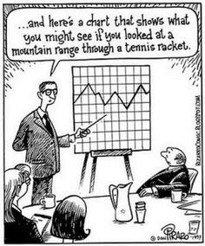
Consider Cash Flow
What do you expect to be coming in?
Fluctuating/ uncertain income
Existing grant commitments
Costs

Slide 14
Financial Risks?
Higher than expected levels of expenditure
A drop in income
Prolonged financial challenges
Unforeseen and uninsured liabilities

Slide 15
Undertaking extra due diligence on the applicant
How far to go e.g. COVID-19 H&S policies of applicants?
Finances (including reserves) of applicants
Reputational risk could be relevant

Slide 16
Grant conditions
Make them clear – on your website, application form, guidance notes, offer letters, contracts, grants agreements etc.

Slide 17
In these unusual times, what if the project ….
Cannot go ahead?
Is delayed?
Costs less … or more?
Is materially different to that in the application?

Slide 18
Do your grant conditions specify … ?
Reporting of any changes and delays
When there should be a refund of the grant
Reporting after the project has taken place
Do your systems have flexibility – delegated decision making?

Slide 19
Payment arrangements
Cheques or BACS?
Should you hold back making payment?
Processes, timescales and impact of Covid-19?

Slide 20
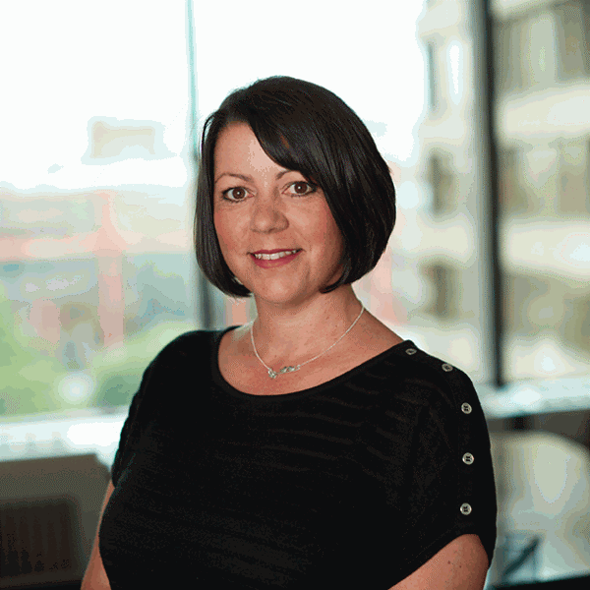
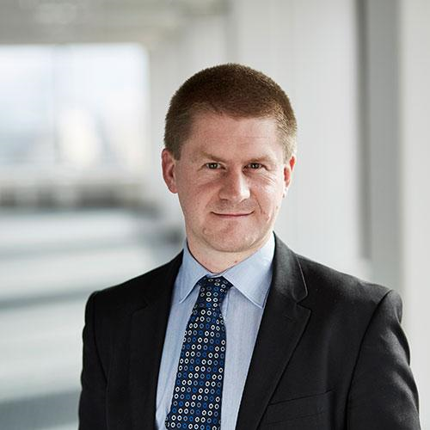
ANY QUESTIONS?
Sue Greaves
Partner
0114 267 5625
sue.greaves@wrigleys.co.uk
Ian Potter
Partner
0114 267 5588
ian.potter@wrigleys.co.uk

