Slide 1
The Long Haul
Perspectives on COVID-19:
Yorkshire Funders – November 2020
Notes:
Plain title slide – option one. You only need one title slide per presentation!

Slide 2
2018-22 strategy: Who are we?
Fund
Grants to deliver for
those in need
Develop
Influence
Support to develop charities’ capacity & resilience and to influence local systems to create sustainability
Action to improve the environment for charities & those they serve
2 COVID-19 recovery

Slide 3

What we fund in Yorkshire and the Humber
*Transition point
@lloydsbankfoundation
@LBFEW

Slide 4
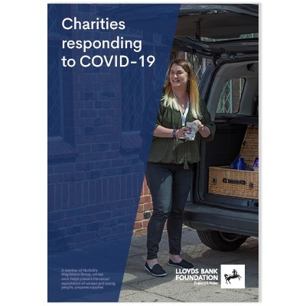
Today >
What’s going on out there?
What are we doing?
Future gazing…
The ACF Collaborative Hub
What might you do?
Questions for Funders?
4 COVID-19 recovery

Slide 5
Eight months on – November ‘20
Meeting the Moment
Basics first – food & health
Impressive switch to digital/online
Adapting housing to make safe
Old clients coming back
Concerns now
Concern at loss of group work/F2F
Access issues to prisons, MH units
Opportunities
BUT Local ‘System’ flex
Better recognition locally
Few closures
Concerns about Future
Mental Health of staff/leaders
Concern about unsuitable premises
Can a mixed model work?
Clients who need F2F/groups
Funding – short term fine
? Long term funding
& Funder focus on new/current objectives
Need for long term core costs
Charity Commission concerns
Economic impact = Inequality
Report: Charities responding to COVID-19
5 COVID-19 recovery

Slide 6
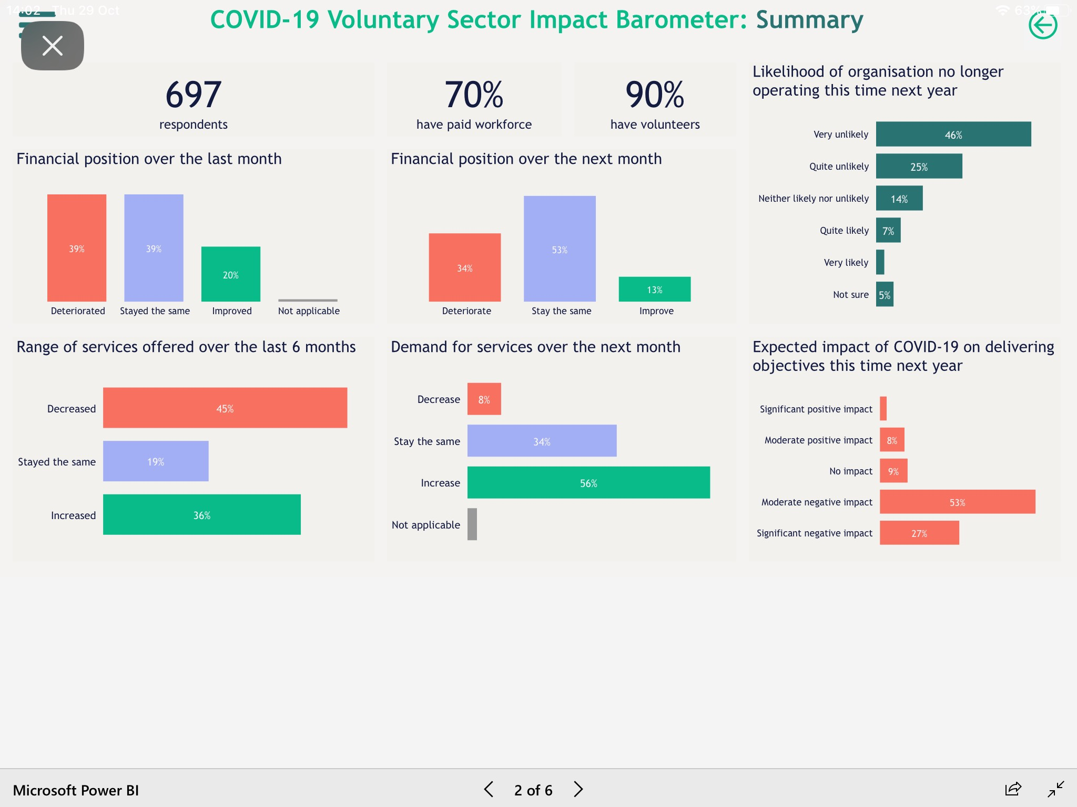

Slide 7
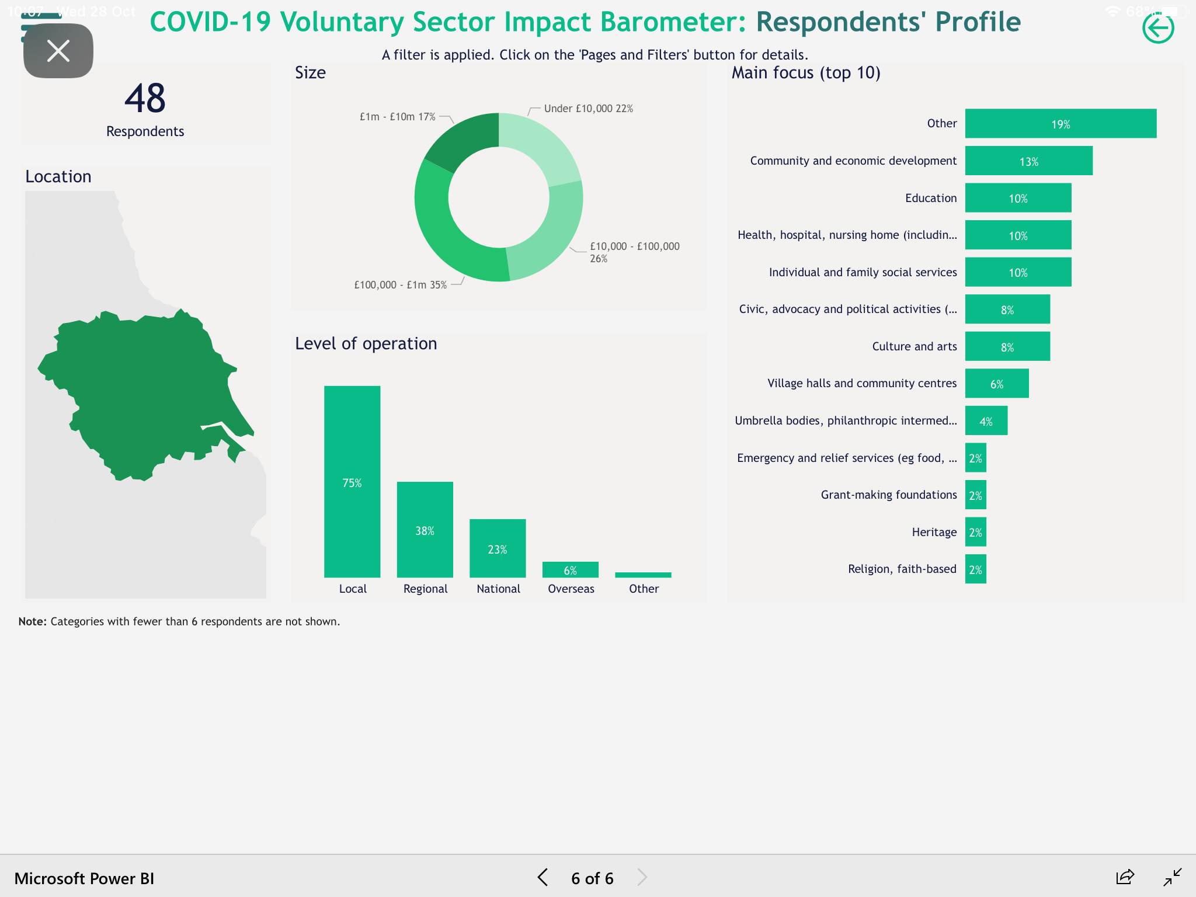

Slide 8
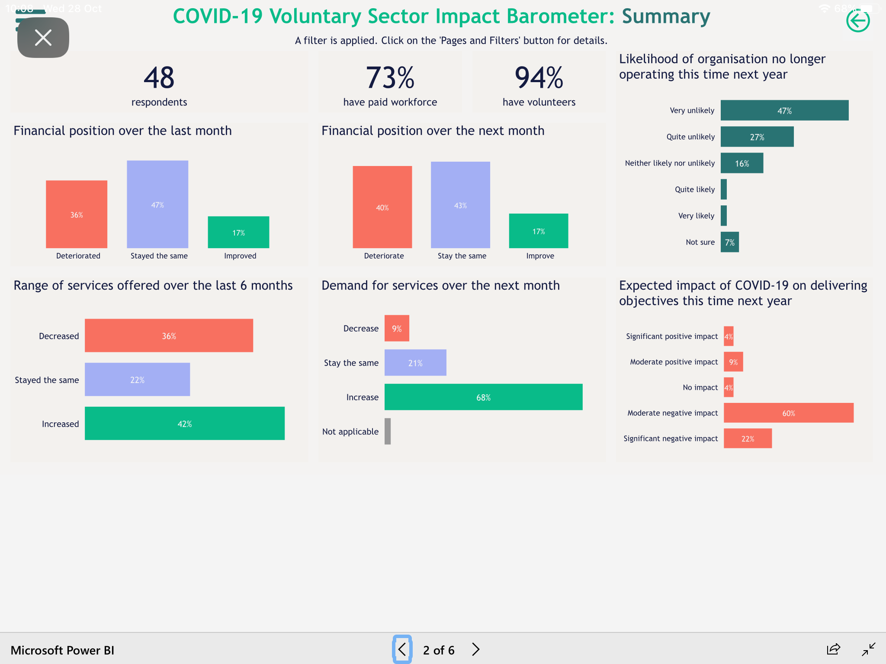





Slide 9
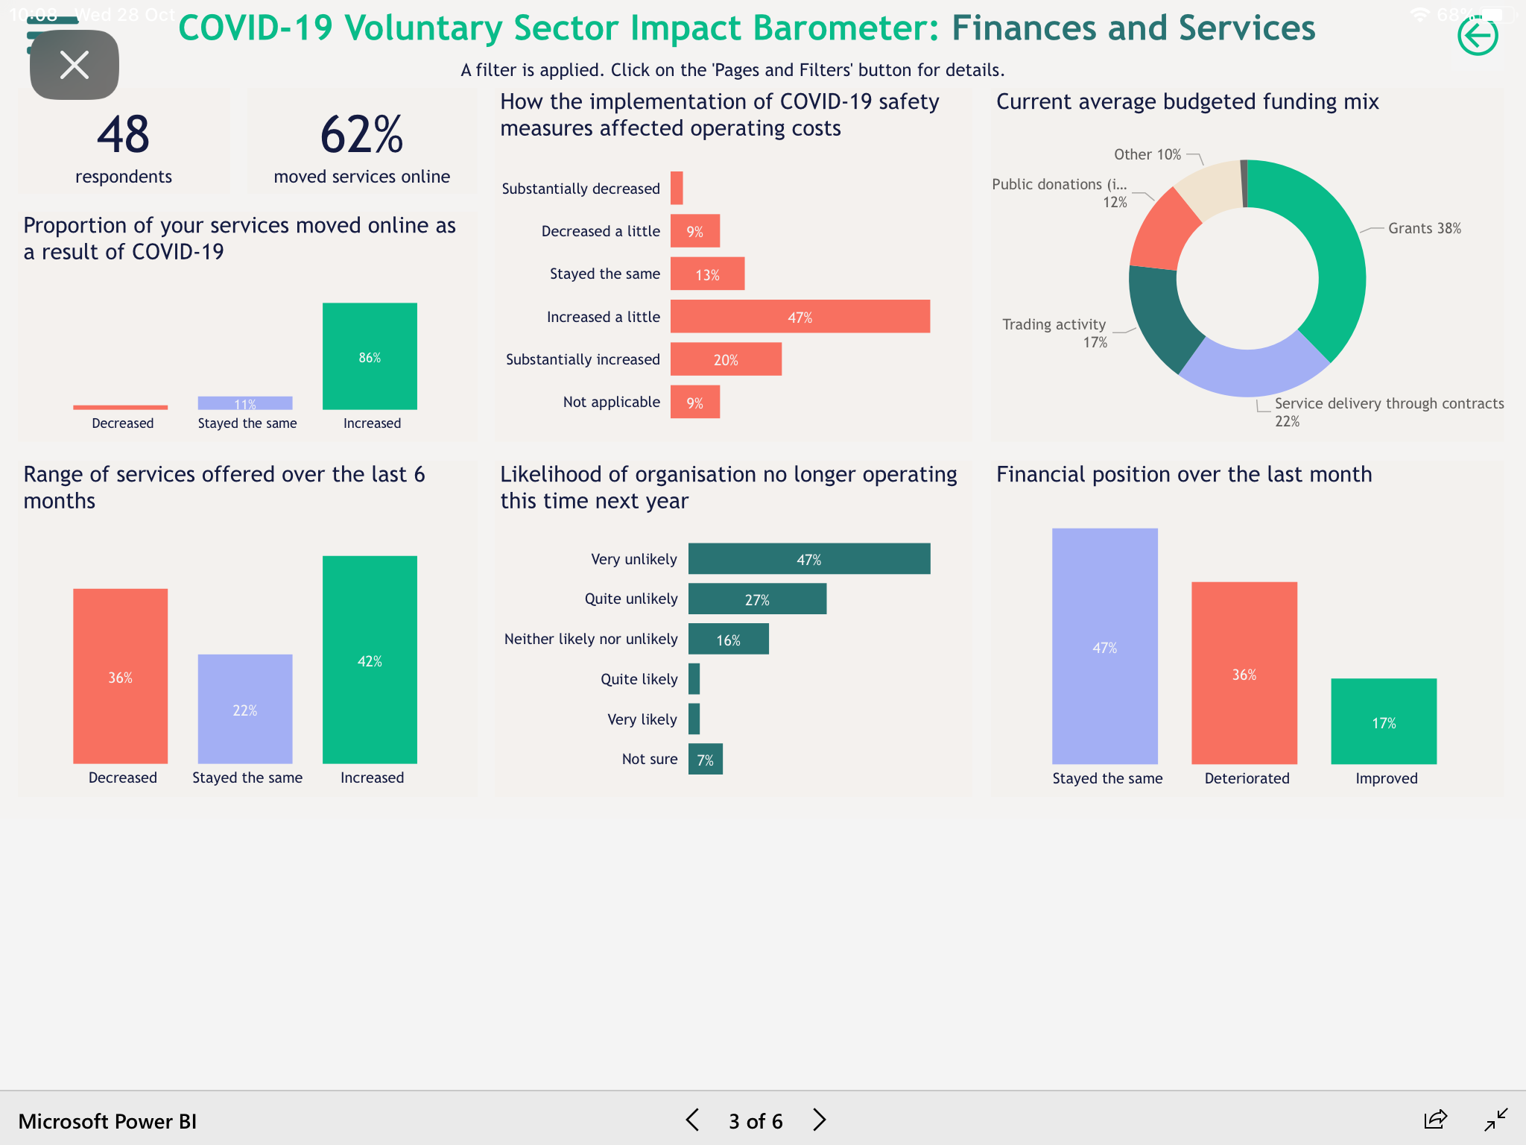


Slide 10
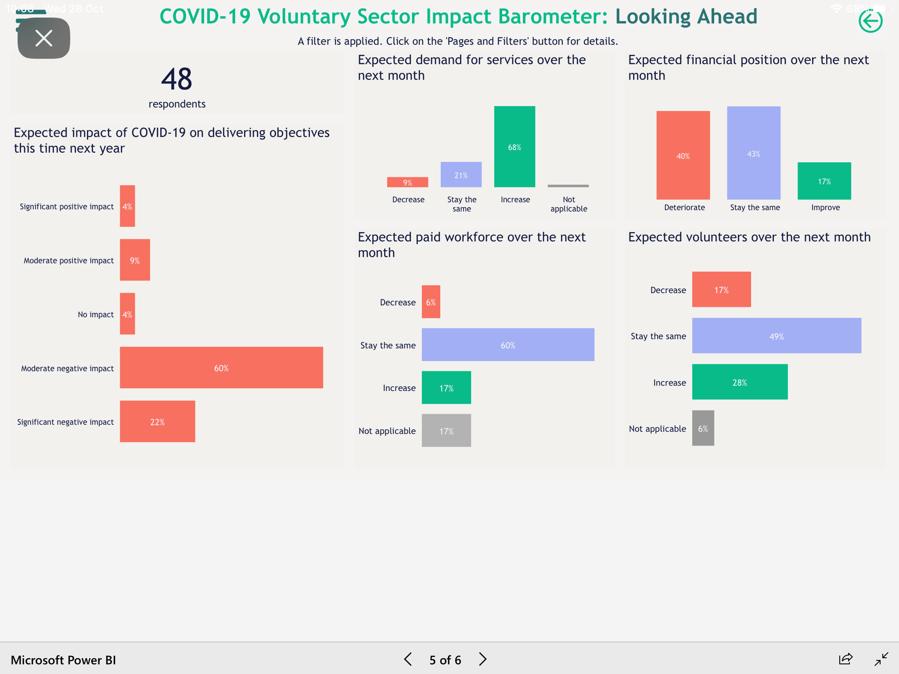




Slide 11
Our response to date
Funding
Increased flexibility for grant holders and additional funding to help them adapt
New COVID Recovery Programme with DCMS – 25% Black, Asian, Minority led
Development
New Funder + and LBG volunteering offers available to grant holders, former grant holders and applicants
Development Partner for new Programme
Working with the six communities to deal with challenges and developing their responses
Influencing
Supported sector-wide lobbying for funding and submitted our own evidence to government and MPs
Rapid response grants to support influencing
Increased learning and network opportunities
So what next in 2021 & beyond?...
11 COVID-19 recovery

Slide 12
Context: Assumptions going forward
For charities | For wider society
Service and business models will continue to be challenged Adapting over next 12-18 months will be critical for survival Need to build on digital adaptations made over last three months May be opportunities to build from positive reputation in crisis | Impact of the crisis will be long-lasting The most marginalised communities will suffer most – poorer places, BAME, etc. Recession will deepen impacts Huge pressures on public spending, particularly locally Happening at the same time as Brexit Government’s bandwidth will be stretched ...but there are some opportunities
12 COVID-19 recovery

Slide 13
Scenarios – Gloom & Bloom …or… Doom?
Gloom & Bloom
Doom
Demand and need grow even more
Charities go back to old ways
Govt – local & national distracted
Public focus on survival/themselves
Massive shake out in the sector
Inequalities – as left but worse
K shaped recovery – people & place
Demand and need grows
Charities respond embed changes made
Govt – local & national gets charities
A new deal/relationship
Levelling up drives policy
Local people & companies go local
Inequalities – people/place
& charity cover
A Key ?
Is Rishi - Keynes
or Friedman
13 COVID-19 The Next leg

Slide 14


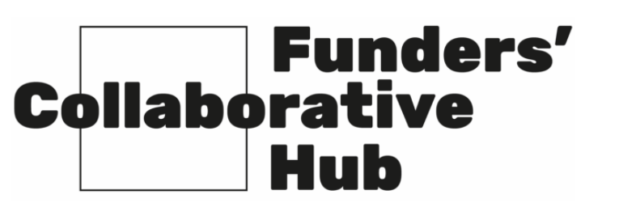
@FunderHub
The ‘Hub’ is an initiative to enable:
Increased understanding of foundation collaboration
Closer alignment of funding decisions
Opportunities for new foundation collaboration
It aims to enhance the effectiveness and impact of individual and collective responses by foundations to Covid-19 by:
Focusing beyond the immediate emergency on recovery and renewal
Having a UK wide remit
Delivering over the next 12-18 months

Slide 15
What does the Hub do for funders?
The Hub helps funders answer four primary questions:
“What collaborations are happening already in response to Covid-19?”
“Who else is involved or is interested in a collaboration focused on an area of importance to us?”
“How can our foundation best help?”
“What and where are the emerging needs and gaps?”

Slide 16
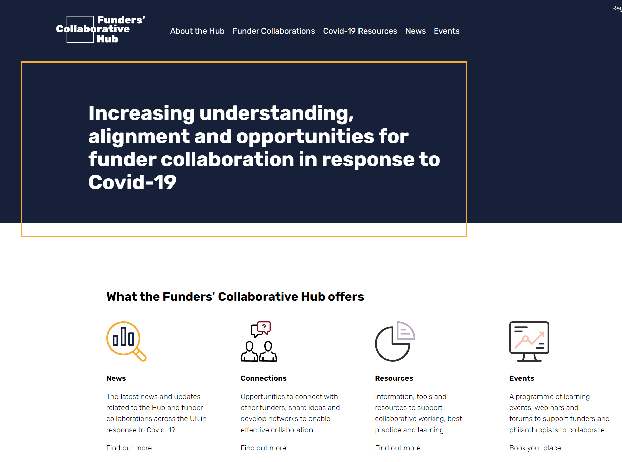
To achieve these outcomes the Hub will:
Enable funders to connect
Promote the benefits of collaboration
Ensure that the Hub platform is up-to-date, comprehensive and easy to engage
Bring to funders the voices, key evidence and data from wider civil society
Ensure funders are directed towards emerging needs and gaps

Slide 17
How the Hub is already supporting funders
Engagement with existing collaborations
Supporting nascent collaborations
Showcasing the benefits of foundation collaboration
Engaging with wider civil society
What’s next?
Platform piloting and development from early November
A programme of events, including collaboration drop-ins, workshops and panel discussions
Convening and connection between collaborations
Shining a light on evidence and emerging needs, and giving voice to those directly affected

Slide 18




How to get involved?
Email Policy@acf.org.uk to join the mailing list
Follow @FunderHub on Twitter for the latest news and events
Take part in the Hub’s engagement and events programme
Contribute information to the Hub platform www.funderscollaborativehub.org.uk (launching soon)

Slide 19
Looking ahead - A Personal Perspective
The small charity ‘pivot’ has astonished me
CEOs seem upbeat at the moment but >
Digital is great but >
Short term crisis income has been key but >
Is the national messaging too much about us and the loss of income
and not enough about the people & issues we are here and the impact on them?
Will this sort the wheat from the chaff?
But if so what is the collateral damage – on people, organisations & places
19 COVID-19 recovery

Slide 20
Questions for funders
How do we find the wheat that’s become the chaff?
Are your criteria clear to avoid wasted time and effort?
Are you enabling those you fund to flex their funding?
If so what are you doing about monitoring? Have you flexed that too?
Can you go to unrestricted funding?
How can you lighten the burden on stretched leaders?
Is there any non financial support you can provide?
Can you collaborate/co-fund with others?
Can you use your influence to improve their environment/local systems?
Can you talk up charities & their role & their need for resources
20 COVID-19 recovery

Slide 21
The Long Haul
Perspectives on COVID-19:
Yorkshire Funders – November 2020
Notes:
Plain title slide – option one. You only need one title slide per presentation!

