Slide 1

Local Collaboration in Action:
The Sheffield/South Yorkshire Funders Meeting
The Neill Charities:
Marjorie Coote Old People’s Charity Fund
The Hugh Neill Charity
The James Neill Trust Fund
Anne Neill
Chair of the Neill family
grant making Trusts
neillcharities@me.com
Sam Caldwell
Head of Grants
South Yorkshire’s Community Foundation
sam@sycf.org.uk

Slide 2
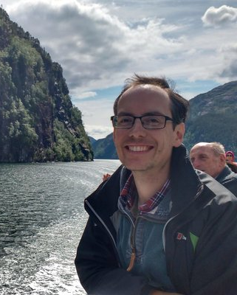
Sam Caldwell
The Neill Charities:
Marjorie Coote Old People’s Charity Fund
The Hugh Neill Charity
The James Neill Trust Fund
Head of Grants for South Yorkshire’s Community Foundation
For the last 34 years, we have raised and distributed over £31m in grants to community and voluntary projects across South Yorkshire and created an Endowment of over £12m to create a lasting legacy that will continue to support South Yorkshire for many years to come.
Notes:
Sam to speak to this slide

Slide 3
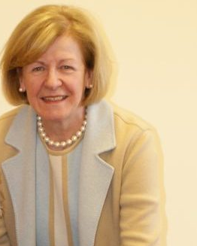
Anne Neill
The Neill Charities:
Marjorie Coote Old People’s Charity Fund
The Hugh Neill Charity
The James Neill Trust Fund
Chair of 3 family grant-making Trusts:
Marjorie Coote Old People’s Charity Fund,
The James Neill Trust Fund,
The Hugh Neill Charity
Notes:
Anne to speak to this slide

Slide 4
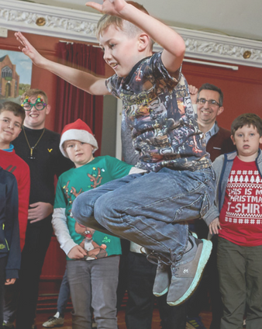
The Sheffield/South Yorkshire Funders Meeting
The Neill Charities:
Marjorie Coote Old People’s Charity Fund
The Hugh Neill Charity
The James Neill Trust Fund
What the Meeting is
Who is involved in the Meeting
How the Meeting started
Notes:
Sam to speak to this slide

Slide 5
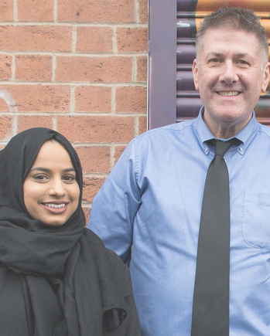
What we’ve done
The Neill Charities:
Marjorie Coote Old People’s Charity Fund
The Hugh Neill Charity
The James Neill Trust Fund
Shared information about who we have funded
Shared applications to consider co-funding
Thematic discussions
Opportunities for further collaboration, e.g. the South Yorkshire Community Resilience Fund
Notes:
Sam to speak to this slide

Slide 6
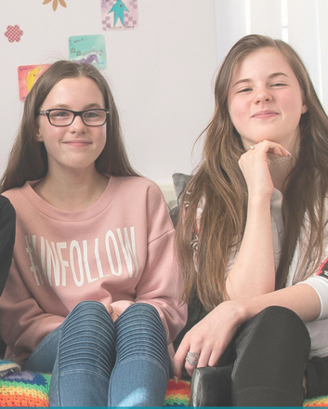
The Challenges
The Neill Charities:
Marjorie Coote Old People’s Charity Fund
The Hugh Neill Charity
The James Neill Trust Fund
Independence and different ways of working
Working during Covid-19
Availability
Notes:
Sam to speak to this slide

Slide 7
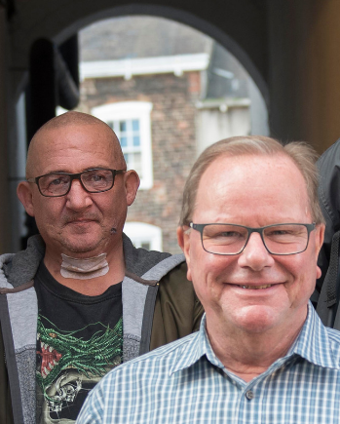
The Benefits
The Neill Charities:
Marjorie Coote Old People’s Charity Fund
The Hugh Neill Charity
The James Neill Trust Fund
Building relationships
Links between local charitable trusts, larger institutional funders and statutory funders
Informative discussions where everyone has a voice
We work better when we work together
Notes:
Anne to speak to this slide

Slide 8
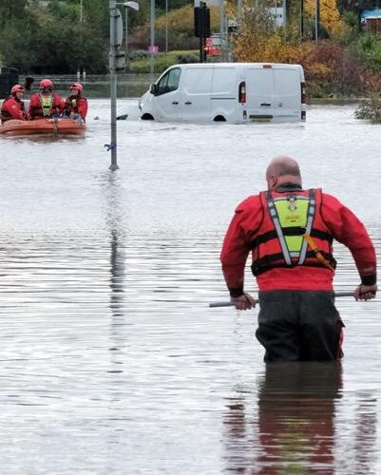
Plans for the future
The Neill Charities:
Marjorie Coote Old People’s Charity Fund
The Hugh Neill Charity
The James Neill Trust Fund
Developing clear terms of reference
More thematic discussions
More co-funding and collaboration opportunities
Identify common themes and priorities
Notes:
Sam to speak to this slide

Slide 9
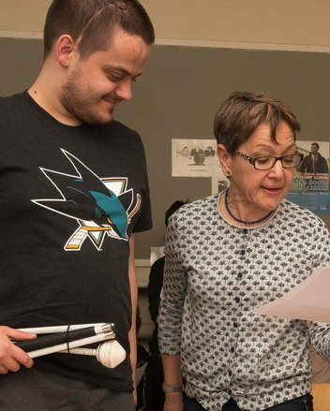
Practical tips
The Neill Charities:
Marjorie Coote Old People’s Charity Fund
The Hugh Neill Charity
The James Neill Trust Fund
Make the time, it is really worthwhile
Easier on Zoom than face-to-face
Start from where you are: don’t need to do it all at once
Make it active and practical, not a talking shop
Top tip: not owned by any one organisation, but have 2 or 3 key people to drive it forward
Notes:
Anne to speak to this slide

Slide 10
Any questions?
The Neill Charities:
Marjorie Coote Old People’s Charity Fund
The Hugh Neill Charity
The James Neill Trust Fund

