Slide 1
Time for flexibility
17th September 2020
Yorkshire Funders Forum

Slide 2
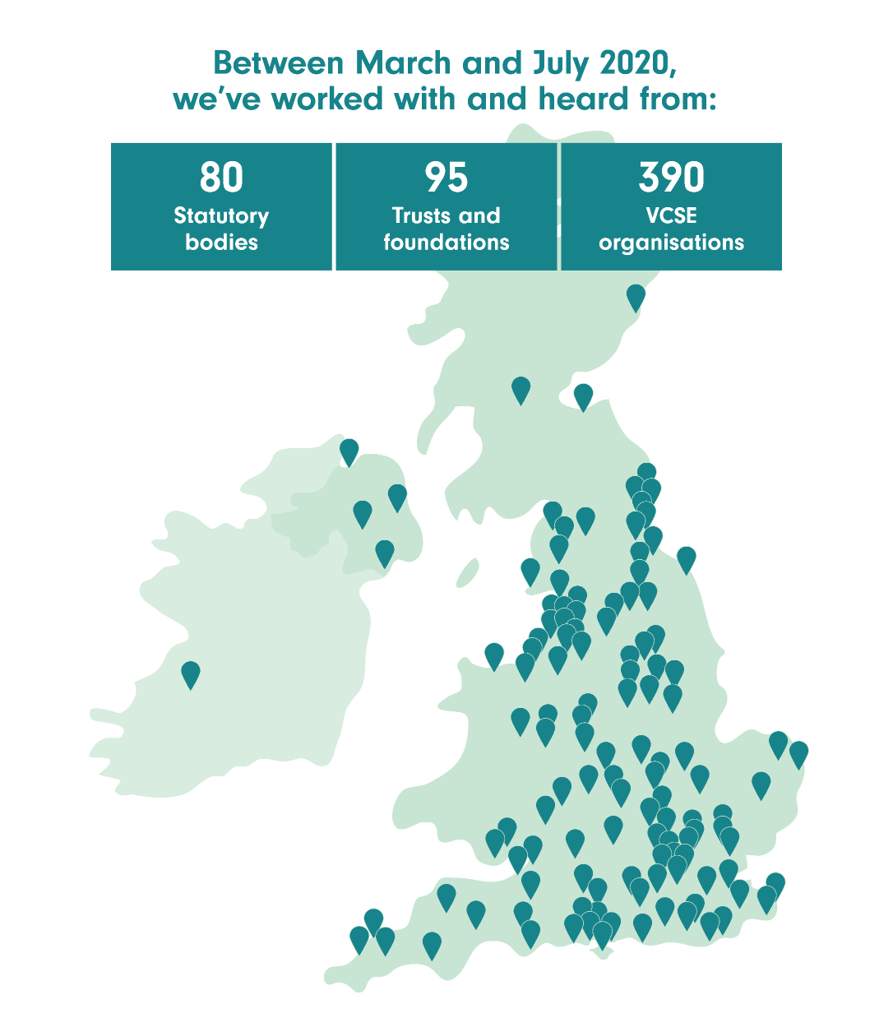

Slide 3
Challenges VCSE leaders have been facing
Welfare of workforce and themselves
Welfare of their service users
Continuity of service delivery
Funding: access and prospects
Long-term impact of the pandemic
The organisation’s survival

Slide 4

How funders have responded
Drawing on earlier research:
Commitment to speed
Managing risk through relationships
Collaborative delivery and delegated decision-making
Light-touch application and monitoring
Flexible funding

Slide 5
It’s a different thought process: ‘Are they competent? Are they telling me the truth? Are they able to deliver this?’

Slide 6
Every day in a community is an emergency. They don’t have to have a tragedy to give money that way.

Slide 7
We can understand ‘effectiveness’ in this context as meaning straightforward, easy, quick and trusting.

Slide 8
VCSE leaders’ views of funders’ emergency responses in 2020
Appreciation of the flexibility shown by most (but not all): unrestricted income; reporting; reassurance
Hiatus with new applications
Reliance on funders to weather crisis and adjust to whatever is needed for the future; worried about changes in funder’s long-term priorities

Slide 9
Sustaining progressive practice: priorities for action
Support for leaders
Unrestricted funding
Priorities and plans: clear; grounded; joined up; decisive; letting go of the fallacy of certainty
Process: light-touch; flexible; sensible
Expectations: realistic; proportionate
Engagement with bigger questions, e.g. diversity, equality and inclusion; voice and advocacy
Thinking about who you haven’t heard from

Slide 10

Sustaining progressive practice: IVAR Learning review
Collaborative process with UK funders and VCSE organisations to:
Capture and distil the key features and aspects of funder responses to the Covid-19 crisis
Identify opportunities and practical options for longer-term adaptations and innovations to funding behaviours and processes (e.g. eligibility criteria; application requirements; due diligence; decision-making)

Slide 11
A simple ambition for grant-making
We have seen what is possible in an emergency. The challenge now is for funders and VCSE organisations together to interrogate these new behaviours and to nurture and grow the best of them into the future. A future that, as far as the eye can see, will be characterised by uncertainty and unpredictability. A future that therefore requires a sustained commitment to flexibility and creative adaptation.

