Slide 1
What’s on the horizon for investments?
Yorkshire Funders’ Forum - July 2020

Slide 2

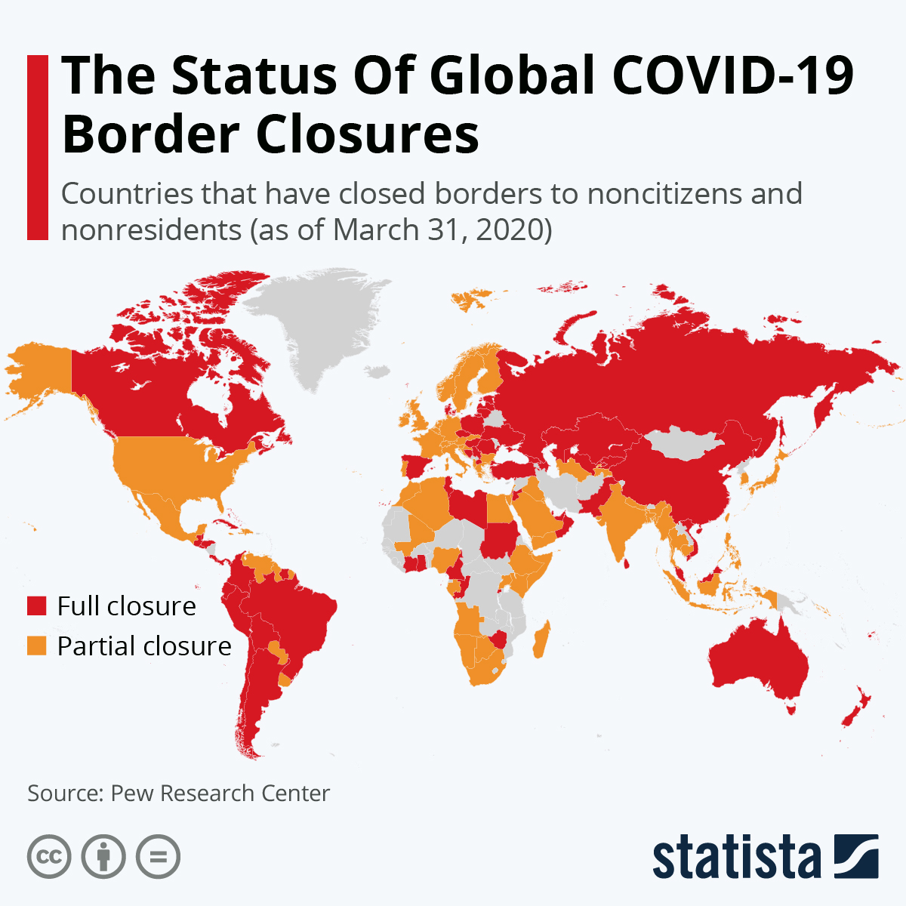
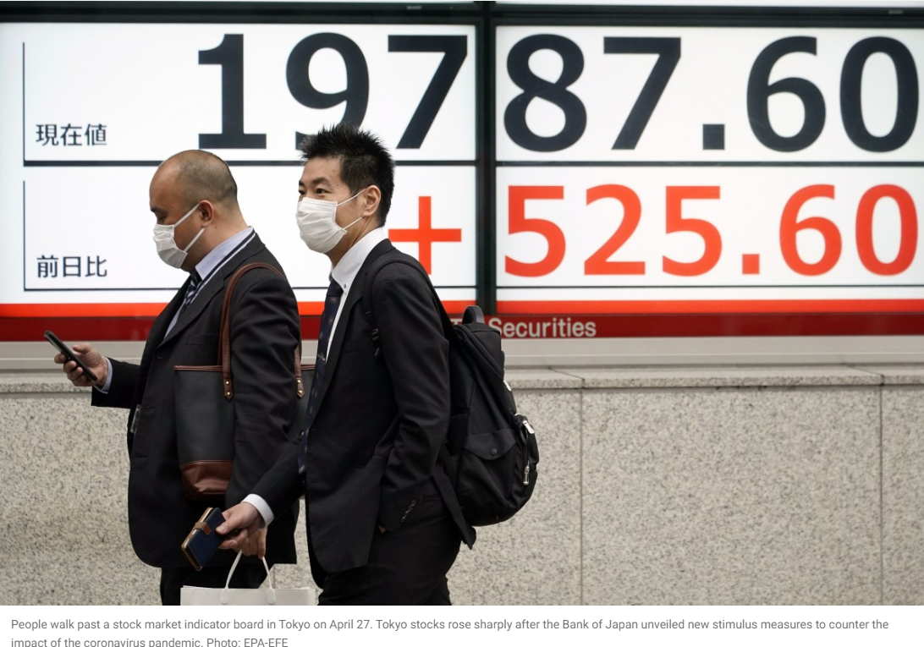
COVID-19 healthcare and economic crisis
Source: New Scientist, Statista, EPA-EFE

Slide 3
Stock market response
Source: Bloomberg 2020

Slide 4
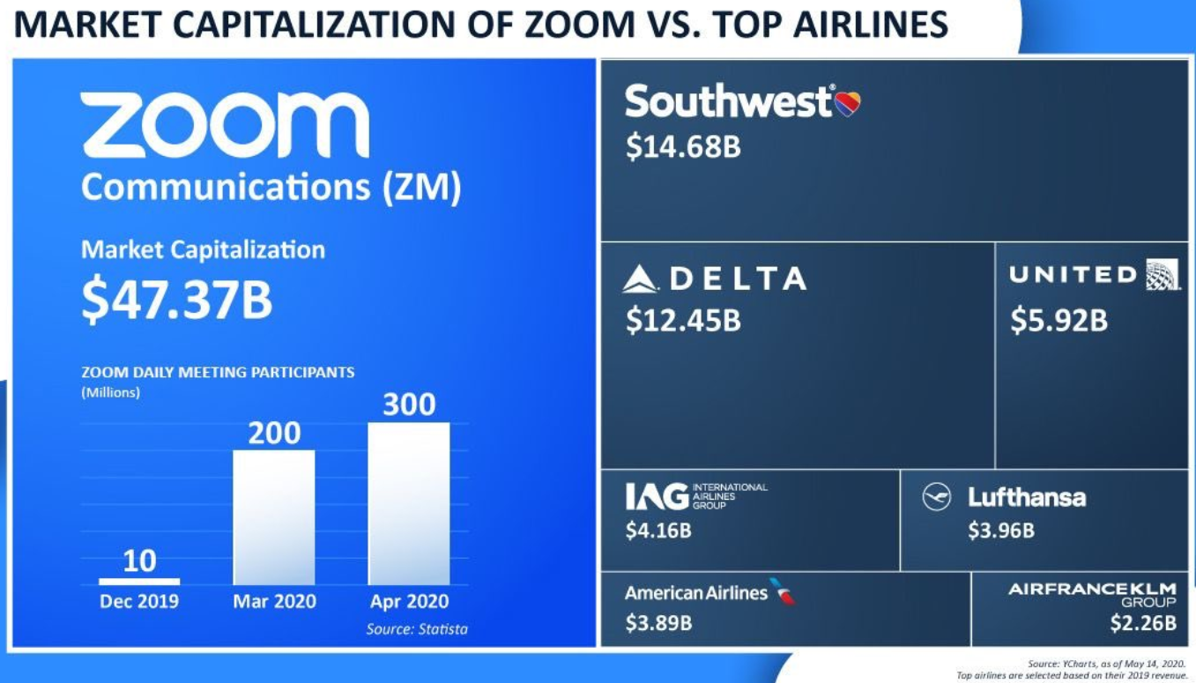
Short term winners and losers
Source: Statista

Slide 5
What can we learn from history?
• Black Monday
• Great Depression
• Financial Crisis
Source: Bloomberg 2020

Slide 6
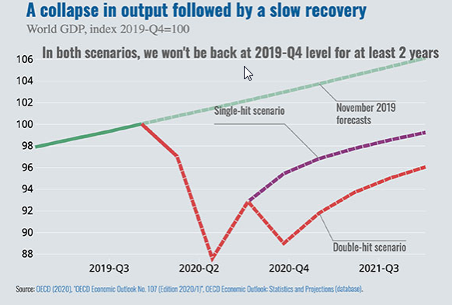
Economic outlook
  Government support/interference
  Rising debt levels
  Low interest rates
  Rising unemployment
  Ongoing geopolitical risks
      US Election, US/China trade tensions, Brexit
  Stock markets appear vulnerable to further setbacks

Slide 7
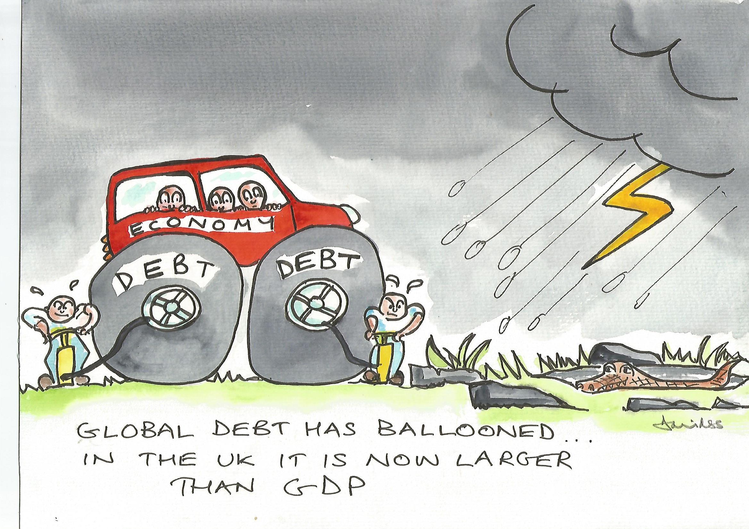
What might the recovery look like?
Source: Cartoon by kind permission of David Shaw Stewart

Slide 8
Implications for investment portfolios
  Review your Investment Policy Statement
  Discussion points:
      Importance of diversification in the portfolio – asset classes, countries and sectors
      Capital preservation and liquidity within the portfolio
      Active management vs passive
      Challenge of finding sustainable income without taking undue risk
      Can you move towards a ‘total return’ approach – income plus capital?
  Maintain a long-term view

Slide 9


McInroy & Wood Ltd.
www.mcinroy-wood.co.uk email@mcinroy-wood.co.uk
Directors: Tim A U Wood, Guido A Bicocchi, Wendy A Ferguson,
Antonia H Fraser, Simon J Fraser, John E Marshall, J Campbell McAulay, Lord Francis Seymour,
David H Shaw Stewart, Hugo O H Swann, Charles T F White, Victor N U Wood, Joy A Young
Registered in Scotland No. 100377. Registered Office: Easter Alderston, Haddington, East Lothian, EH41 3SF
AUTHORISED AND REGULATED BY THE FINANCIAL CONDUCT AUTHORITY
London office
53 Davies Street
London, W1K 5JH
Tel: +44 (0)20 3709 7240
Haddington office
Easter Alderston
Haddington
East Lothian, EH41 3SF
Tel: +44 (0)1620 825867
Harrogate office
Windsor House
Cornwall Road
Harrogate, HG1 2PW
Tel: +44 (0)1423 222 200

Slide 10
A Word of Caution
We provide a discretionary management service. As such, we do not offer wealth planning services covering strategic advice and guidance on, for example, pension arrangements, insurance, estate planning or tax efficient structures (including FICs, AIM Portfolios, VCTs and EISs). However, we conduct a suitability assessment to ensure that the chosen investment mandate is suitable in light of financial circumstances and attitude to risk.
Markets and currency movements may cause the value of investments and income from them to fall as well as rise and you may get back less than you invested when you decide to sell your investments. Investing in securities in international markets or smaller companies, such as those quoted on AIM, involves certain risks and special considerations. Movements in foreign exchange rates may have a separate effect, unfavourable as well as favourable, on the gain or loss otherwise experienced on an investment. Investment in emerging markets can be subject to risks not normally associated with developed markets.
This presentation is intended for the recipients’ use only and not for onward distribution.

