Slide 1
Social Prescribing
David Cowan
Social Prescribing Facilitator Yorkshire & Humber (NHSE four days a month)
Care Navigation Programme Manager
Twitter: @HealthyDaveC
David.cowan1@keraconsultancyltd.com

Slide 3
Support the embedding of social prescribing link workers with all primary care networks across the region, as part of the NHS England personalised care programme.
This includes:
Supporting local system leaders
Acting as a social prescribing champion for the region.
Being the main point of contact for the regional social prescribing networks
Support local system leaders to understand how social prescribing fits within a wider personalised care approach.
Supporting opportunities to embed social prescribing across local health and care systems.
Facilitating regional social prescribing workshops, to share good practice and provide peer support and challenge

Slide 4
SOCIAL PRESCRIBING AS SIGNPOSTING
Online access to community activities
Direct signpost from GP practice
Emerging evidence base
Leaflet in the GP practice
No link worker
SOCIAL PRESCRIBING LIGHT
Run by the voluntary sector to refer people to other activities delivered by the voluntary sector
To address a specific need of vulnerable patients
No direct links with GP practices

Slide 5
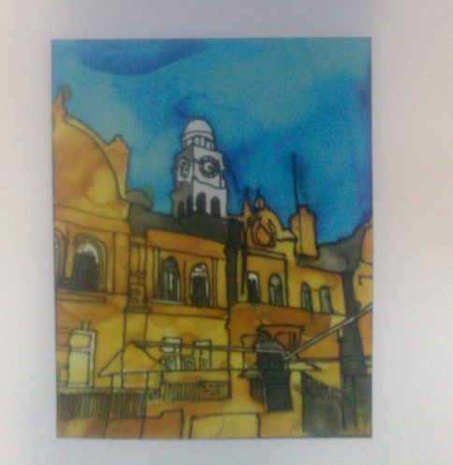
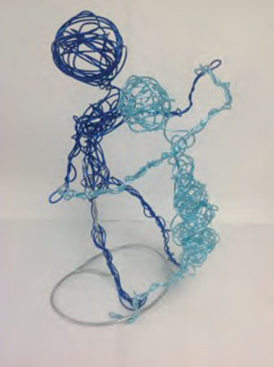
SOCIAL PRESCRIBING MEDIUM
Link worker or advanced care navigator
Health focused (nutrition, diet, CBT)
Signpost to voluntary sector and/or self-help groups
Not focused on beneficiary needs in a holistic way
SOCIAL PRESCRIBING HOLISTIC
Direct primary care referral to SP provider
SP provider is local and employs link workers
Link worker follows a ‘holistic’ approach (centred on person’s needs)
No limits on number of sessions. These depend on person’s need
Risk of working in isolation in PCN
Silk painting and Wired for Wellbeing Micro-Commissioned

Slide 6
Ways to Wellness’ Social Prescribing
Ways to Wellness uses a personalised, comprehensive, long-term social prescribing approach to help people aged 40 to 74 years living with certain long-term conditions in the west of Newcastle upon Tyne
Our overall aims are to (a) improve the health and wellbeing for 10,000 patients living with LTCs and, as a result; (b) reduce NHS costs related to those patients’ care.
Over the past 4 years, Ways to Wellness has received over 6,000 referrals, of which:
approximately 4,600 clients have engaged on the service for an average of 18-19 months
clients set an average of 4 to 5 goals and develop action plans for goals
60% of clients are signposted on to other services or activities, when aligned with their goals
Over 30 (26 FTE) Ways to Wellness Link Workers are employed across a local charity and a social enterprise and are currently working with approximately 2,900 clients
NHS data and academic research* shows that patients referred have a high level of complexity, including historical use of hospital services, co-morbidity, anxiety and depression, and multiple social and economic issues (including debt, housing problems, low income and unemployment)
Impact measurement
Hospital costs and activity impact measures
Ways to Wellness has demonstrated reductions in hospital costs of over £1.2 million in 2017/18. The annual net savings for the CCG in 2017/18 was approximately £440,000.
The 2018/19 non-elective activity has been halved for the Ways to Wellness cohort
Wellbeing improvements
The average patient improved 3.1 points (11%) – more than double target
Clients move from describing themselves as, "finding out how they can improve things in their life to feel more in control", to "making changes”, or even "managing their lives pretty well".
http://waystowellness.org.uk *http://bmjopen.bmj.com/content/bmjopen/7/7/e015203.full.pdf

Slide 7
Measurement
AWC – modality
Leeds practice

Slide 8
What does good social prescribing look like?

Slide 9
At BCVS …
Support
Community Interest Company
Wider provision
Access to all
Notes:
Sarah popped into BCVS and asked could we promote her groups , She was still a private company at this stage and we only promote community/voluntary groups.
Our partnership officer suggested Sarah registered as a Community interest group
Supported Sarah’s transition from a private company to a Community Interest Company
Sarah could take a wage, but all profit would be ploughed back into the business to benefit the community at large
This enabled Sarah to offer services elsewhere across the district with access to all
Evidence : 1.5, 1.4, 2.3

Slide 10
BCVS Services Available
Two distinct services commissioned by Bassetlaw CCG:-
Social Prescribing (over 65s, socially isolated, clinical referral required into service, funded service)
Community Advisor (age 16 +, open access or referral, signposting access and navigation service)

Slide 11
Community Advisor
Social Prescribing Service
Self-referral or Sign-posted
Aged 16 +
Referral by Health Professional
Aged 65+ and socially isolated
Community Advisor
(Speaks to patient face to face in surgery, at BCVS or via telephone)
Social Prescribing Advisor
(Undertakes assessment during home visit)
Signposting and Navigation into appropriate service
Patient receives funding to access social support service/activity (and transport, if meets criteria)
Community, Voluntary or other Statutory Services
Complex patients may be offered telephone review
Social Prescribing Advisor Review at 6 and 12 weeks

Slide 12
Notes:
LWW is a social WB Service funded by Public Health and delivered in the form of a partnership between SWYPFT and Nova, we provide social prescribing and self management courses and workshops

Slide 13
What does the Live Well Wakefield Service do?
The Live Well service is available for people aged 18+ living in the Wakefield district. The service delivers:
Stroke reviews, which are carried out through the Stroke Review Care Pathway
1:1 support with Live Well Advisors and Live Well Volunteers
Self-management programmes, workshops and support.
Small Grants
Notes:
Provides a single point of contact (SPOC).
Offers roles for volunteers to directly support people to access local services.
Offers roles for volunteers to deliver self management courses and workshops
We have an emphasis on collaborative working with the voluntary and community sector, including clear links with the new social wellbeing grants programme, which will be managed by Nova.

Slide 14
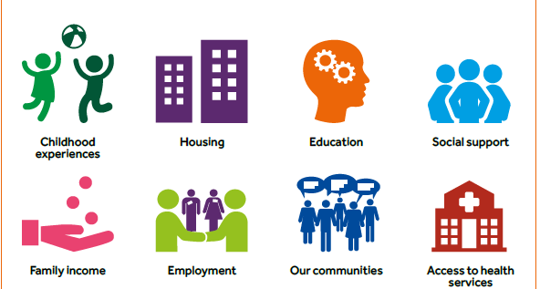
Notes:
Live Well Wakefield is commissioned to address the social determinants of health, we get referrals for all sorts of issues but most are displayed on the slide

Slide 15
Notes:
The Wakefield SP tool is based around the 5 ways to wellbeing and is holistic in approach covering everything from diet and smoking to finances, employment and social connections. We use this as a way to identify what the person wants to achieve (a goal) or what is having biggest impact on their H&WB. We then agree a plan with the client, detailing what we will do and in some cases what the client will do (to encourage self care where appropriate)

Slide 16
Micro-Commissioning Live Well Wakefield
Community asset approach
Complex interplay between community asset development and health related behaviour
Salutogenic approaches by including community development roles within social prescribing models S.Yorks / Wakefield / East Ridings
Do you know of other areas that use this approach?

Slide 17
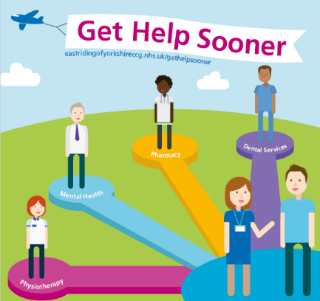
East Ridings of Yorkshire Network of Activity supporting Social Prescribing
Community Link Workers (Navigator Role +) within all 30+ East Riding Practices
All reception staff across ERoY GP practices trained to Actively signpost to Community Link Workers and MECC (plus another 6 services)
Media Company produced local information videos for GP waiting areas to inform patients of the Community Link Worker service (and others) – planned for roll-out on LCD screens in 2019

Slide 18
Link Worker (Practice Worker/Assessor)
Acts as the link between the referrer and the connector, responsible for assessing the individuals and coproducing an action plan.
Community Connector (Navigator/Community Link Worker)
Proactively supports the individual to access appropriate services that help them in achieving their action plan and supports Builders to identify assets and gaps
Asset Builder (Activator)
Maps, identifies gaps and helps communities to build assets that support local delivery of community services/assets

Slide 19
Key elements of Social Prescribing

Slide 20
From small acorns grow mighty oaks

